Slide 1
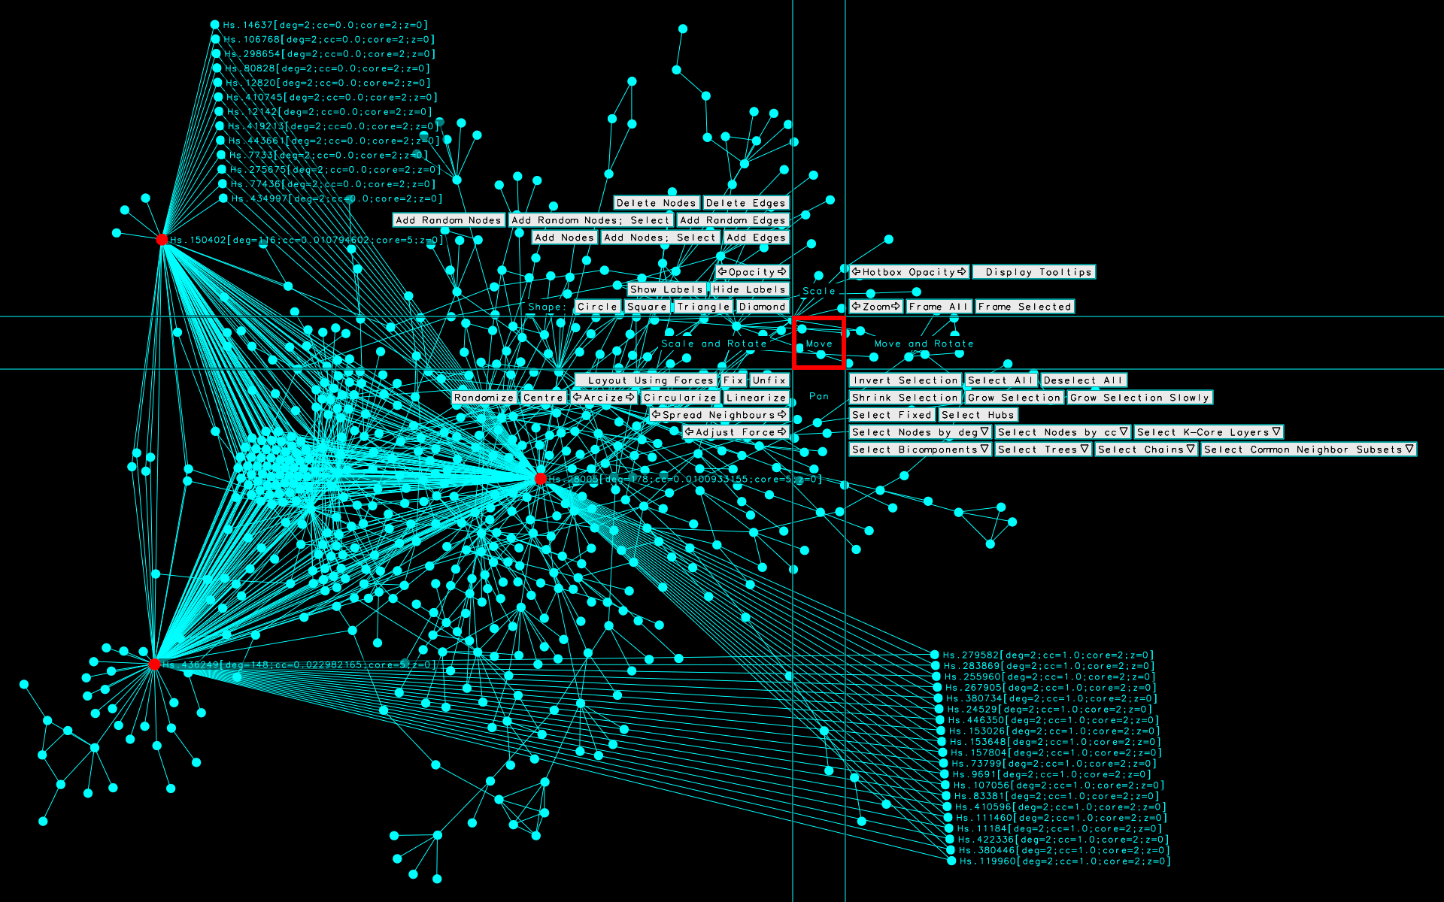
ALifeVis2020:
Visualization Principles and Techniques for Research in ALife
A tutorial presented at ALife 2020
http://www.michaelmcguffin.com/alifevis2020/
Michael McGuffin, Ph.D., Assoc. Prof.
Department of Software and IT Engineering
École de technologie supérieure (ETS)
Montreal, Canada

Slide 2
Outline
Visualizing tabular data
Using color
Visualizing network data
  Visualizing tree data
A critique of visualizations chosen from 200 papers related to ALife and origins of life
Ideas for applying vis to ALife research
3D, Virtual Reality, Augmented Reality
More visualizing tabular data: GPLOM

Slide 3
On Slack: #tutorial-alifevis2020
  I’ve shared a link there to a folder containing these slides

Slide 4
Visualizing Tabular Data

Slide 5
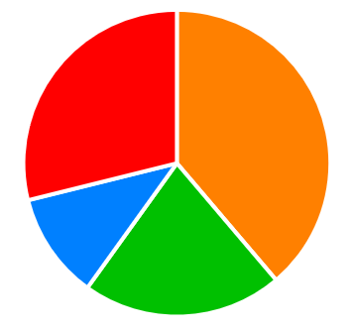
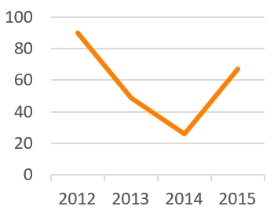
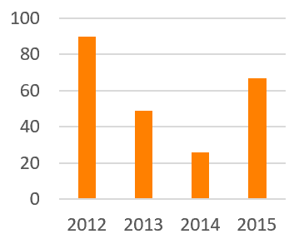

Year (independent variable) (dimension) | Sales (dependent variable) (measure)
2012 | 90
2013 | 49
2014 | 26
2015 | 67
1d1m dataset:
1 dimension,
1 measure
Line chart.
Often the best choice for 1d1m data, when the dimension is time or some continuous variable.
Makes small changes in slope easier to see.
Bar chart.
Pie chart.
Communicates that the parts form a whole.
But difficult to judge small differences in angles.
Doesn’t scale well to many values of the dimension.

Slide 6
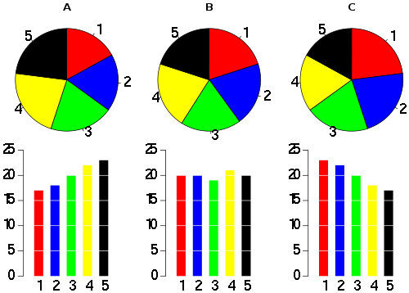
Pie charts versus bar charts
Which makes it easier to see if the sequence is increasing, decreasing, or neither?
http://en.wikipedia.org/wiki/File:Piecharts.svg
http://en.wikipedia.org/wiki/Pie_chart
http://www.businessinsider.com/pie-charts-are-the-worst-2013-6
http://www.quora.com/Data-Visualization/What-should-everyone-know-about-making-good-charts-and-graphs-to-represent-data

Slide 7
Bar chart versus line graph
Which makes it easier to see changes in slope?

Slide 8
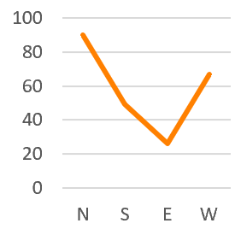
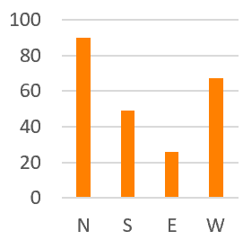

Region (independent variable) (dimension) | Sales (dependent variable) (measure)
N | 90
S | 49
E | 26
W | 67
1d1m dataset:
1 dimension,
1 measure
Line chart.
Misleading to use when the dimension is not a continuous variable and not time.
Bar chart.
Often the best choice for 1d1m data, when the dimension is categorical.
Pie chart.
Communicates that the parts form a whole.
But difficult to judge small differences in angles.
Doesn’t scale well to many categories.

Slide 9
Kinds of variables
Is the variable independent (dimension) or dependent (measure)?
Where is it within Steven’s typology?
  Quantitative (or continuous or metric)
    Examples: x, y, time, temperature, money
  Ordinal: discrete and ordered, but not admitting comparisons of magnitude (we cannot say one value is twice as big as another)
    Example: level of education (high school diploma, bachelor’s, …)
    Example: periods in western music (medieval, renaissance, baroque, classical, romantic, modern, contemporary)
  Categorical (or nominal): discrete, with no natural ordering (except maybe alphabetical, which is arbitrary and language-dependent)
    Example: types of macronutrients (proteins, carbohydrates, fats)
    Example: bachelor’s program (pure math, biochemistry, mechanical engineering, …)
    Example: car maker (Toyota, Tesla, Volkswagen, Daimler, GM, ...)
    Example: countries of the world
Dimensions are either discrete (like "Region"), or quantitative variables that have been discretized (like time → "Year").
Measures are often quantitative (like "Sales").

Slide 10
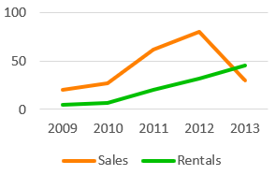
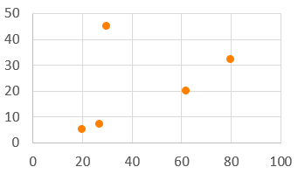
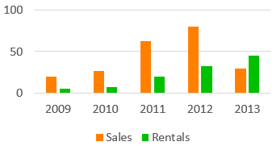
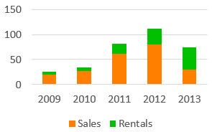
Year (dimension) | Sales (measure) | Rentals (measure)
2009 | 20 | 5
2010 | 27 | 7
2011 | 62 | 20
2012 | 80 | 32
2013 | 30 | 45
1d2m dataset:
1 dimension,
2 measures
Overlapping line chart.
Easier to see changes in slope.
All comparisons of measures involve the position channel.
Scatterplot.
Makes correlations apparent.
Doesn’t show the dimension.
Rentals
Sales
Grouped bar chart.
All comparisons of measures involve the position channel.
Stacked bar chart.
Best for comparing totals, and
part-to-whole comparisons.

Slide 11

Hierarchy of visual channels
Quantitative (continuous, metric)
Position
Length
Angle
Area
Color value, Color saturation
Volume, Color hue, Shape
value
saturation
hue

Slide 12
Hierarchy of visual channels
Quantitative (continuous, metric)
Position
Length
Angle
Area
Color value, Color saturation
Volume, Color hue, Shape
Ordinal
Position
Color value, Color saturation
Length, Angle, Area
Volume, Shape, Color hue
Categorical (nominal)
Position
Color hue
Color value, Color saturation, Shape
Length, Angle, Area, Volume
Adapted from:
Munzner, Tamara (2014). Visualization analysis and design.
Heer, Jeffrey, and Michael Bostock (2010). "Crowdsourcing graphical perception: using mechanical turk to assess visualization design."
Mackinlay, Jock (1986). "Automating the design of graphical presentations of relational information."

Slide 13
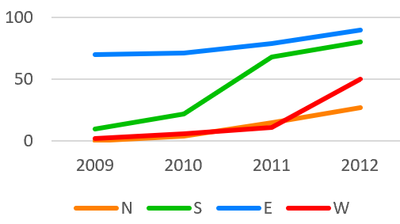
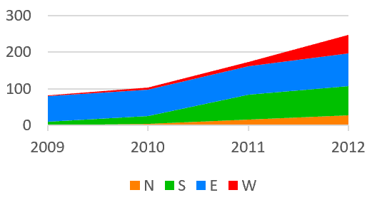
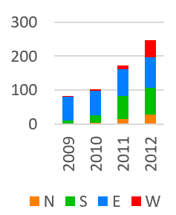
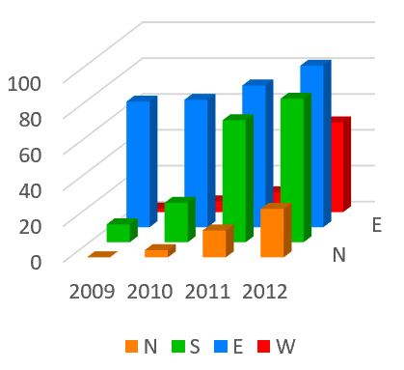
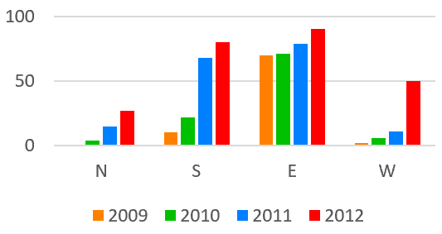
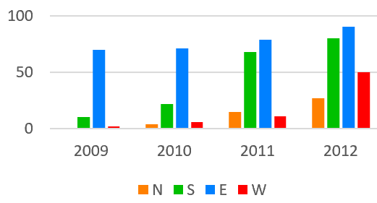
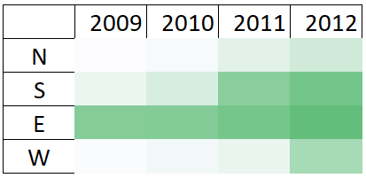
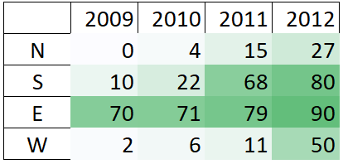
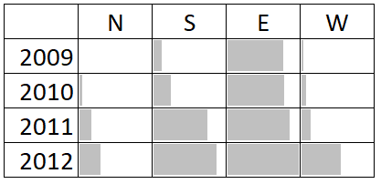
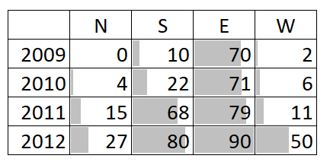
Year | Region | Sales
2009 | N | 0
2009 | S | 10
2009 | E | 70
2009 | W | 2
2010 | N | 4
2010 | S | 22
2010 | E | 71
2010 | W | 6
2011 | N | 15
2011 | S | 68
2011 | E | 79
2011 | W | 11
2012 | N | 27
2012 | S | 80
2012 | E | 90
2012 | W | 50
2d1m dataset: 2 dimensions, 1 measure
Overlapping line chart
Stacked line chart
Stacked bar chart
Grouped bar chart
Grouped bar chart
3D bar chart
Measure
Heatmap
Dimensions
Parallel bar charts

Slide 14
Comments on the previous slide
Line charts are good for seeing slight changes in slope.
The overlapping line chart and grouped bar charts allow all comparisons to be done with the position channel, which is great. Stacked line charts, stacked bar charts and parallel bar charts require some comparisons to be done with the length channel, which isn’t quite as good, but on the other hand the stacked {line,bar} charts show totals per year, which can be useful.
The heatmap has the disadvantage of using a color channel to show a quantitative measure, which is less effective than position or length.
Charts that combine visual channels with textual information allow patterns and outliers to be quickly ascertained (thanks to visual channels), and also make detailed information available to read (thanks to text labels).
Heatmaps and parallel bar charts have the advantage of not requiring multiple colors for coding, hence they scale better.
Heatmaps scale up to very large tabular data. Each cell can be shown with one pixel, and with aggregation a user can zoom out even further.
3D bar chart is bad because it suffers from occlusion, and many comparisons involve the length channel.

Slide 15
Year | Region | Sales
2009 | N | 0
2009 | S | 10
2009 | E | 70
2009 | W | 2
2010 | N | 4
2010 | S | 22
2010 | E | 71
2010 | W | 6
2011 | N | 15
2011 | S | 68
2011 | E | 79
2011 | W | 11
2012 | N | 27
2012 | S | 80
2012 | E | 90
2012 | W | 50
Region | 2009 | 2010 | 2011 | 2012
N | 0 | 4 | 15 | 27
S | 10 | 22 | 68 | 80
E | 70 | 71 | 79 | 90
W | 2 | 6 | 11 | 50
Dimension
(independent variable)
Measures
(dependent variables)
Dimensions
(independent variables)
Measure
(dependent variable)
Note: The same dataset can be viewed in different ways.
Left: a 2d1m dataset where Sales is a function of Year and Region.
Right: a 1d4m dataset where Sales₂₀₀₉, Sales₂₀₁₀, Sales₂₀₁₁, and Sales₂₀₁₂ are each functions of Region.

Slide 16
Other examples of tabular data
Client_name | Product_bought | Price | Date | …
Robert G. | Trombone | 500.00 | 2018-Mar-07 | …
Robert G. | Sheet music vol. 1 | 45.00 | 2018-Mar-07 | …
Lucy M. | Flute | 180.00 | 2019-Nov-11 | …
Cynthia S. | Sheet music vol. 2 | 40.00 | 2019-Nov-20 | …
Jules T. | Piano | 6000.00 | 2019-Dec-16 | …
Jules T. | Sheet music vol. 1 | 45.00 | 2019-Dec-16 | …
… | … | … | … | …
Which of the columns are dimensions (independent variables),
and which are measures (dependent variables)?

Slide 17
Other examples of tabular data
Client_name | Product_bought | Price | Date | …
Robert G. | Trombone | 500.00 | 2018-Mar-07 | …
Robert G. | Sheet music vol. 1 | 45.00 | 2018-Mar-07 | …
Lucy M. | Flute | 180.00 | 2019-Nov-11 | …
Cynthia S. | Sheet music vol. 2 | 40.00 | 2019-Nov-20 | …
Jules T. | Piano | 6000.00 | 2019-Dec-16 | …
Jules T. | Sheet music vol. 1 | 45.00 | 2019-Dec-16 | …
… | … | … | … | …
All the columns are measures (dependent variables). If we wanted a dimension, we would have to add an extra column to serve as primary key or an index that uniquely identifies each row.
This kind of tabular data is sometimes called multidimensional multivariate (mdmv) data, or relational data (as in relational database).
Why the term “relational”? Imagine the set of all possible client names, the set of all possible products bought, the set of all possible prices, etc. Then imagine the cartesian product of these sets. The table determines a subset of this cartesian product, hence the table is a relation (= subset of cartesian product). Each row can be thought of as a tuple or a point.

Slide 18
Other examples of tabular data
In this example, the table enumerates the pixels in each frame of a video. Each row of the table corresponds to 1 pixel at some moment in time.
X | Y | Time | Red | Green | Blue
0 | 0 | 0 | 0 | 54 | 64
0 | 1 | 0 | 1 | 53 | 65
… | … | … | … | … | …
0 | 0 | 0.1 | 1 | 57 | 62
0 | 1 | 0.1 | 1 | 54 | 64
… | … | … | … | … | …
Which of the columns shown above are dimensions (independent variables), and which are measures (dependent variables)?

Slide 19
Other examples of tabular data
In this example, the table enumerates the pixels in each frame of a video. Each row of the table corresponds to 1 pixel at some moment in time.
X | Y | Time | Red | Green | Blue
0 | 0 | 0 | 0 | 54 | 64
0 | 1 | 0 | 1 | 53 | 65
… | … | … | … | … | …
0 | 0 | 0.1 | 1 | 57 | 62
0 | 1 | 0.1 | 1 | 54 | 64
… | … | … | … | … | …
Dimensions
(independent variables)
Measures
(dependent variables)

Slide 20

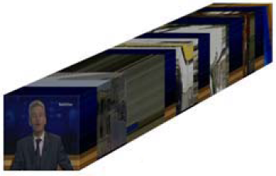
Three different visualizations of a video: the designer chooses the mapping from variables in the data to variables in the visualization medium
Y
Blue
X
Time
Red
Y
Time
Green
A scatterplot of the pixel colors might seem weird, but is entirely possible as a mapping. Here, only 4 pixels are shown, for illustration.
X
[Gareth Daniel and Min Chen, 2003]

Slide 21
To visualize data, we need to choose a mapping
Input data set:
an arbitrary number of variables, each of which can be
a {dimension, measure}
and
{quantitative, ordinal, categorical}
Output graphical representation:
at most 3 spatial dimensions (often just 2), at most 1 temporal dimension (animation),
but also multiple visual channels

Slide 22
What techniques allow us to visualize many variables at once?
Examples we’ve already seen for 2d1m data: parallel barcharts, heatmaps, etc.
Glyphs
…

Slide 23
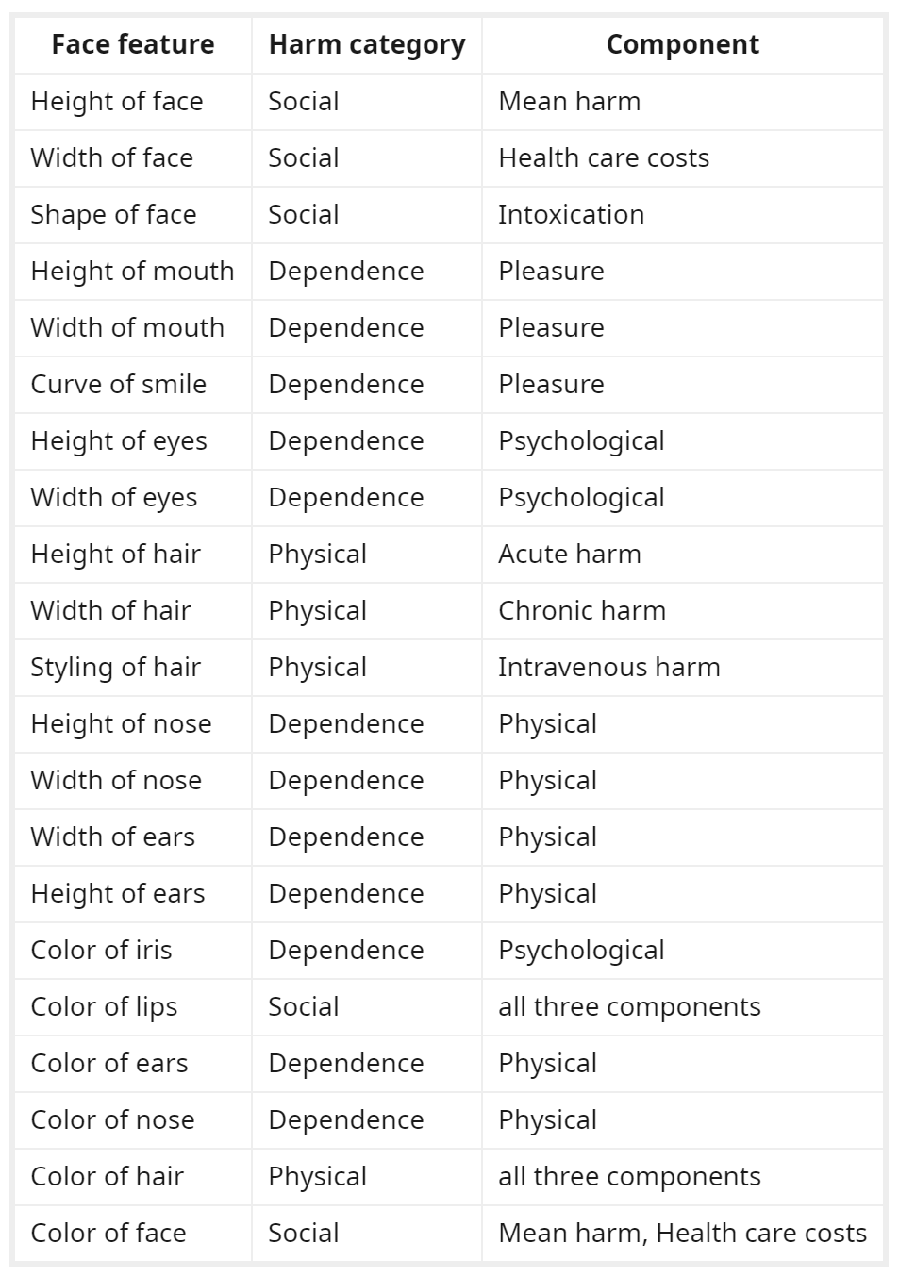
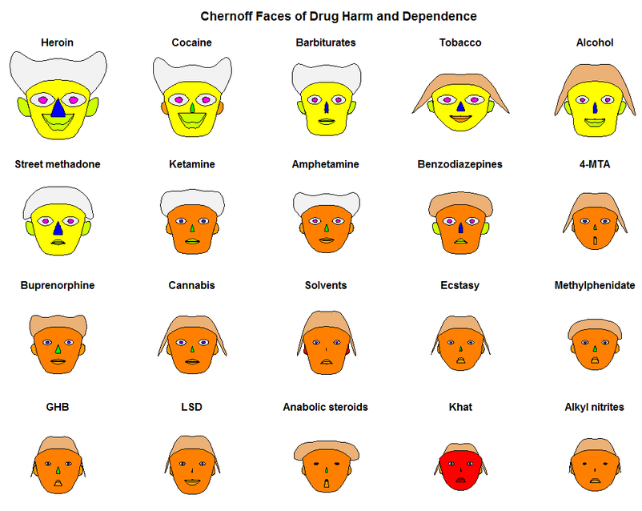
Example glyph: Chernoff faces
Chernoff, Herman. "The use of faces to represent points in k-dimensional space graphically." Journal of the American statistical Association 68, no. 342 (1973): 361-368.
https://www.reddit.com/r/dataisbeautiful/comments/aqek3y/oc_chernoff_faces_of_drug_harm_and_dependence/

Slide 24
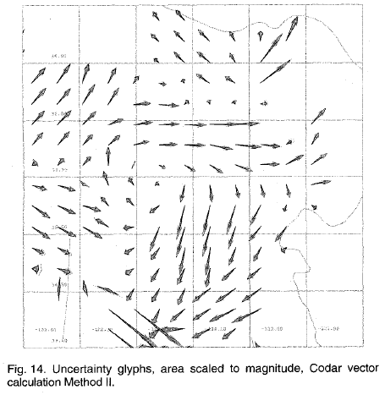
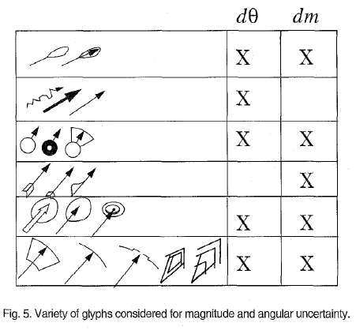
Arrow glyphs for visualizing wind
Wittenbrink, Pang, Lodha (1996) “Glyphs for Visualizing Uncertainty in Vector Fields”, IEEE TVCG.

Slide 25
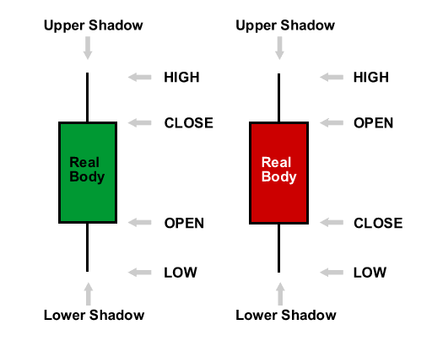
Candlestick charts
Invented by Homma Munehisa (1724-1803),
who amassed a fortune by trading rice
Used in the technical analysis of financial markets
Glyphs that shows evolution over time
http://goodasgoeldi.com/wordpress/2009/06/26/reading-a-candlestick-graph/

Slide 26
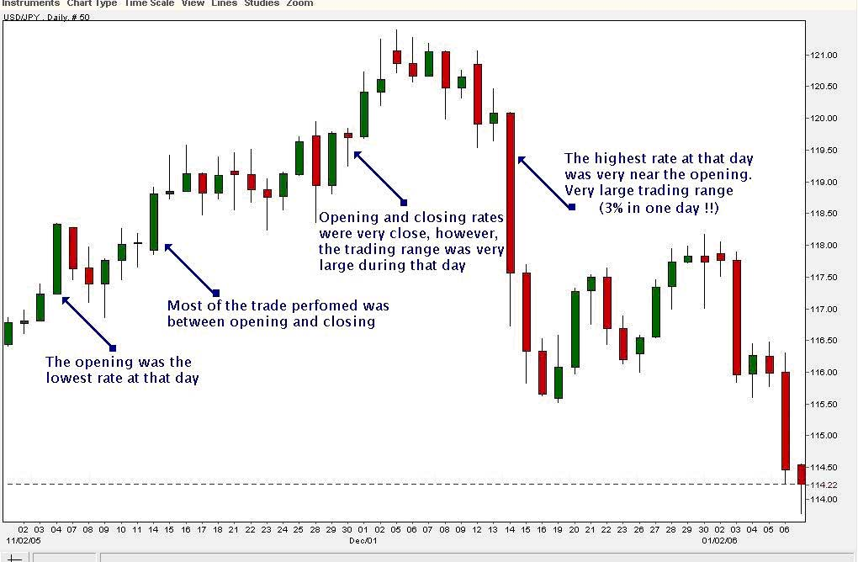
http://goodasgoeldi.com/wordpress/2009/06/26/reading-a-candlestick-graph/

Slide 27
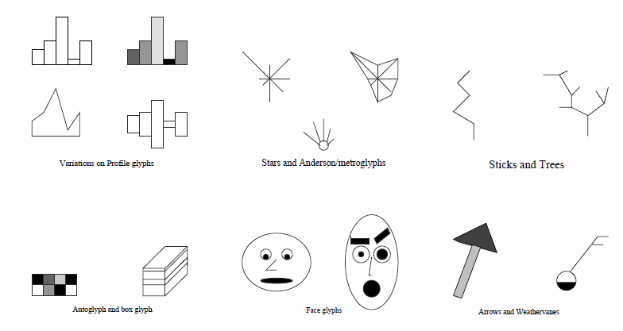
Other examples of glyphs
M. Ward (2002), “A Taxonomy of Glyph Placement Strategies for Multidimensional Data Visualization”, Information Visualization.

Slide 28
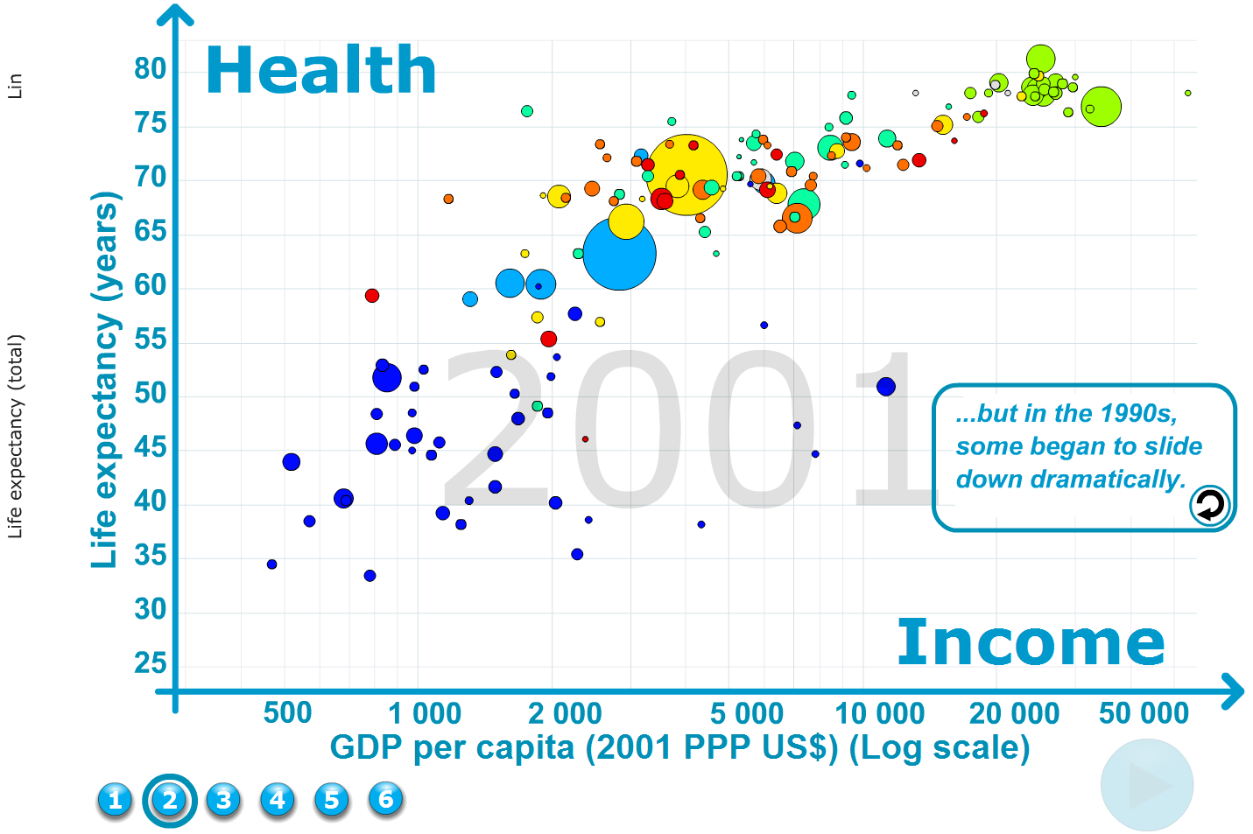
Development of countries
Notice that the “points” here are glyphs, each with a radius and a color.
See also Hans Rosling’s presentations on http://www.ted.com

Slide 29
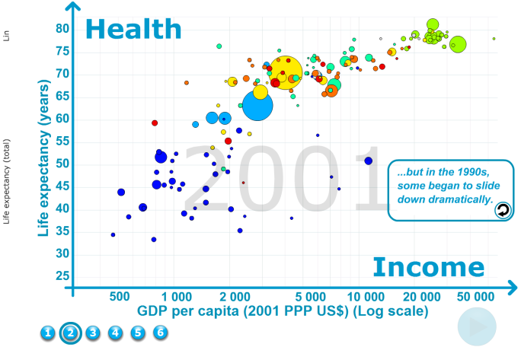
Glyphs
measure
measure
dimension
measure
dimension
dimension

Slide 30
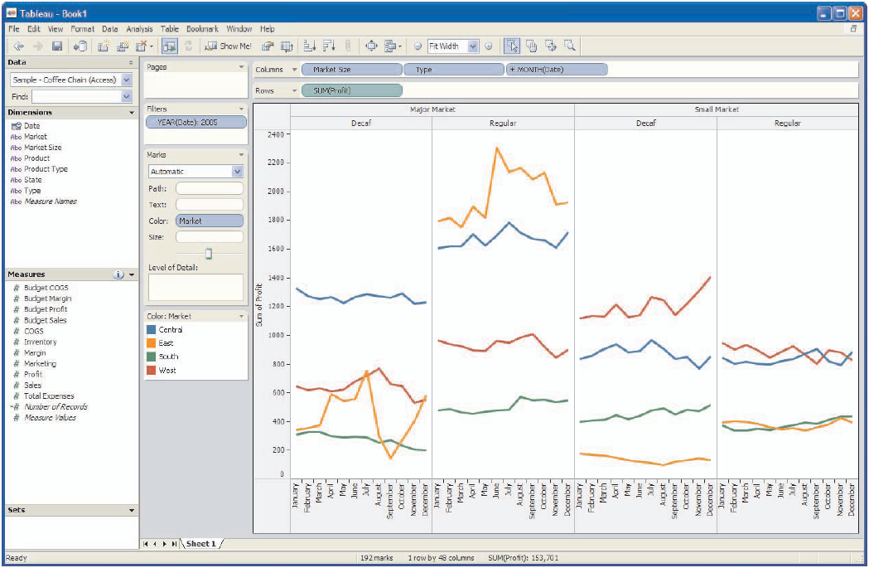
Tableau: software for visualizing databases
(Mackinlay et al. 2007; tableau.com)
Notes:
http://www.tableausoftware.com/products/tour
Longer video: http://www.tableausoftware.com/products/desktop/demo

Slide 31
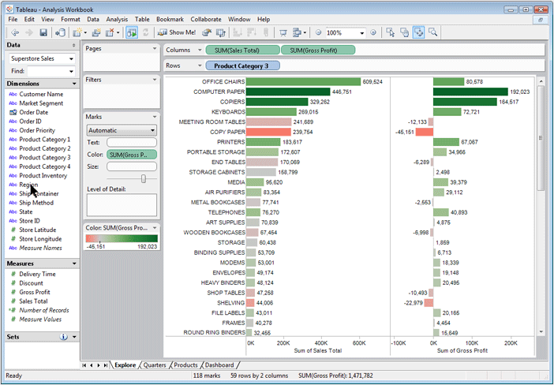

Slide 32
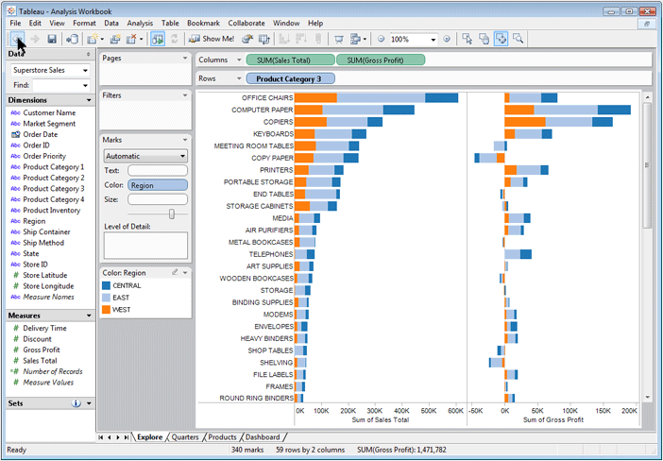

Slide 33
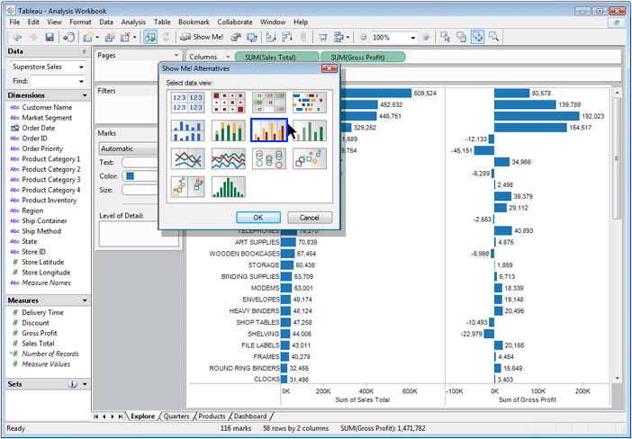

Slide 34
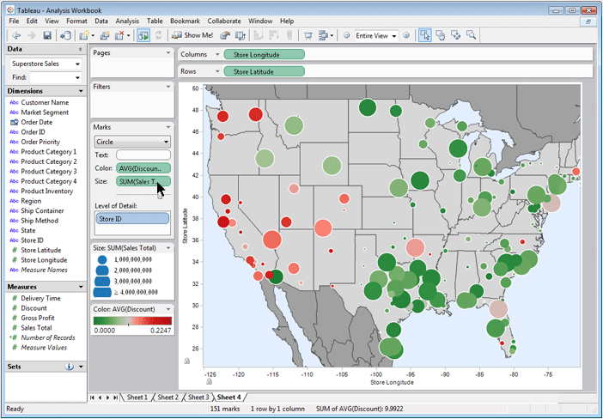

Slide 35
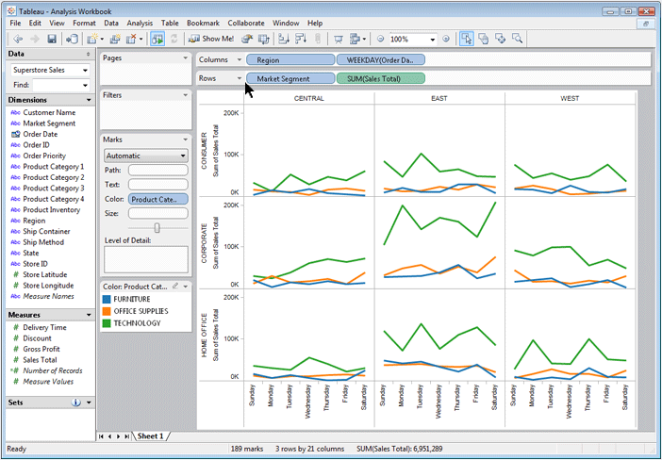

Slide 36
Columns: a, x
Rows: b, y
b
This is called
dimensional stacking
y
y
Dimensional stacking has been used in previous work before Tableau, but Tableau is a really nice implementation of it, as well as a successful commercial product.
x
x
y
y
x
x
a

Slide 37
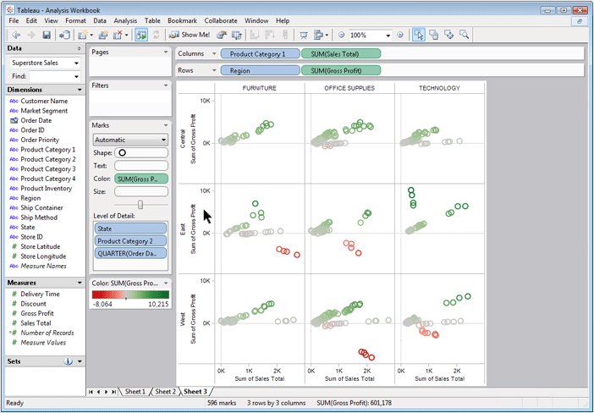

Slide 38
Exercise
Design one or more graphics to visualize a data set with the following variables:
Car model: {Accord, AMC Pacer, Audi 5000,
BMW 320i, Champ, Chev Nova, …} (19 models
in total, one model for each tuple; i.e. 19 tuples)
Car price: [$0, $13500]
Car mileage: [0,40]
Repair record: {Great, Good, OK, Bad, Terrible}
Car weight: [0,5500]
Most important variables

Slide 39
What techniques allow us to visualize many variables at once?
Examples we’ve already seen for 2d1m data: parallel barcharts, heatmaps, etc.
Glyphs
Dimensional stacking
Parallel coordinates
Scatterplot matrix (SPLOM)
Principle Component Analysis (PCA),
Multi-Dimensional Scaling (MDS), t-SNE …

Slide 40
Imagine a tabular dataset of student marks
 | Physics | Math | French literature | History
Student 1 | 90 | 95 | 65 | 70
Student 2 | 30 | 20 | 90 | 90
…
Each student is a row, or a tuple.

Slide 41
Parallel Coordinates
(Alfred Inselberg)
French
Literature
Physics
Math
History
100%
(90%, 95%, 65%, 70%)
0%

Slide 42
Parallel Coordinates
(Alfred Inselberg)
French
Literature
Physics
Math
History
100%
(30%, 20%, 90%, 90%)
(90%, 95%, 65%, 70%)
0%

Slide 43
Scatterplot Matrix (SPLOM)
Math
(90%, 95%, 65%, 70%)
French
Literature
History
French
Literature
Physics
Math

Slide 44
Scatterplot Matrix (SPLOM)
Math
(90%, 95%, 65%, 70%)
(30%, 20%, 90%, 90%)
French
Literature
History
French
Literature
Physics
Math

Slide 45
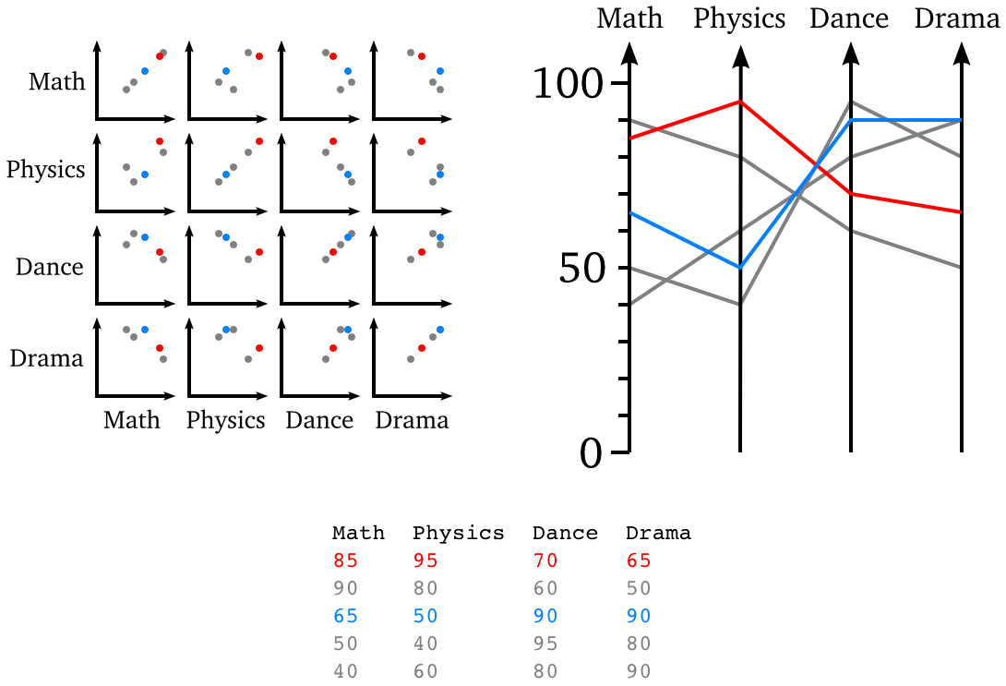

Slide 46
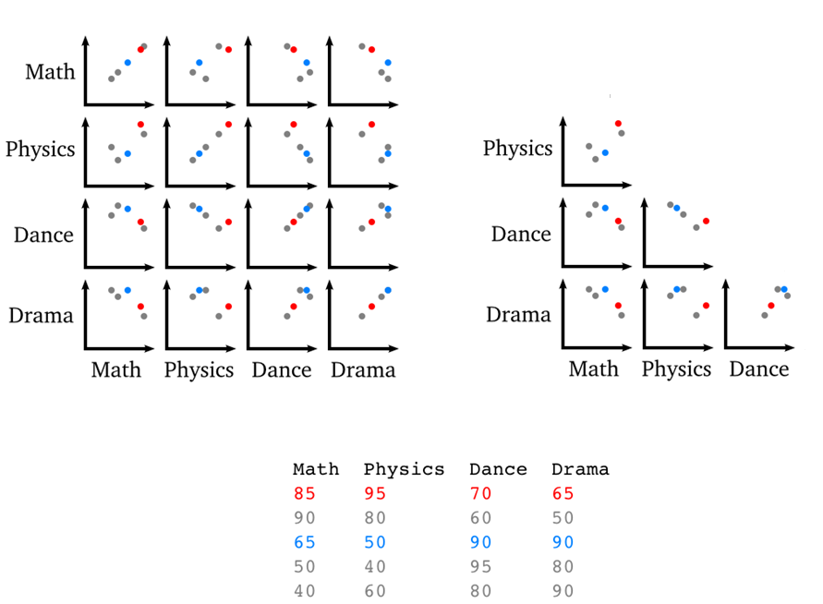

Slide 47
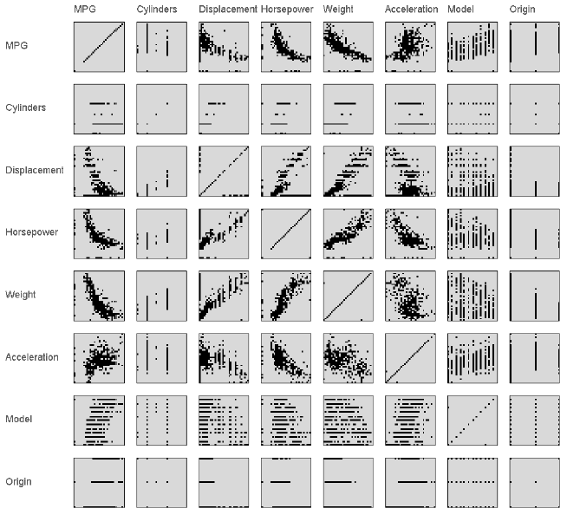
Scatterplot Matrix or SPLOM
Within each scatterplot, we could be interested in seeing outliers, correlations, etc.
Notice: the upper triangular half is the same as the lower triangular half, and the diagonal is not very interesting.
Niklas Elmqvist, Pierre Dragicevic, Jean-Daniel Fekete (2008). “Rolling the Dice: Multidimensional Visual Exploration using Scatterplot Matrix Navigation”. Proceedings of InfoVis 2008.

Slide 48
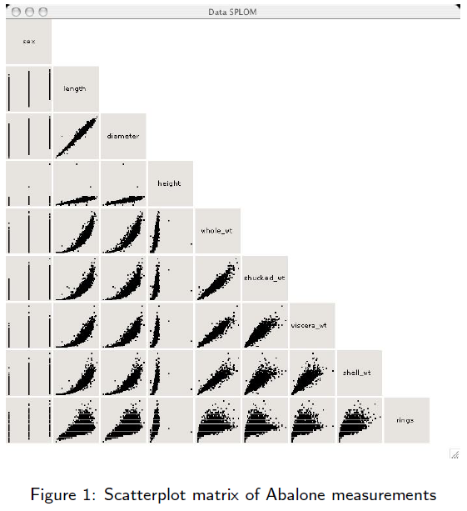
Scatterplot Matrix or SPLOM
Note: the diagonal is used to show the names of the variables
Wilkinson, Anand, Grossman,
“Graph-Theoretic Scagnostics”, 2005

Slide 49
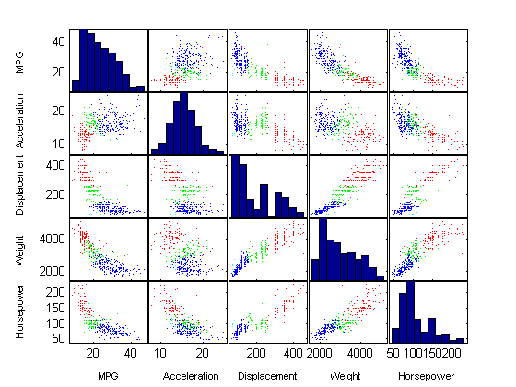
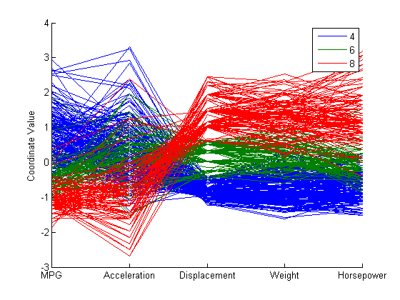
Example from Matlab: “carbig.mat”
http://www.mathworks.com/products/statistics/demos.html?file=/products/demos/shipping/stats/mvplotdemo.html

Slide 50
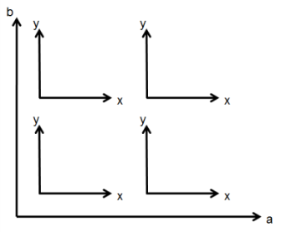
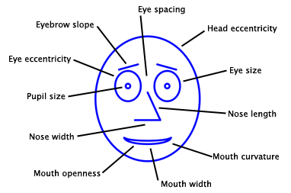
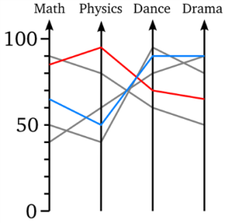
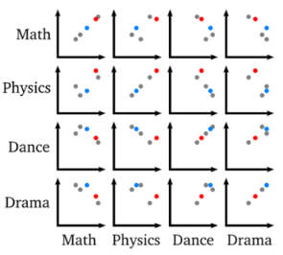
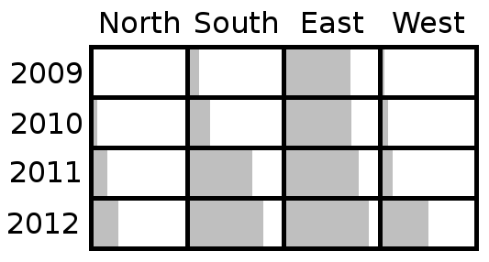
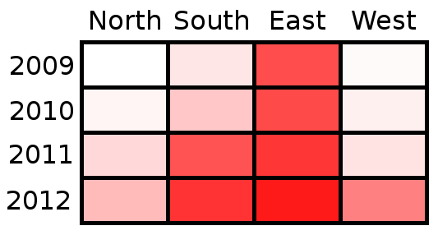


Summary of techniques for visualizing mdmv data
1 dimension + 1 measure :
barchart, line chart
0 dimensions + 2 measures :
scatterplot
2 dimensions + 1 measure :
parallel barcharts, heatmap
Up to ≈6 dimensions + ≈4 measures:
dimensional stacking
Up to ≈2 dimensions + ≈20 measures :
glyphs, parallel coordinates, scatterplot matrix
How can we visualize many dimensions?
?
See: Im, McGuffin, Leung (2013). GPLOM: The Generalized Plot Matrix for Visualizing Multidimensional Multivariate Data.
http://www.youtube.com/watch?v=AtbIeCvB-E0

Slide 51
Using Color

Slide 52



Solid curves: cones. Dashed curved: rods.
Most humans have 3 kinds of cones on their retina.
Most forms of colorblindness affect the green or red cones, involving genes on the X chromosome, hence more common in men (≈8%).
Additive color system: the primaries are red, green, blue
Subtractive color system (inks, pigments): the primaries are cyan, magenta, yellow

Slide 53



Color spaces: Red, Green, Blue (RGB) and Hue, Saturation, Value (HSV)
0°
240°
120°
Hue (angle)
Saturation
(radius)
Value (height)
http://msdn2.microsoft.com/en-us/library/aa511283.aspx
http://msdn2.microsoft.com/en-us/library/aa511283.aspx

Slide 54
Never put blue text on a black background!
Blue text on a white background is easy to see.
Do you see all four dots?
Yellow text on a black background is easy to see.
Never put yellow text on a white background!

Slide 55
Guidelines for choosing colors
Avoid blue on black, yellow on white, or other pairs of color that differ only in the blue component
Yellow on white ☹
Blue on black ☹
Red on magenta ☹
Cyan on green ☹
Please prepare your eyes …
Yellow on white ☹
Blue on black ☹
Red on magenta ☹
Cyan on green ☹

Slide 56
Guidelines for choosing colors
Avoid blue on black, yellow on white, or other pairs of color that differ only in the blue component
Use (desaturated) pastels for large areas, and more saturated colors for small details, thin lines, and text
Yes 👍🏽
No🙅

Slide 57

Guidelines for choosing colors
Avoid blue on black, yellow on white, or other pairs of color that differ only in the blue component
Use (desaturated) pastels for large areas, and more saturated colors for small details, thin lines, and text
When using colors to show a categorical variable:
  Prefer colors that have simple-to-remember names.
These colors have easy-to-remember, one-word names.
Using many shades of orange and blue creates confusion.

Slide 58
Guidelines for choosing colors
Avoid blue on black, yellow on white, or other pairs of color that differ only in the blue component
Use (desaturated) pastels for large areas, and more saturated colors for small details, thin lines, and text
When using colors to show a categorical variable:
  Prefer colors that have simple-to-remember names.
  When displaying thin lines/curves or dots that are color-coded, consider using a 50% gray background. You might find it makes it easier to choose the color palette for foreground colors.
  Avoid red+green color coding, or offer an alternative (yellow+blue) for colorblind users

Slide 59
Guidelines for choosing colors
Avoid blue on black, yellow on white, or other pairs of color that differ only in the blue component
Use (desaturated) pastels for large areas, and more saturated colors for small details, thin lines, and text
When using colors to show a categorical variable:
  Prefer colors that have simple-to-remember names.
  When displaying thin lines/curves or dots that are color-coded, consider using a 50% gray background. You might find it makes it easier to choose the color palette for foreground colors.
  Avoid red+green color coding, or offer an alternative (yellow+blue) for colorblind users
When using color to show a quantitative variable, avoid using a rainbow spectrum. Consider instead a spectrum that varies only one component, possibly with a discontinuity to distinguish positive and negative values.
No🙅
Yes👍🏽

Slide 60

Notes:
TODO: Redo this image only using colors that have distinct names, and show 1-pixel thick strips of the colors side-by-side, not just spaced out.

Slide 61


Slide 62

Using colors to show a categorical variable on thin lines and areas
50% gray background,
with these 10 distinct
foreground colors, all
with easy-to-remember
one-word names:
"#00ff00", // green
"#ffff00", // yellow
"#0000ff", // blue
"#00ffff", // cyan
"#800080", // "purple" (dark magenta)
"#ff0000", // red
"#ffffff", // white
"#000000", // black
"#ff8000", // orange
"#ff80ff" // "pink" (pastel magenta)
Challenge: find another set of 10 foreground colors, with easy-to-remember one-word names, that are easy to distinguish when used on thin lines, on a white background or on a black background.

Slide 63

Using color to show a quantitative variable over an area
No🙅
Yes👍🏽
Rogowitz and Treinish, “Why Should Engineers and Scientists Be Worried About Color?”

Slide 64



Borland and Taylor, “Rainbow Color Map (Still) Considered Harmful”, IEEE CG&A, 27(2):14-17, 2007

Slide 65





Using color to show a quantitative variable on thin lines
No🙅
Yes👍🏽

Slide 66


EnChroma lenses can help people with certain kinds of colorblindness
http://sitn.hms.harvard.edu/flash/2015/from-kansas-to-oz-how-new-glasses-could-change-the-way-the-colorblind-see-the-world/
http://enchroma.com/technology/

Slide 67
Visualizing Network Data

Slide 68


Generated by Graphviz
( http://www.graphviz.org/Gallery/directed/unix.html )
Generated with a “SugiyamaLayout”
( http://www.ogdf.net/ogdf.php/tech:howto:hierlr )

Slide 69

Force-directed layout
Pseudo-physical simulation of masses and springs that converges toward a final layout
The nodes are masses that are mutually repelled by an electric force
The edges are springs
http://www.michaelmcguffin.com/slides/mcguffin-javascript-canvas-examples/forceDirectedLayoutDemo.html ;
http://profs.etsmtl.ca/mmcguffin/code/#SimpleNetworkVisualizer

Slide 70
Layout by “stress majorization”
Guaranteed to converge to a (possibly local) optimal layout (with minimal stress) with each iteration; oscillations are impossible; converges in many fewer iterations than typical force-directed algorithms
Unfortunately, requires Θ(N²) memory, and each iteration requires Θ(N²) time (though approximate shortcuts are probably possible for sparse graphs)
Details: Emden R. Gansner, Yehuda Koren, Stephen North, "Graph Drawing by Stress Majorization", Graph Drawing (GD) 2004; http://scholar.google.ca/scholar?q=Gansner+Koren+North+%22Graph+Drawing+by+Stress+Majorization%22 ; equation 12

Slide 71
Layout by “stress majorization”
Takes as input the desired distance d_{i,j} between each pair of nodes {n_{i}, n_{j}} and the weight w_{i,j} (or importance) of each distance.
Easy way to compute these inputs: define d_{i,j} = 1 if n_{i}, n_{j} are adjacent, then compute d_{i,j} for other pairs of nodes with the Floyd–Warshall algorithm for finding all shortest paths ( http://en.wikipedia.org/wiki/Floyd–Warshall_algorithm ) which requires cubic time, then define w_{i,j} = 1/(d_{i,j})²
Once all the d_{i,j} and w_{i,j} are known, iterate equation 12 from the paper. The stress majorization algorithm will position nodes to try to respect as closely as possible the desired distances. Iterate until the nodes move very little (e.g., less than 1 pixel).
An easy optimization (to save memory and accelerate the Floyd–Warshall algorithm) can be performed by noticing that the matrix of d_{i,j} and w_{i,j} values is symmetric

Slide 72

Layout by “stress majorization”
Excerpt from the paper:

Slide 73

Arc Diagrams
43 nodes, 80 edges,
random ordering,
180 degree arcs
barycenter
heuristic
ordering
100 degree arcs
[McGuffin, 2012]

Slide 74


43 nodes, 80 edges
[McGuffin, 2012]

Slide 75

43 nodes, 80 edges,
random ordering
barycenter heuristic ordering,
180 degree arcs added à la MatLink
[Henry+Fekete 2007]
[McGuffin, 2012]

Slide 76

43 nodes, 80 edges
[McGuffin, 2012]

Slide 77



50 nodes, 200 edges
For a tutorial on simple algorithms for these: http://profs.etsmtl.ca/mmcguffin/research/#mcguffin_2012
[McGuffin, 2012]

Slide 78
Visualizing Tree Data

Slide 79


Slide 80

http://en.wikipedia.org/wiki/File:Tree_of_life_with_genome_size.svg

Slide 81

http://www.cookingforengineers.com/2004/09/recipe-file-basic-tiramisu.html

Slide 82


Slide 83


Treemaps
(Ben Shneiderman and others) http://www.cs.umd.edu/hcil/treemap-history/
Marc Smith and Andrew Fiore, 2001
Martin Wattenberg, 1998
and
http://www.smartmoney.com/map-of-the-market/

Slide 84


http://iguide.travel/Philippines/Regions

Slide 85

Trees
Michael McGuffin and Jean-Marc Robert, 2010
https://www.youtube.com/watch?v=DnUkXSSK5hA

Slide 86

Asymptotic Analysis of the Space-Efficiency of Tree Representations
Key ideas:
Impose a 1×1 bounding square on all representations
Evaluate size of smallest nodes, not just total area
Evaluate size of labels as a function of their aspect ratio L
Examine limits of these sizes as depth D→∞
Michael McGuffin and Jean-Marc Robert, 2010
https://www.youtube.com/watch?v=DnUkXSSK5hA

Slide 87
A critique of visualizations chosen from a survey of ≈200 papers related to artificial life, origin of life, and biology

Slide 88
McAtee and Szabo (2019), "Complex Systems and Artificial Life: A Decade’s Overview"

Slide 89



McAtee and Szabo (2019), "Complex Systems and Artificial Life: A Decade’s Overview"
Alternatives:

Slide 90

Szilágyi et al. (2020), "Dynamics and stability in prebiotic information integration: an RNA World model from first principles"
Alternative:

Slide 91
Hickinbotham et al. (2016), "Maximizing the Adjacent Possible in Automata Chemistries"
Yellow on white ☹

Slide 92

Karr et al. (2012), "A Whole-Cell Computational Model Predicts Phenotype from
Genotype"
Pastels should not be used for thin lines on a white background. Saturated colors are better.

Slide 93

Xavier et al. (2020), "Autocatalytic chemical networks at the origin of metabolism"
Great use of color to ensure labels are legible over edges. These labels were probably manually positioned.

Slide 94

Koonin and Novozhilov (2008), "Origin and evolution of the genetic code: The universal enigma"
Saturated colors should not be used for background colors. ☹

Slide 95

Könnyű et al. (2015), "In silico ribozyme evolution in a metabolically coupled RNA population"
Great use of pastels for background colors. The black text is easy to read.

Slide 96

Breuer et al. (2019), "Essential metabolism for a minimal cell"
Great use of pastels for background colors. Foreground elements are easy to read.

Slide 97
Dolson et al. (2019), "The MODES Toolbox: Measurements of Open-Ended Dynamics in Evolving Systems"
Great use of transparency on the right.

Slide 98

Hayes (1998), "Prototeins"

Slide 99

… after modifying:

Slide 100
Heaton (2019), "Evolving continuous cellular automata for aesthetic objectives"

Slide 101

Leonard Eisenberg

Slide 102

Figure adapted from Ballen and Greene (2017), "Walking and talking the tree of life: Why and how to teach about biodiversity"
95 labels

Slide 103

96 labels
David Hillis
http://www.zo.utexas.edu/faculty/antisense/DownloadfilesToL.html

Slide 104

Hug et al. (2016), "A new view of the tree of life"

Slide 105





Wochner et al. (2011), "Ribozyme-Catalyzed Transcription of an Active Ribozyme"
Ma and Hu (2012), "Computer Simulation on the Cooperation of Functional Molecules during the Early Stages of Evolution"
Chen and Ma (2020), "The origin of biological homochirality along with the origin of life"
3D barcharts and surface plots should be avoided,
in favor of heatmaps or parallel barcharts (below).
Suzuki (2011), "Artificial Chemistry and Molecular Network"
Madina et al. (2003), "Cellular Evolution in a 3D Lattice Artificial Chemistry"

Slide 106


Hordijk and Steel (2016), "Autocatalytic sets in polymer networks with variable catalytic distributions"
There are two kinds of nodes, but they are too small.
Arrow heads are redundant.

Slide 107

Hordijk and Steel (2017), "Chasing the Tail: The Emergence of Autocatalytic
Networks"
There are two kinds of nodes, but they are too small.
Arrow heads are redundant.
The use of curved edges is nice to avoid overdrawing (look at the double edge from “10” to the left-most reaction).
Difficult to check if each RAF set is complete.
Reflexively Autocatalytic and Food-generated (RAF) sets

Slide 108
Quick-and-dirty redesign:
01
00100
00
R
111
01111
R
R
11100
1010
1
0
R
100
11
110
R
R
010
R
R
10

Slide 109
R
01
01111
R
111
00100
R
1010
00
R
100
10
R
11100
R
010
0
R
1
11
R
110

Slide 110
R
01
01111
R
111
00100
R
1010
00
R
100
10
R
11100
R
010
0
R
1
11
R
110

Slide 111
R
01
01111
R
111
00100
R
1010
00
R
100
10
R
11100
R
010
0
R
1
11
R
110

Slide 112
R
01
01111
R
111
00100
R
1010
00
R
100
10
R
11100
R
010
0
R
1
11
R
110

Slide 113
R
01
01111
R
111
00100
R
1010
00
R
100
10
R
11100
R
010
0
R
1
11
R
110

Slide 114
(Do we have time for even more examples?)

Slide 115

Baum (2018), "The origin and early evolution of life in chemical composition space"
… sketch of redesign of the texture showing mixture

Slide 116

Adamski et al. (2020), "From self-replication to replicator systems en route to de novo life"
Good use of pastels for background colors. The black text is easy to read.

Slide 117

Nellis (2012), "Towards meta-evolution via embodiment in artificial chemistries"

Slide 118

Aziz et al. (2016), "The early history and emergence of molecular functions and modular scale-free network behavior"
Imagine replacing the discs with little glyphs like this, with one bar showing degree, another showing age:
This would use the length channel instead of color hue and area.

Slide 119

Rasmussen et al. (2016), "Generating minimal living systems from non-living materials and increasing their evolutionary abilities"

Slide 120

Kun et al. (2015), "The dynamics of the RNA world: Insights and challenges"

Slide 121
Ideas for research involving visualization applied to artificial life

Slide 122


Idea for ALife research: visualize an artificial chemistry over time by describing the molecules within it using several variables (v₁,v₂,…,v_{N}), design a glyph that displays these variables, and plot these glyphs in some space. Maybe some variables (number or concentration, folding state) change over time, and others (atomic weight, net charge, complexity, catalytic activity) are fixed for a given molecule. Maybe also show reactions between molecules as arrows between glyphs.
Complexity of molecule
Concentration of molecule
Time

Slide 123

Kincaid and Lam (2006), "Line Graph Explorer: Scalable Display of Line Graphs Using Focus+Context"
Idea for ALife research: visualize time series data with techniques like “Line Graph Explorer”, where each time series can be shown as a single row of colored pixels that can be expanded-on-demand to also show values with vertical position.

Slide 124


Waser et al. (2010), “World Lines"
Idea for ALife research: visualize multiple simulations, run with different parameters, as a branching tree structure, using visual channels and glyphs to show simulation results, taking inspiration from work like “World Lines”.

Slide 125


Gareth Daniel and Min Chen (2003), “Video Visualization"
Idea for ALife research: visualize a cellular automaton by imagining it as a space-time block, and designing filters to show interesting events or interesting structures within the space-time block. Or take inspiration from the design of “transfer functions” in volume visualization to visualize features of interest within the space-time block.
Carlos D. Correa and Kwan-Liu Ma (2008), “Size-based Transfer Functions: A New Volume Exploration Technique”

Slide 126

… or take inspiration from the “Cubix” work by Bach et al. to visualize the space-time block of a cellular automaton.
Bach et al. (2014) "Visualizing Dynamic Networks with Matrix Cubes"
High-quality videos:
https://www.youtube.com/watch?v=kP99FT1iYis ;
http://www.aviz.fr/~bbach/cubix/Cubix2.mov

Slide 127
Please fill out the feedback form ☺
There are only 3 questions on it.

Slide 128
Some remarks about 3D vis and VR/AR

Slide 129



For references and links to videos, see McGuffin (2019), "Augmented Reality Knowledge Work: Towards a Research Agenda“.

Slide 130

Microsoft HoloLens 2

Slide 131


Slide 132
Are 3D visualization and VR/AR useful for ALife research?
If you have data that is really 3D (medical images, models of buildings or cars, etc.), then showing this data with a headset gives the user better depth cues thanks to head motion and stereopsis. But this comes at the cost of being less convenient and harder to share.
If you have data that is abstract (networks, trees, multivariate data), then showing it in 2D is probably better than showing it in 3D, as many studies have shown.
  Reasons: 3D suffers from occlusion, makes it harder to judge differences in lengths and positions, requires training, involves more complicated navigation, is more complicated to program and to share; furthermore, input+output hardware designed for 3D is less common than devices designed for 2D.
  2D visualizations can be made powerful with multiple coordinated views
VR and AR headsets could still be used to show the user many 2D visualizations, with the advantage of providing “unlimited”/“immersive” spaces for information. Scrolling with a mouse on a screen is slower than rotating your head (but maybe scrolling is also less tiring).
Given a choice between VR and AR, programming on current VR headsets is easier.

Slide 133
Visualizing Tabular Data:
The GPLOM

Slide 134
Summary of techniques for visualizing mdmv data
1 dimension + 1 measure :
barchart, line chart
0 dimensions + 2 measures :
scatterplot
2 dimensions + 1 measure :
parallel barcharts, heatmap
Up to ≈6 dimensions + ≈4 measures:
dimensional stacking
Up to ≈2 dimensions + ≈20 measures :
glyphs, parallel coordinates, scatterplot matrix
How can we visualize many dimensions?
?

Slide 135
“Nuts and Bolts” dataset
(72 rows):
Dimensions
Measures
Region | Month | Product | Sales | Equipment_costs | Labor_costs
0 | 0 | 0 | 2.76 | 0.92 | 4.3
0 | 0 | 1 | 4.92 | 1.64 | 4.3
0 | 1 | 0 | 4.2 | 1 | 4.3
0 | 1 | 1 | 8.4 | 2 | 4.3
0 | 2 | 0 | 5.28 | 9.6 | 4.3
0 | 2 | 1 | 14.52 | 26.4 | 4.3
0 | 3 | 0 | 5.016 | 0.88 | 4.3
0 | 3 | 1 | 8.436 | 1.48 | 4.3
… | … | … | … | … | …
2 | 10 | 0 | 8.82 | 2.1 | 4.9
2 | 10 | 1 | 9.156 | 2.18 | 4.9
2 | 11 | 0 | 5.655 | 1.45 | 5.2
2 | 11 | 1 | 9.4965 | 2.435 | 5.2

Slide 136
“Nuts and Bolts” dataset

Slide 137
“Nuts and Bolts” dataset
Not very useful
The SPLOM works well with mesures,
but not with dimensions

Slide 138
“Nuts and Bolts” dataset

Slide 139
“Nuts and Bolts” dataset
Parallel coordinates work well with mesures, but not with dimensions
Not very useful

Slide 140
“Nuts and Bolts” dataset
Example view that would be possible with Tableau (dimensional stacking):
Each of the above examples only show 4 of the 6 variables. Showing all 6 variables (3 dimensions and 3 mesures) would require much space.

Slide 141
“Nuts and Bolts” dataset
Example view that would be possible with Tableau (dimensional stacking):
The above example only shows 4 of the 6 variables. One of these is “Month”, which has 12 levels, greatly increasing space requirements.

Slide 142
Glyphs
measure
measure
dimension
measure
dimension
dimension
Glyphs can show many measures at once, but cannot easily show more than 2 dimensions at once.

Slide 143
Generalized PLOt Matrix (GPLOM) of the “Nuts and Bolts” dataset
Scales better than Tableau’s dimensional stacking to a large number of dimensions (and can also show many measures)

Slide 144
Generalized PLOt Matrix (GPLOM)
[Im, McGuffin, Leung, IEEE InfoVis 2013]

Slide 145
Summary of techniques for visualizing mdmv data
1 dimension + 1 measure :
barchart, line chart
0 dimensions + 2 measures :
scatterplot
2 dimensions + 1 measure :
parallel barcharts, heatmap
Up to ≈6 dimensions + ≈4 measures:
dimensional stacking
Up to ≈2 dimensions + ≈20 measures : glyphs,
parallel coordinates, scatterplot matrix
Up to ≈12 dimensions + ≈12 measures:
generalized plot matrix

Slide 146
Example solutions to the exercise from earlier

Slide 147


Mackinlay (1986), “Automating the Design of Graphical Presentations of Relational Information”, ACM TOG.

Slide 148
END

