Slide 1
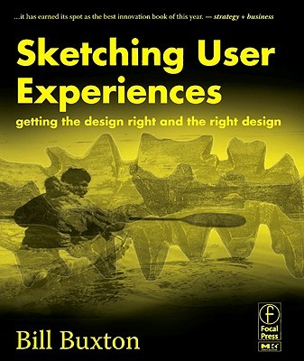
Les diapos suivants sont pris et adaptés d'une présentation de Bill Buxton à la conférence CHI 2014 de l'ACM.
Ils résument des idées discutées dans son livre "Sketching User Experiences" et dans l'article Buxton, B. (2008), The Long Nose of Innovation, BusinessWeek.com.

Slide 2
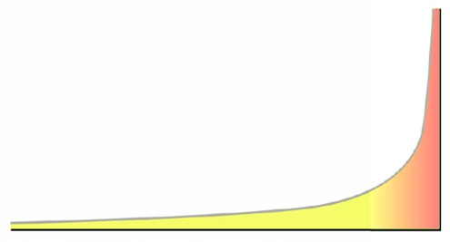
The Long Nose of Innovation
$1B
New technology
Radar
≈20-30 years

Slide 3
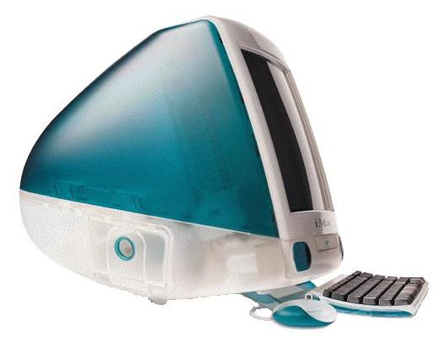
Arguably, the original bondi-blue iMac saved Apple
It is useful to remember that behind the skin, in the OS, applications, and processor, it was the same as what preceded it.

Slide 4
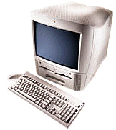
Power Macintosh G3 All-in-one
iMac
Introduced: March 1998
Terminated: September 1998
Processor
CPU: PowerPC 750 "G3"
CPU Speed: 233/266 MHz
Introduced: August 1998
Terminated: January 1999
Processor
CPU: PowerPC 750 "G3"
CPU Speed: 233 MHz

Slide 6
More detailed view showing OS releases.
Mac OS 8

Slide 7
The Long Nose of the iPod

Slide 8
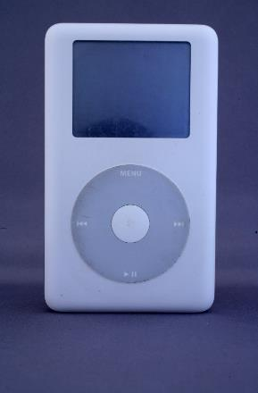
Christmas 2004 could be called “iPod Christmas”
Seemingly out of nowhere (for many), the iPod became the “must have” gift
Released in July that year, it stormed the marketplace
But was it really “out of nowhere”?
No. It was actually the 4th generation of a product that had just hit the “tipping point”
Up to then, it had just been following the Long Nose, below the radar.
July 2004

Slide 9
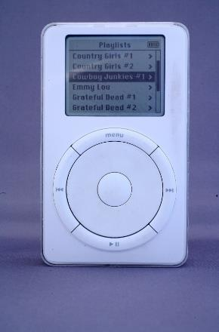
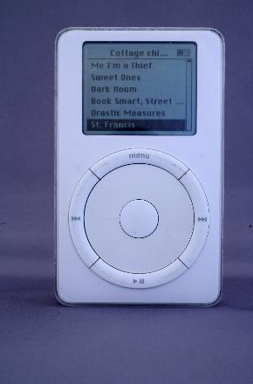
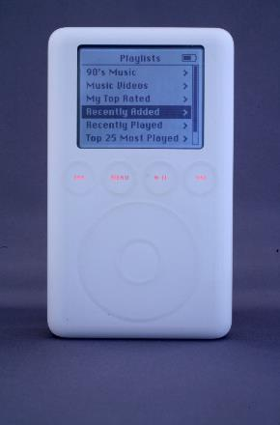
G1: October 2001
G2: July 2002
G3: April 2003
G4: July 2004

Slide 10
Observation 1:
It took 3 ¾ years and 4 generations for the iPod to become an “overnight” success.

Slide 11
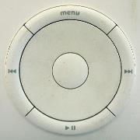
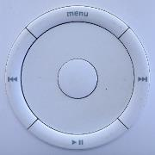
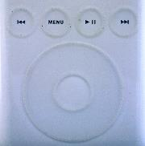
Observation 2:
Each generation tinkered with one of its most iconic features: the scroll wheel.

Slide 12
Precedents Questions around the nature of innovation, originality, and design.

Slide 13
What about a portable music player on which you can listen through headphones as you move around?

Slide 14
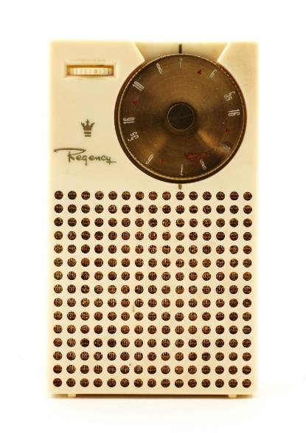
Regency TR-1 Transistor Radio (1954)
World’s first commercially available transistor radio.
Designed by Painter, Teague and Peterfil

Slide 15
What about a portable music player on which you can store your own music?

Slide 16
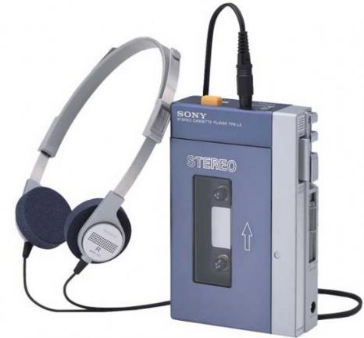
Sony TPS-L2 Walkman (1978)
Used audio cassette technology
Introduced 1978

Slide 17
What about one that uses random access digital MP3 files rather than analogue, sequential audio cassettes?

Slide 18
Elger Labs MPMan F10 (1998)
First portable music player using MP3 files
Stored music in flash memory, enabling random access
$250
32MB of memory
could hold eight 4-minute songs.
could upgrade the memory to 64MB by sending the unit back to Eiger labs with a check for $69 plus $7.95 shipping.

Slide 19
What about one that stores the MP3 files on a miniature hard drive, thereby increasing amount of music that you can store?

Slide 20
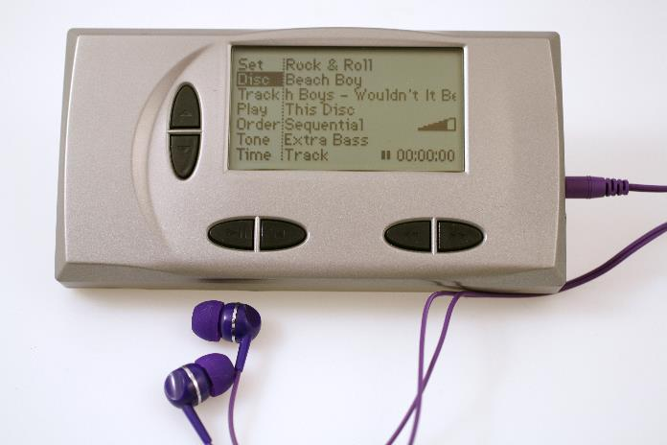
HanGo / Remote Solution Personal Jukebox PJB-100 (2000)
First hard-disk based portable MP3 Player
The original design was developed by Compaq starting in May 1998.
Compaq licensed the design to HanGo Electronics
Had 4.8GB vs the 32/64MB storage found on flash memory players of the time
Upped storage to over 1,000 songs.
Original price: $799. USD

Slide 21
What about roots of the form-factor / industrial design?

Slide 22
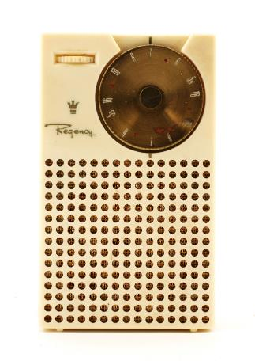
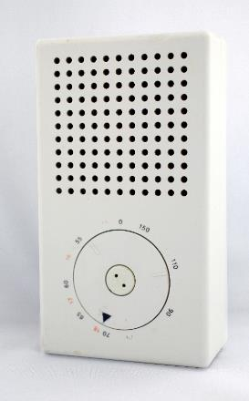
Typically, ideas do not advance in a single step; rather, in a linked chain of steps, each link building on the tradition of those preceding. Above are 3 steps in such a progression. To me, a core part of design competence is the skill to search for, find, and appreciate such chains. Recognizing a design as such a link is far more interesting and informative than thinking about it as the result of some divine creative flash of genius, and thus coming out of nowhere. For the aspiring designer, this is also a relief, since I don’t know anyone who can teach divine inspiration; however I do know that anyone can learn to mine the world for great traditions worthy of building upon.
Regency TR-1 Transistor Radio, 1954
Painter, Teague and Peterfil
Braun T3 Transistor Radio, 1958
Dieter Rams
Apple G4 iPod, July 2004
Jonathan Ive

Slide 23
Impact on Apple Products?

Slide 24
Apple iMac G5 (2004)
Released August 2004, one month after the G4 iPod
Adopts iPod design language
This was stunning brilliance. Apple had been selling computers since 1977, and here they just flipped the whole thing around, redefined their identity. This campaign signaled that Apple was no longer a computer company, something that was formalized 3 years later. To put it in context ….

Slide 25
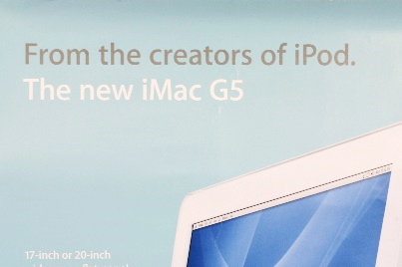
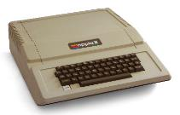
To Start: Just Apple
30 Years
1977 1978 1979 1980 1981 1982 1983 1984 1985 1986 1987 1988 1989 1990 1991 1992 1993 1994 1995 1996 1997 1998 1999 2000 2001 2002 2003 2004 2005 2006 2007
June 10, 1977
Apple ][ Computer Released
October, 2001
G1 iPod Released
January 3, 1977
Incorporated as Apple Computer
July, 2004
G4 iPod Released
August, 2004
iMac G5 Released
January 9, 2007
Name changed to Apple Inc.

Slide 26
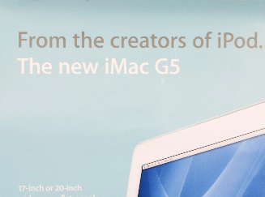
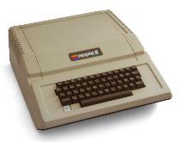
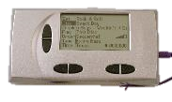
Sony TPS-L2 Walkman, 1978
The Bigger Picture
The Long Nose – 50+ years
1950 | 1960 | 1970 | 1980 | 1990 | 2000
Elgar MPman, 1998
Personal Jukebox, 2000
G1 iPod, 2001
Apple ][ Computer
June, 1977
G4 iPod, 2004
Braun T3, 1958
Regency TR-1, 1954
iMac G5, 2004
Apple Computer Incorporated
Jan. 1977
Name changed to Apple Inc.
Jan. 2007

Slide 27
Another quick example, just to be sure that the above is a pattern, not an exception.

Slide 28
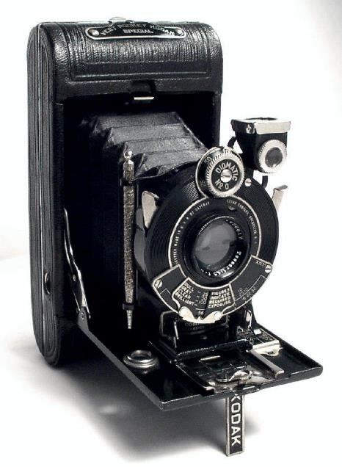
In 1926, Kodak launched this black camera.
It was successful
However, it was selling mainly to men
They wanted to extend the market
So they engaged Walter Dorwin Teague to design a model that would appeal to women
His solution was to release a version of the camera in 5 different colours, each packed in a pseudo-silk lined box, where the box and liner matched the colour of the camera
Kodak Vest Pocket Series III (1926)

Slide 29
Walter Dowrin Teague
Vanity Kodak (1928)

Slide 30
In 2001 launched this white iPod.
It was successful
However, it was selling more to men
They wanted to extend the market
So they designed a model that would better appeal to women
Their solution was to release a smaller version of the iPod in 5 different colours.
Apple G1 iPod, October 2001

Slide 31
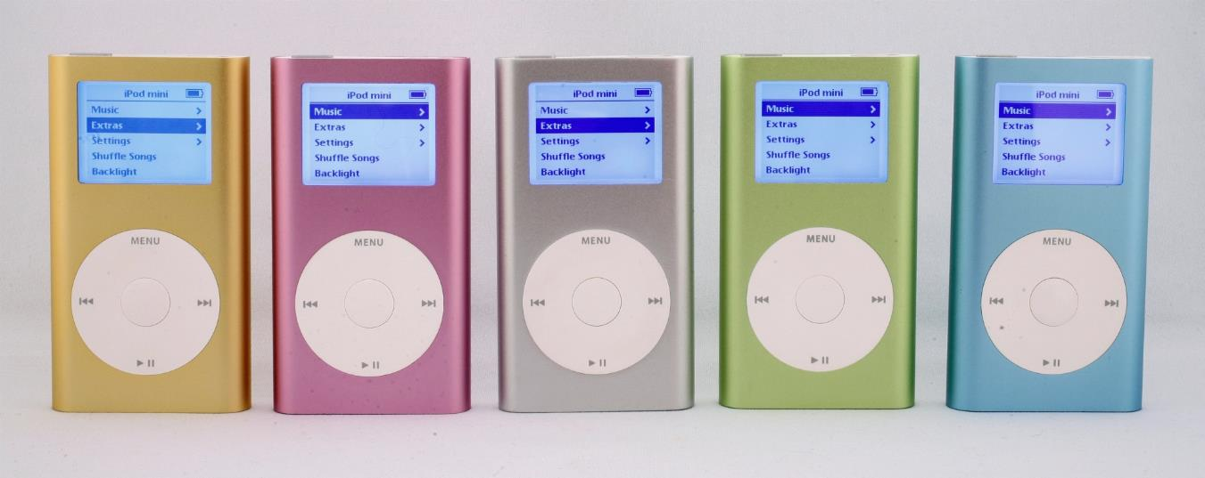
Jonathan Ive
Apple iPod Mini (2004)
Same basic design brief
Same use of colour as part of the solution
Same choice of base colours
Same number of colours
Same simultaneous release
Coincidence?
Walter Dowrin Teague
Vanity Kodak (1928)

Slide 32
Observations
The Teague/Kodak example is a classic
It would be known to virtually any trained industrial designer
Jonathan Ive is nothing, if not an extremely well trained industrial designer, whose work shows a high level of fluency in the history of his craft.
In his solution, he was doing what any competent designer would do: draw inspiration from the past.
Rather than diminish respect for his solution, his choice of what to draw on, and how to shape it to his design brief, is cause to augment respect for his work.

Slide 33
The Long Nose of Innovation
$1B
1984
Capacitive Multi-touch
2007
iPhone Launch
Radar
>20 years

Slide 34
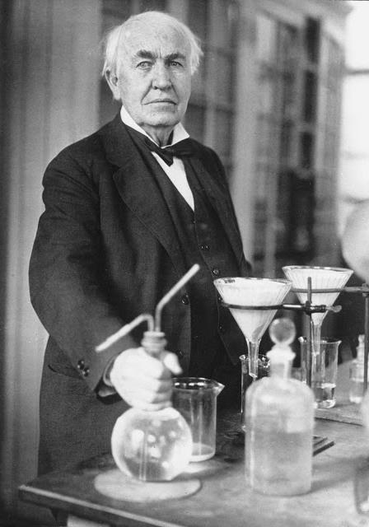
The Edison Myth
of the lone genius inventor
If Edison invented all that he is credited for, what were all those people doing in his labs?
Edison was the Steve Jobs of his era
Actually, that should be the other way around.
As one of the first US businessmen to hire a press agent to create his own myth, he created the model for Jobs.
The key take-away is this: in buying into the Edison Myth, one sets a bar that not even Edison (or Jobs) could achieve.
So what hope have you or me?

Slide 35
Un autre exemple
1965: souris inventée par William English et Doug Engelbart
1968: copiée par le National Research Council de Canada
1973: copiée par Xerox PARC pour le Alto computer
1980: 3 Rivers Systems offre le PERQ-1 workstation, la première station de travail commerciale avec souris
1981: Xerox Star 8010 workstation
1984: le premier Macintosh de Apple
1995: Microsoft Windows 95 (la souris est maintenant répandue)
Délai de 30 ans!
(pour plus de détails, voir Buxton, B. (2008), The Long Nose of Innovation, BusinessWeek.com)

Slide 36
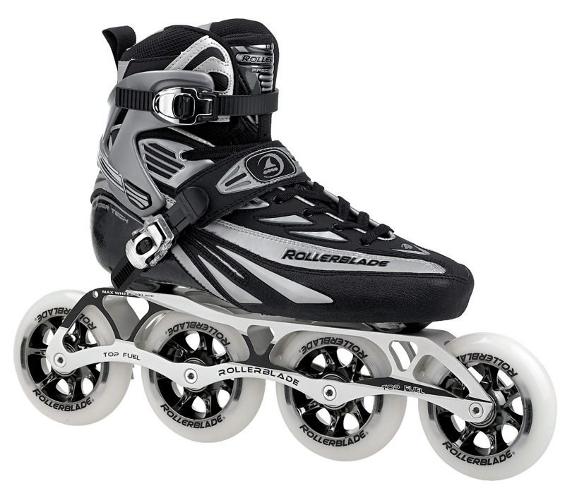
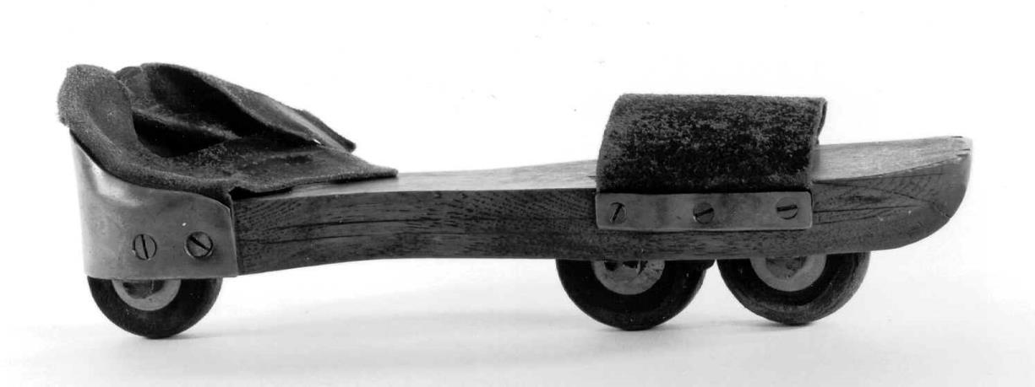
… from a very old idea
Petitbled roller blade. Patented 1819.
Example: A recent commercial success .…
Notes:
An example of a really old idea that has had recent commercial success.

Slide 37
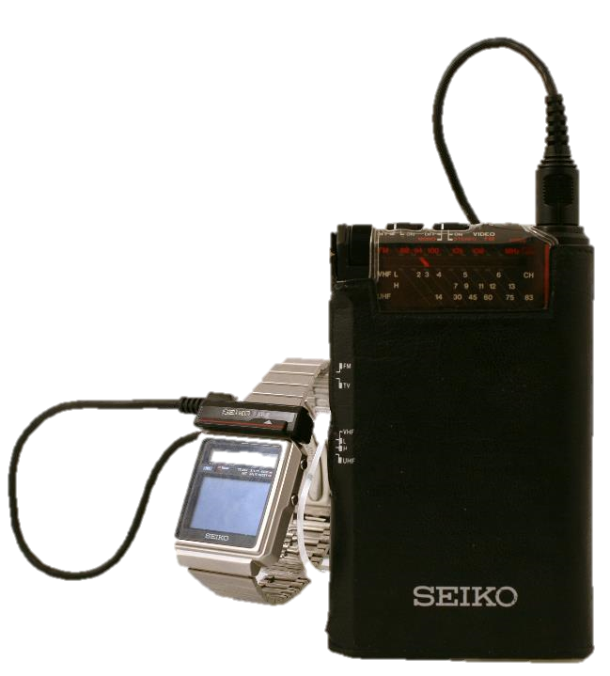
Seiko Watch TV
(1982)
Samsung Galaxy Gear
(2014)
Not quite a fair comparison, but still ….
32 year interval
21 doubling periods of Moore’s Law (21×1.5 years)
Factor of 2,000,000 increase in computing power
Same paired architecture
But we got rid of the wires

Slide 38
Et donc?
Les technologies prennent longtemps avant de maturer
Les meilleures innovations sont des améliorations d'anciennes idées
La meilleure façon d'identifier des innovations intéressantes est d'explorer beaucoup d'idées rapidement (avec une connaissance de ce qui a été fait avant)
Pour faire cela, il faut avoir l'habitude d'observer et de noter les bons et mauvais exemples de design autour de nous, et de faire beaucoup de croquis ("sketches")

Slide 39
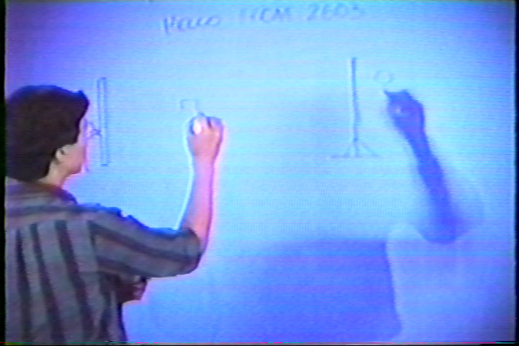
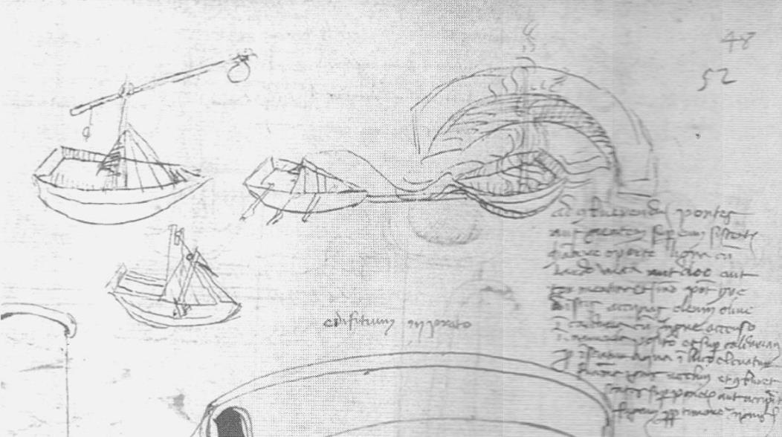
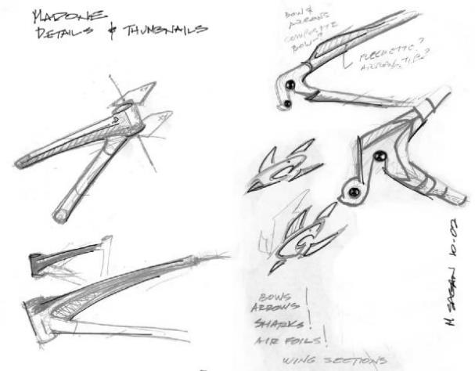
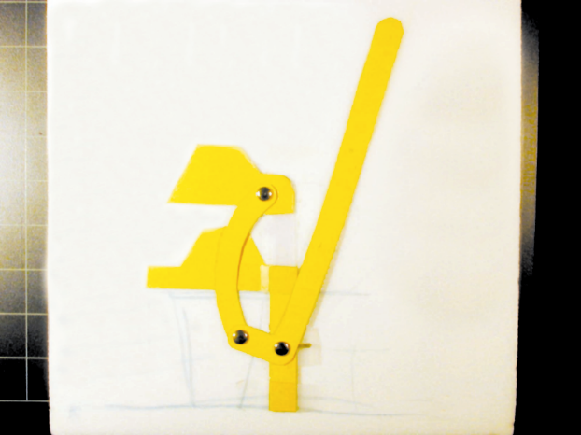
Sketches

Slide 40
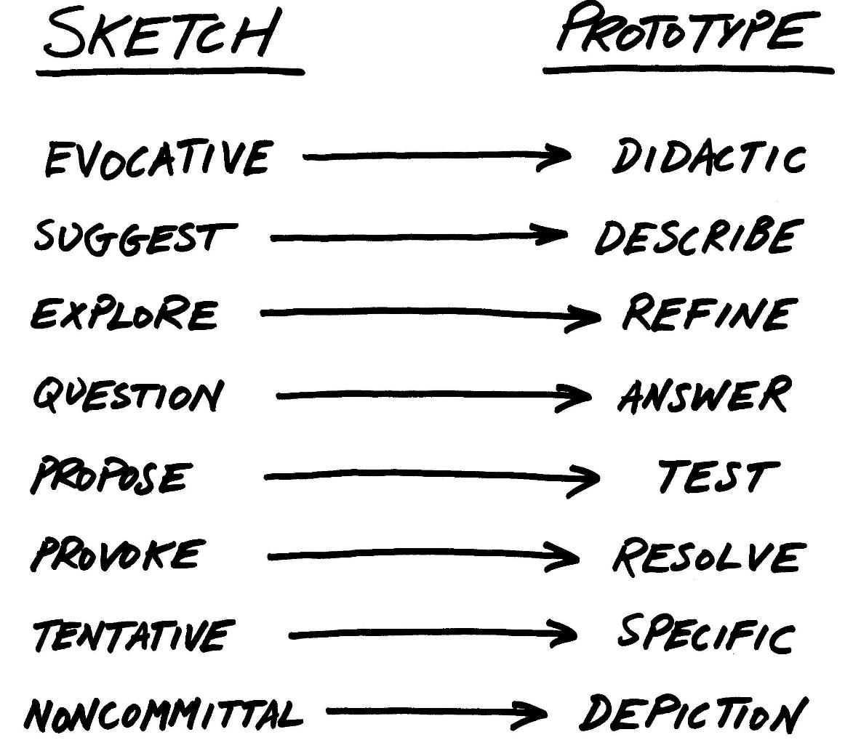

Slide 41
Attributes of a Sketch
Quick
Timely
Inexpensive
Disposable
Plentiful
Clear vocabulary
Minimal Detail
Appropriate Degree of Refinement
Suggest & explore rather than confirm
Ambiguity

Slide 42
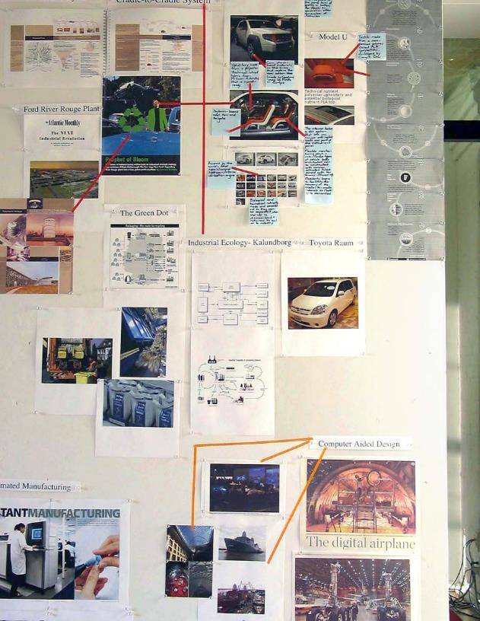
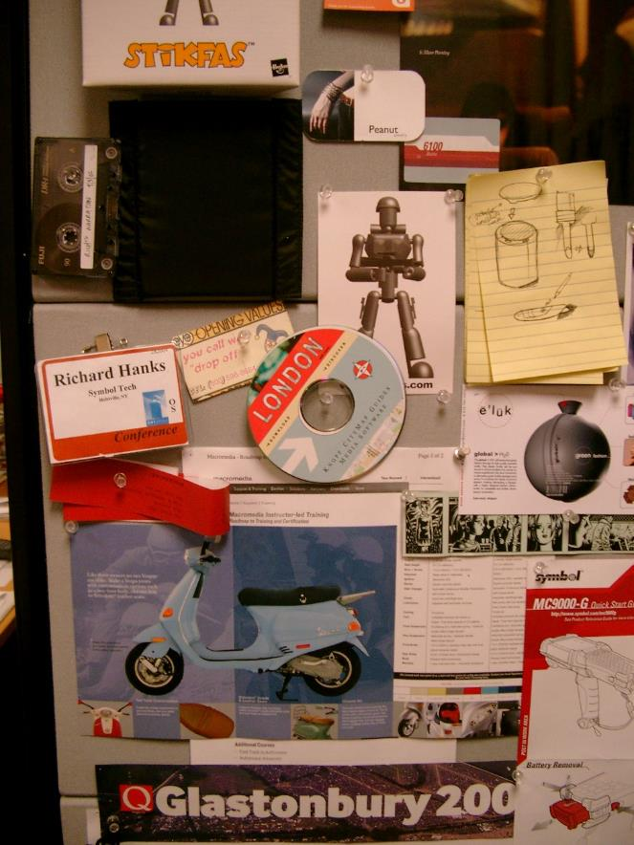
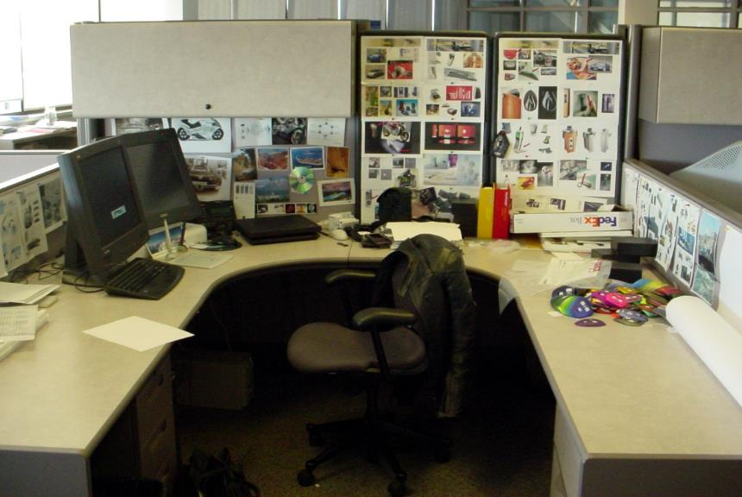
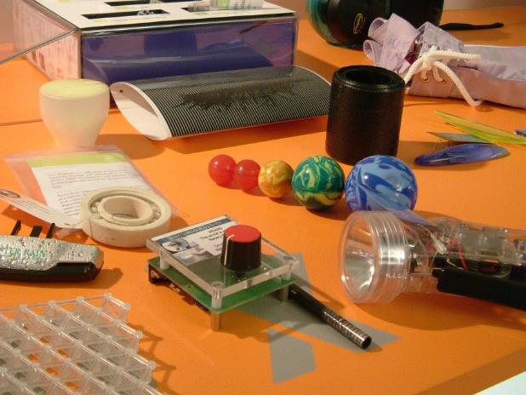
Examples of reference material …

Slide 43
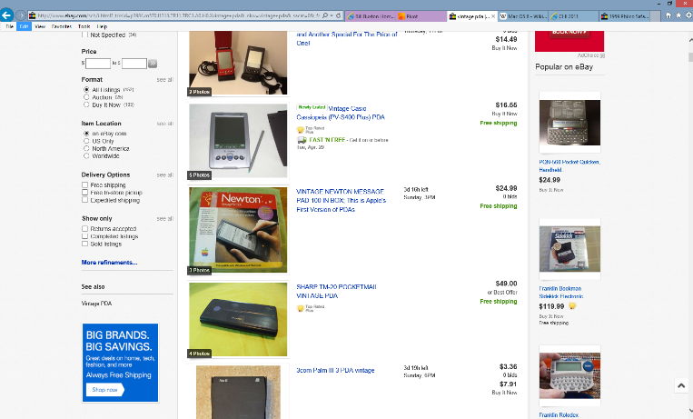
e-bay is one great place to prospect for samples that can serve as experiential sketches.

Slide 44
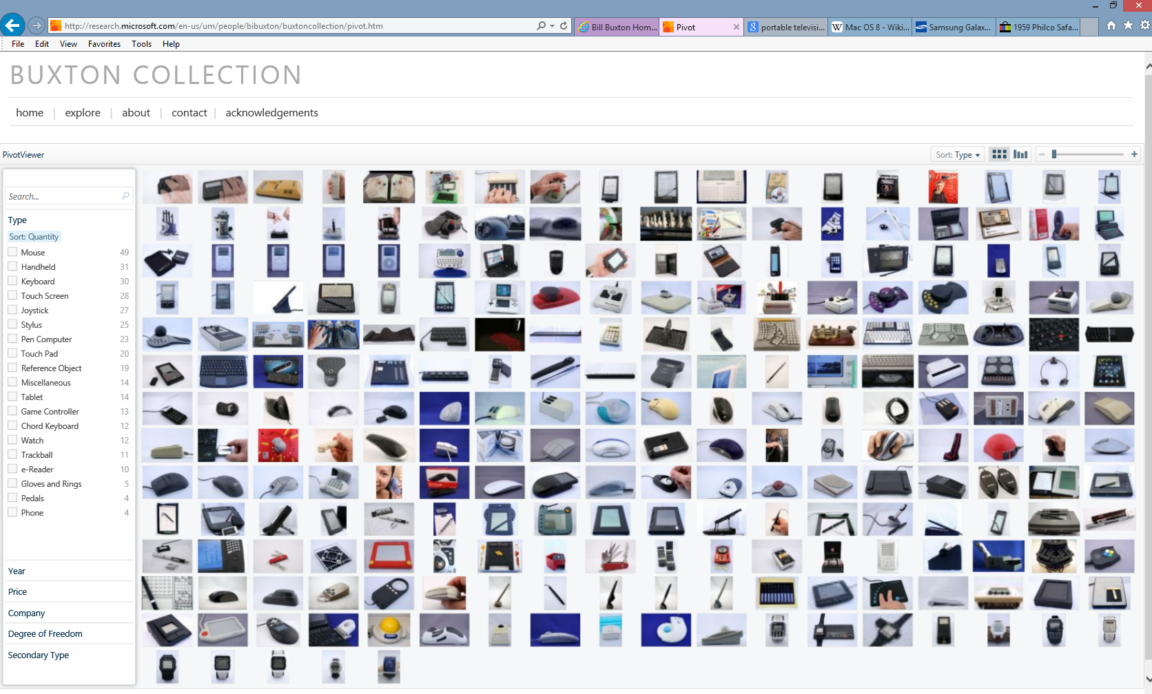
SIGCHI 2011
My collection.…

Slide 45
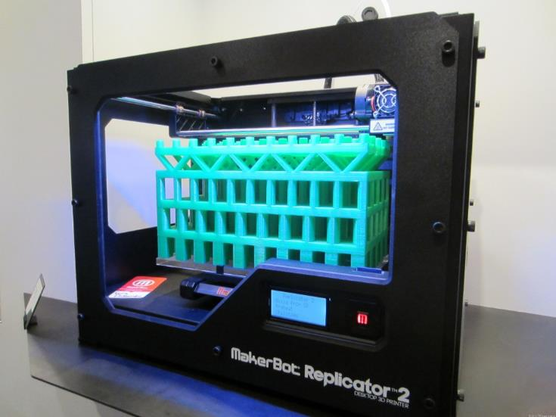
In light of the huge interest in the maker’s movement, to maintain balance, I think it important to understand that e-bay (a sampling tool) may be at least as important as, for example 3D printing, or Arduino (synthesis tools), in sketching experience.

Slide 46
Résumé
Habituellement, la créativité et l'innovation ne viennent pas d'une seule inspiration d'un génie. L'innovation est un processus d'améliorations incrementales qui, suite à beaucoup d'essais et de tentatives, peuvent finalement donner un grand succès. (Buxton parle du "long nez" de l'innovation, prenant 20-30 ans avant qu'une nouvelle technologie soit un grand succès.)
Même les "grands", comme Steve Jobs et Thomas Edison, ont seulement réussi grâce à beaucoup d'essais et d'erreurs par de grandes équipes d'employés qui ont amélioré des idées déjà existantes. Donc, ne vous attendez pas à tomber sur la bonne solution du premier coup, ni de tomber sur une solution complètement originale. Vous devez générer beaucoup d'idées et de solutions potentielles (en vous inspirant d'anciennes idées), et les retravailler en parallèle, avant de pouvoir juger de la meilleure à poursuivre en développement.
Les croquis (sketches) rapides sont une excellente façon d'explorer beaucoup d'idées rapidement. Les prototypes devraient venir plus tard.
Ne sous-estimez pas l'importance du design industriel et le design graphique, ce que Buxton appelle le "styling".

