Slide 1
Gesture Input and Gesture Recognition Algorithms

Slide 2
A few examples of gestural interfaces and gesture sets
(Think about what algorithms would be necessary to recognize the gestures in these examples.)

Slide 3
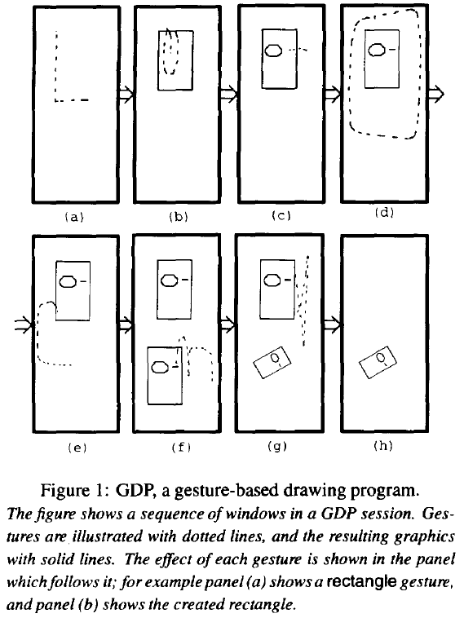
a) rectangle
b) ellipse
c) line
d) group
e) copy
f) rotation
g) delete (“x”)
Rubine, “Specifying gestures by example”, SIGGRAPH 1991,
https://scholar.google.ca/scholar?q=rubine+specifying+gestures+example

Slide 4
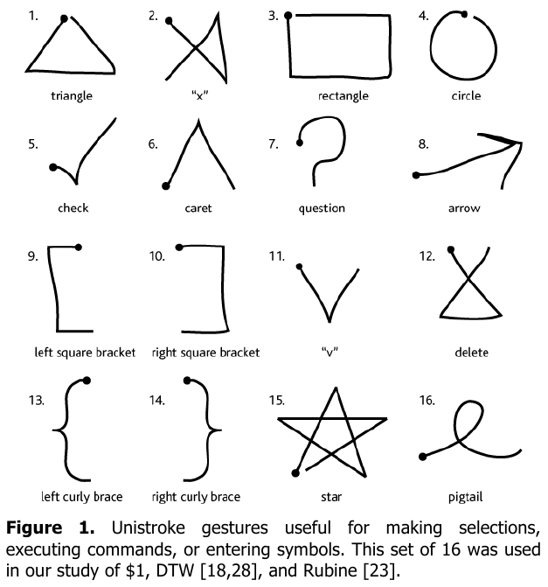
Wobbrock, Wilson, and Li. Gestures without libraries, toolkits or training: a $1 recognizer for user interface prototypes. UIST 2007
https://scholar.google.ca/scholar?q=wobbrock+wilson+gestures+without+libraries+toolkits+training+recognizer

Slide 5
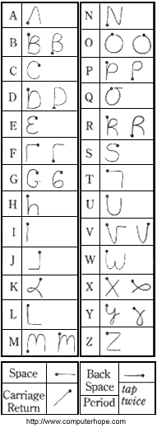
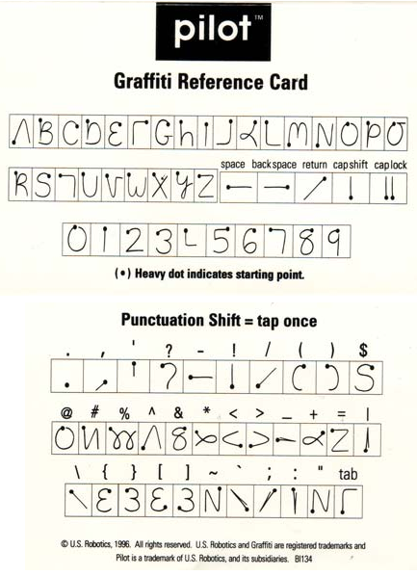
Graffiti
Notes:
Pilot graffiti reference card:
http://www.palminfocenter.com/news/8493/pilot-1000-retrospective/
Tall image showing multiple ways to enter certain characters:
http://www.computerhope.com/jargon/g/graffiti.htm
5

Slide 6
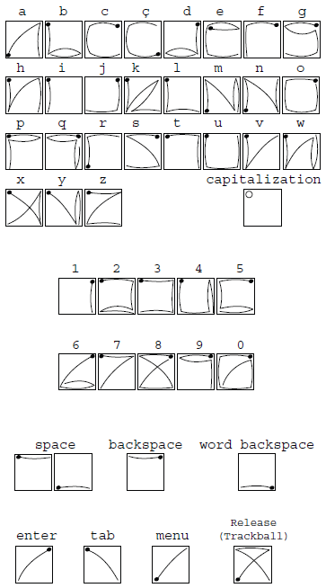
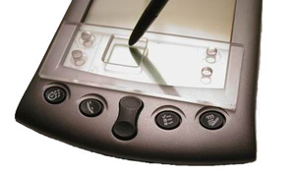
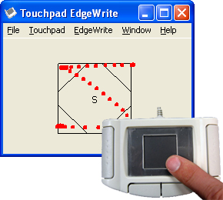
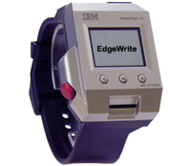
EdgeWrite ( http://depts.washington.edu/ewrite/ )
A mechanical way to simplify gesture recognition,
using physical constraints

Slide 7
EdgeWrite
How can we algorithmically distinguish these gestures?
Answer: find the order in which “corners” (triangular subregions) are visited, and look up the sequence in a dictionary

Slide 8
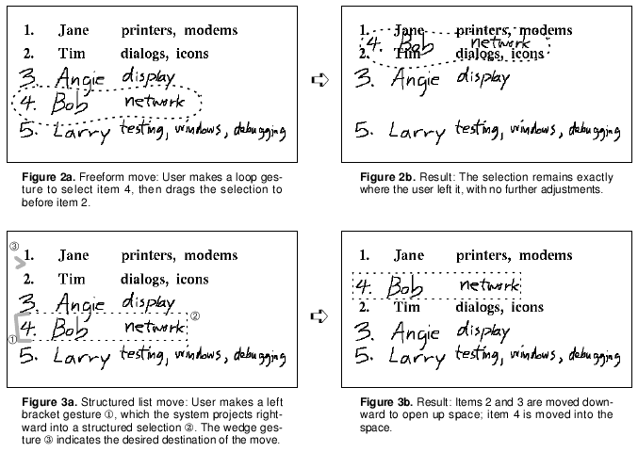
Tivoli
Moran, Chiu, van Melle, and Kurtenbach. Implicit Structure for Pen-based Systems within a Freeform Interaction Paradigm, CHI 1995
https://scholar.google.ca/scholar?q=moran+chiu+kurtenbach+implicit+structure+pen-based+systems+freeform+interaction

Slide 9
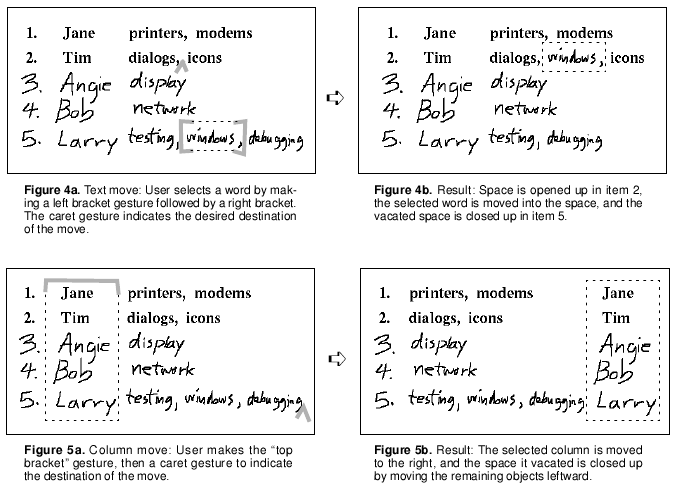
Tivoli
Moran, Chiu, van Melle, and Kurtenbach. Implicit Structure for Pen-based Systems within a Freeform Interaction Paradigm, CHI 1995
https://scholar.google.ca/scholar?q=moran+chiu+kurtenbach+implicit+structure+pen-based+systems+freeform+interaction

Slide 10
How does Tivoli detect rows and columns within sets of ink strokes?
Answer on next slide…

Slide 11
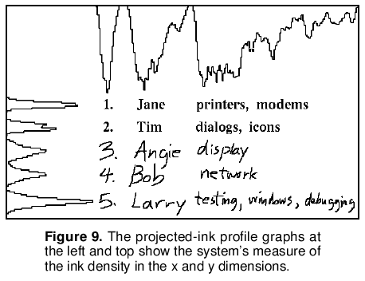
Tivoli
Moran, Chiu, van Melle, and Kurtenbach. Implicit Structure for Pen-based Systems within a Freeform Interaction Paradigm, CHI 1995
https://scholar.google.ca/scholar?q=moran+chiu+kurtenbach+implicit+structure+pen-based+systems+freeform+interaction

Slide 12
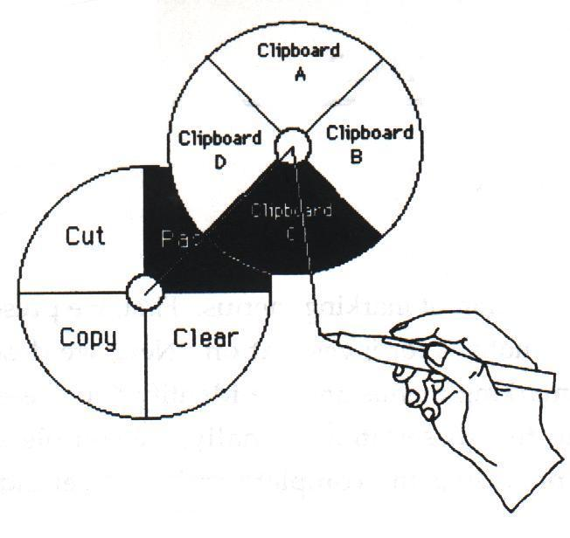
Hierarchical Radial Menu
From Gord Kurtenbach’s PhD thesis
Notes:
12

Slide 13
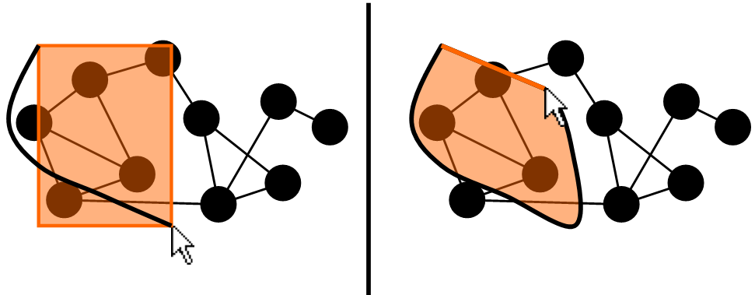
Combination rectangle + lasso selection
Remember!
Question: how can an algorithm distinguish between the gesture on the left and the one on the right?
Answer: check if (length_of_ink_trail) ÷ (straight_line_distance_from_start_to_end_of_drag) > 2.5

Slide 14
Gesture recognition algorithms

Slide 15
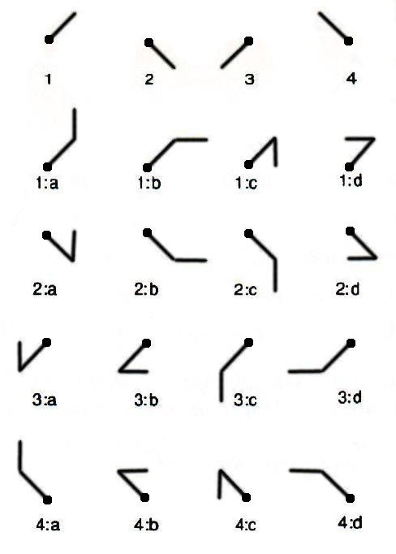
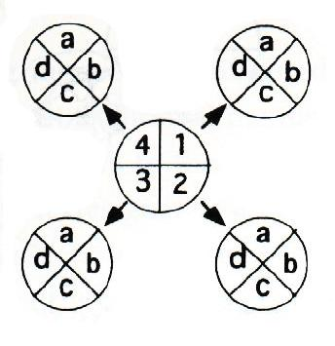
How would we algorithmically distinguish
Marking Menu strokes? (class discussion)
From Gord Kurtenbach’s PhD thesis

Slide 16
How do we find a “corner” in an ink stroke?
What about when the stroke is noisy? What about when there is sporadic noise?
(see written notes about filtering out noise)

Slide 17
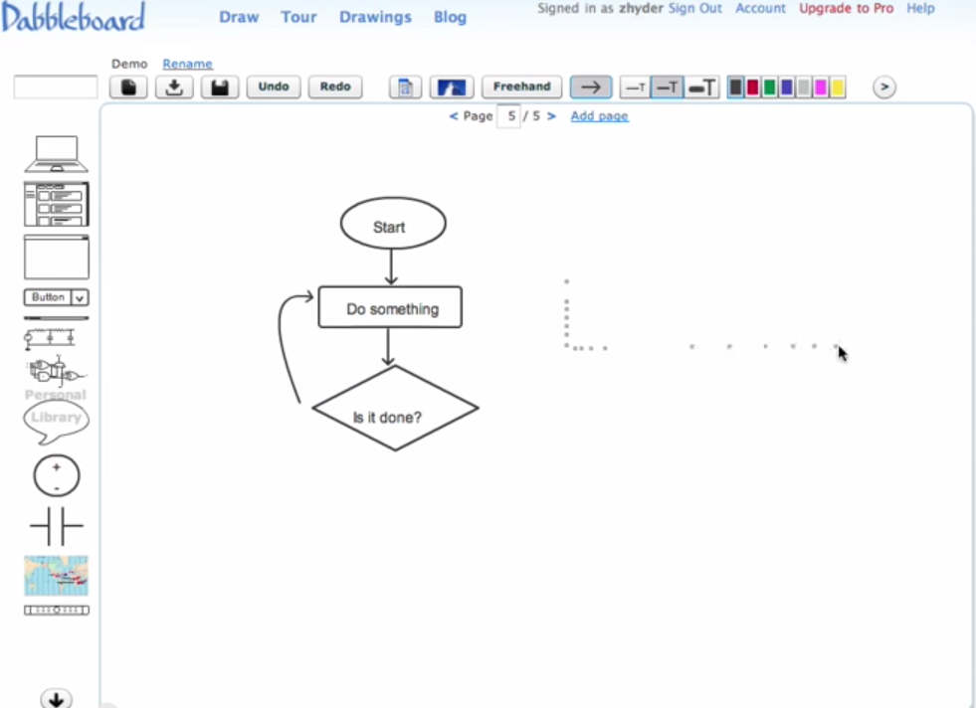
Dabbleboard https://www.youtube.com/watch?v=5kZDqiH_nGM

Slide 18
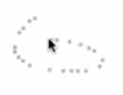
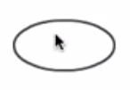
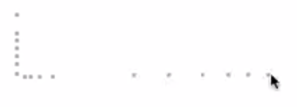
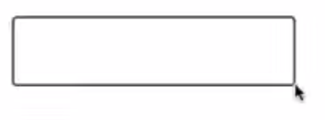
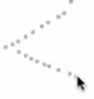
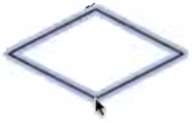
Dabbleboard https://www.youtube.com/watch?v=5kZDqiH_nGM

Slide 19
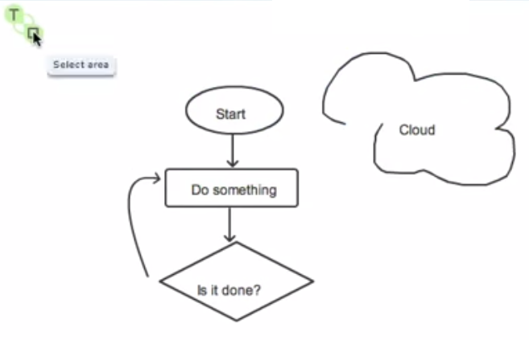

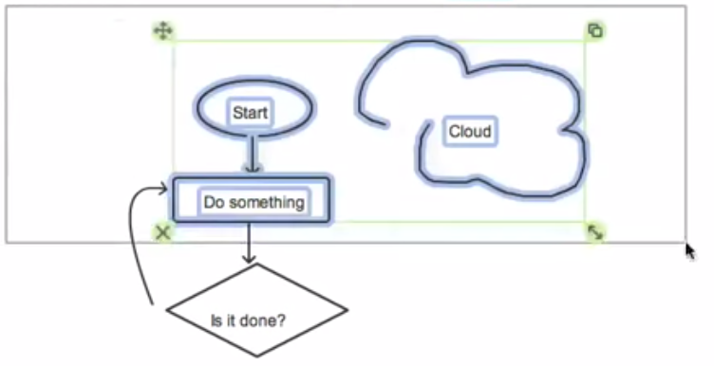
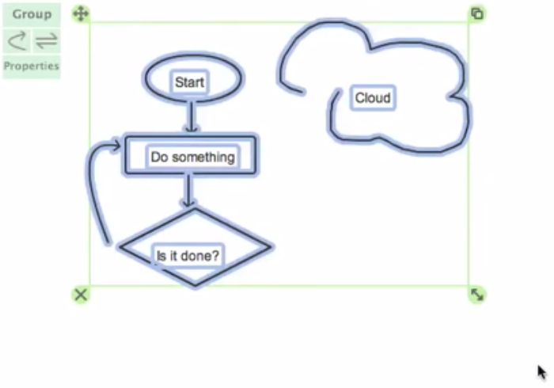
Dabbleboard https://www.youtube.com/watch?v=5kZDqiH_nGM
Click + typing:
entering text
Click + click + drag: rectangle selection
Widgets for moving, duplicating,
deleting, resizing

Slide 20
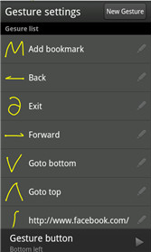
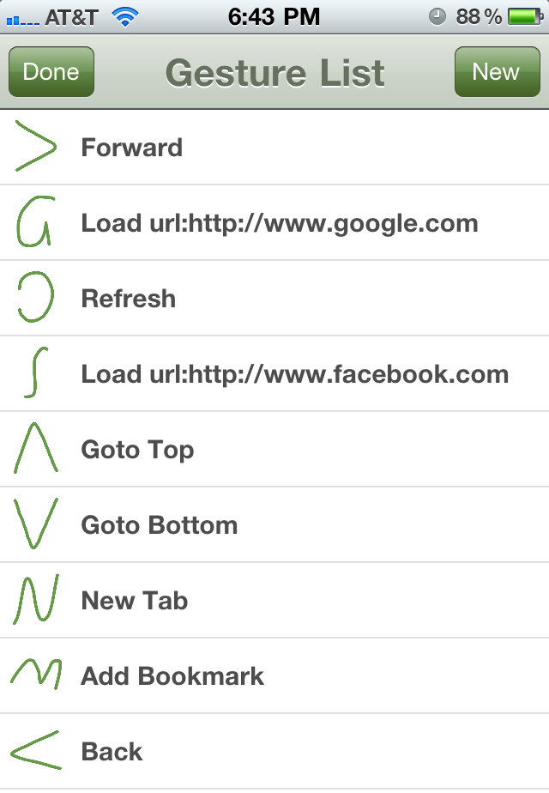
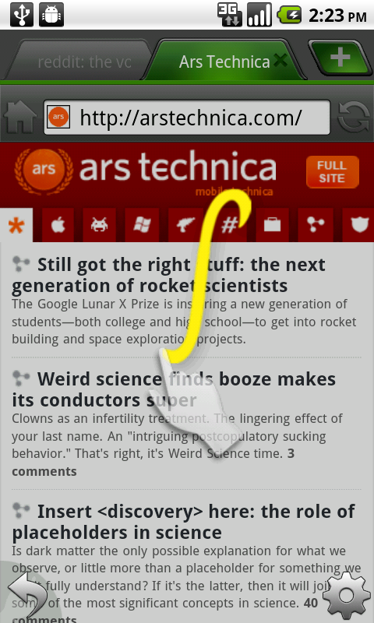
Web browser http://dolphin.com/

Slide 21
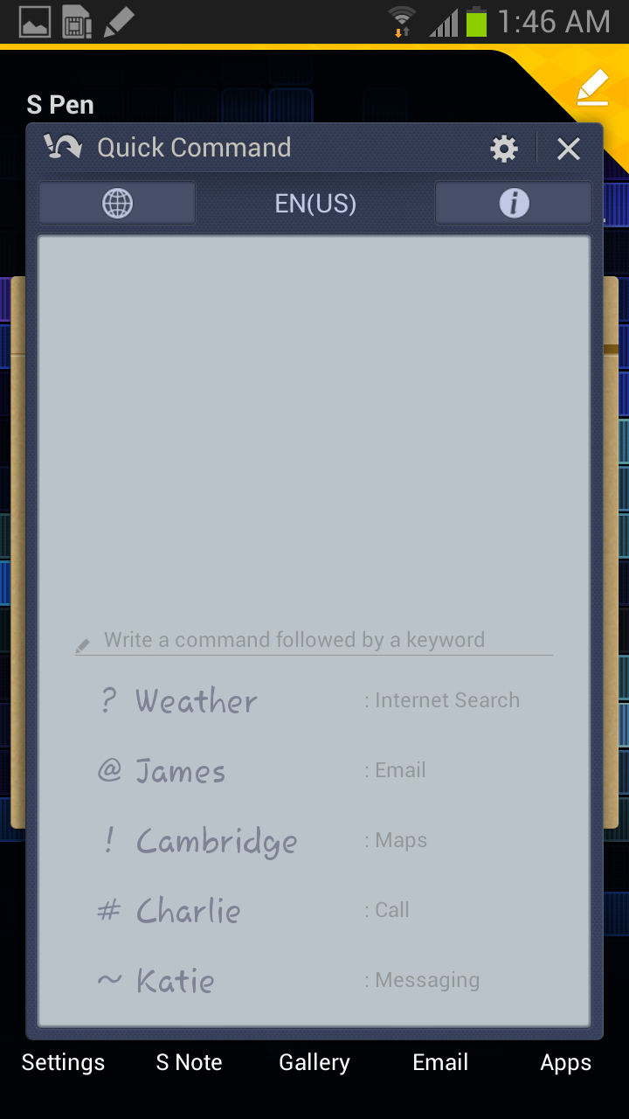
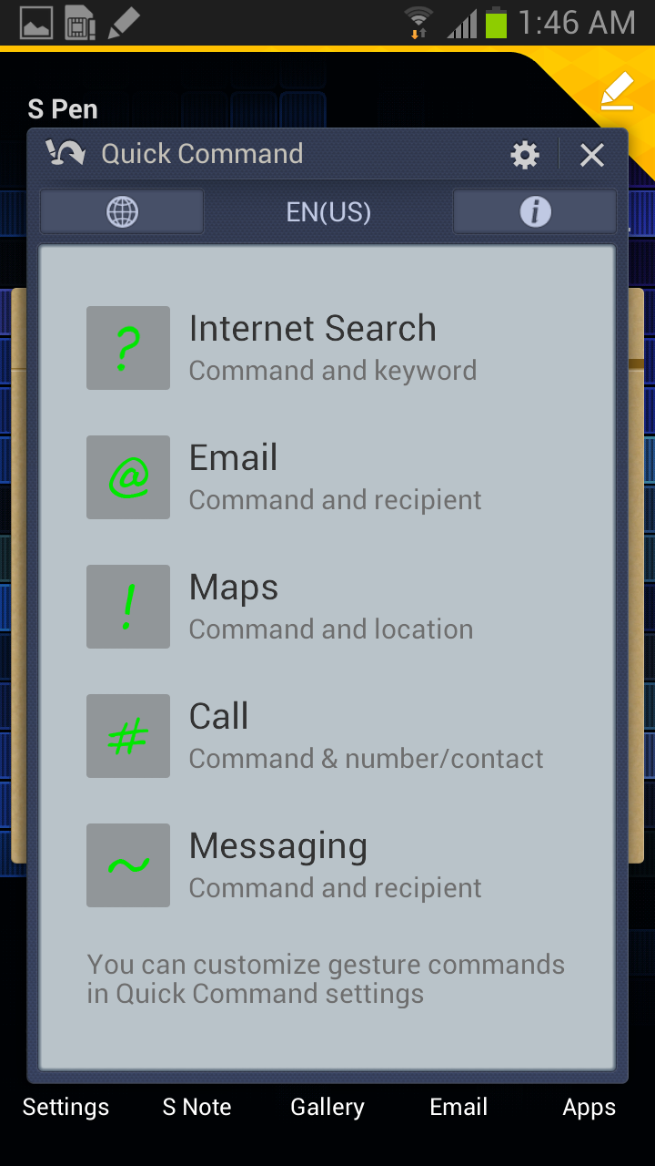
Samsung Galaxy Note

Slide 22
How can we allow a user (or designer) to define new gestures without writing code ?
Specify new gestures with examples!
  Requires performing some kind of “pattern matching” between the pre-supplied example gestures, and each gesture entered during interaction

Slide 23
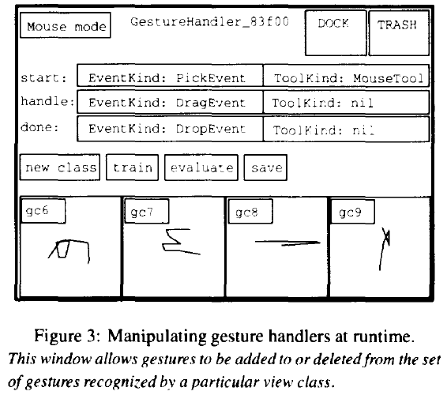
Rubine, “Specifying gestures by example”, SIGGRAPH 1991,
https://scholar.google.ca/scholar?q=rubine+specifying+gestures+example

Slide 24
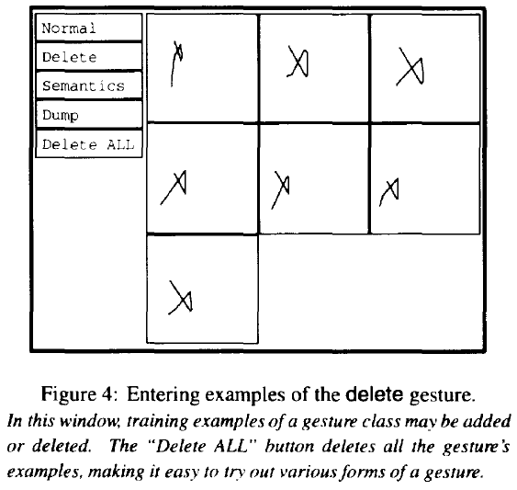
Rubine, “Specifying gestures by example”, SIGGRAPH 1991,
https://scholar.google.ca/scholar?q=rubine+specifying+gestures+example

Slide 25
Gesture recognition with Rubine’s algorithm (1991)
Remember!
Each gesture entered (and each example gesture) is reduced to a feature vector and corresponds to a point in some multidimensional space. We need some way to classify these points among the classes of gestures.
Successful recognition rate measured by Rubine > 95%

Slide 26
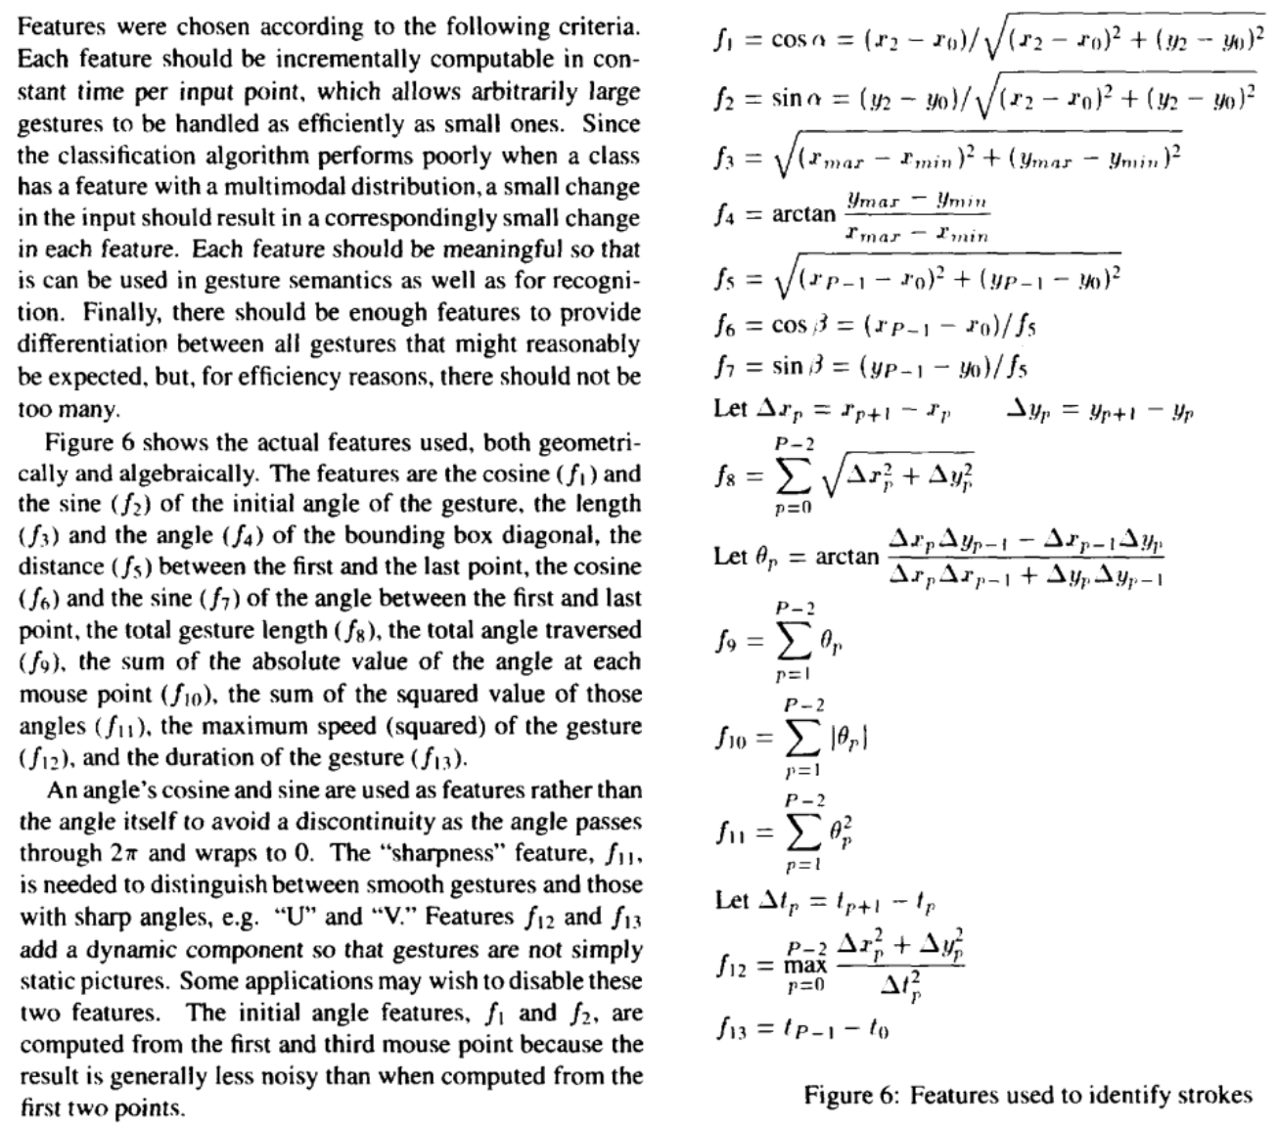
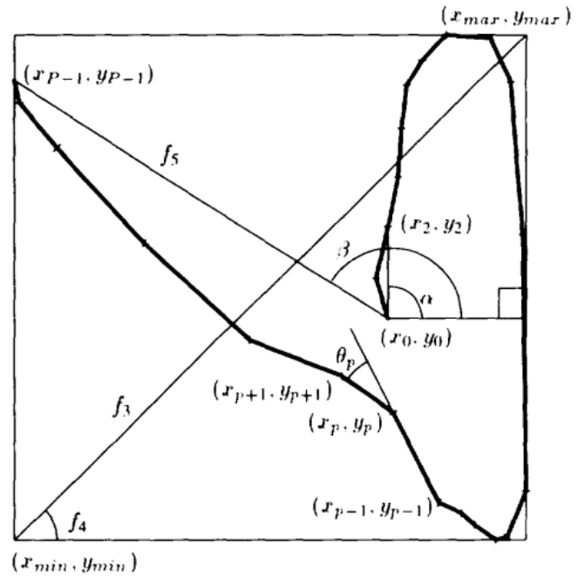
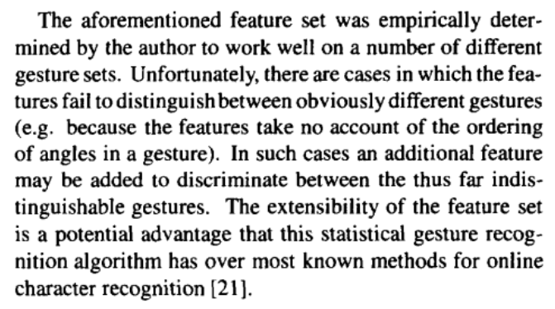
Rubine (1991) https://scholar.google.ca/scholar?q=rubine+%22specifying+gestures+by+example%22

Slide 27
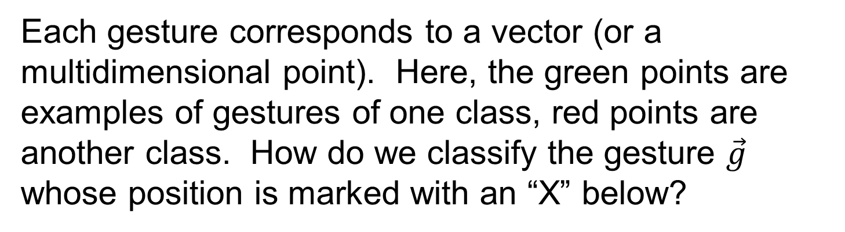

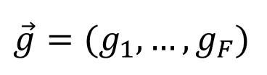
Each gesture corresponds to a vector (or a multidimensional point). Here, the green points are examples of gestures of one class, red points are another class. How do we classify the gesture $\vec{g}$ whose position is marked with an “X” below?
$$\vec{v_{c,e}}=(v_{c,e,1},…,v_{c,e,F})$$
$$\vec{g}=(g_{1},…,g_{F})$$
feature vector of an exemple
gesture to classify

Slide 28
1st solution: compare the distances between the new gesture and each example ("nearest neighbor" search)
- How do we calculate this distance?
- How much time will this take? (Assume F features (i.e., an F-dimensional space), C classes (or kinds of gestures), and E examples per class).
Remember!
$$\vec{v_{c,e}}=(v_{c,e,1},…,v_{c,e,F})$$
$$\vec{g}=(g_{1},…,g_{F})$$

Slide 29
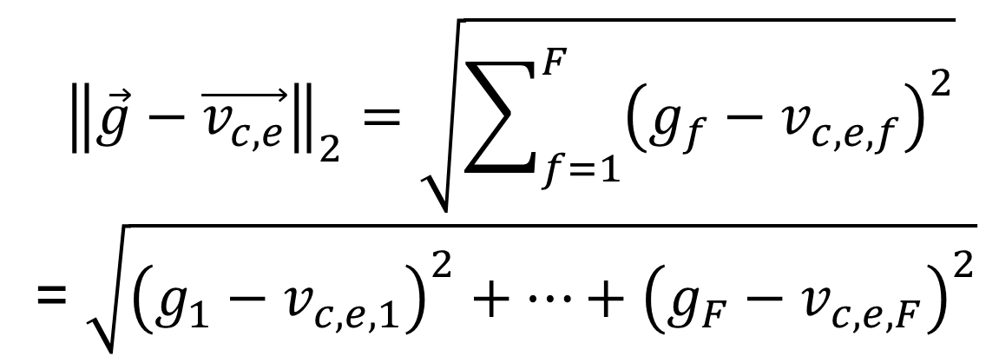
Distance between the gesture to classify and an exemple
Remember!
$${\left\|\vec{g}−\vec{v_{c,e}}\right\|}_{2}=\sqrt{\sum_{f=1}^{F}{{\left(g_{f}−v_{c,e,f}\right)}^{2}}}$$
= $\sqrt{{\left(g_{1}−v_{c,e,1}\right)}^{2}+…+{\left(g_{F}−v_{c,e,F}\right)}^{2}}$

Slide 30

2nd solution: pre-calculate the centroid of each class of examples ("k-means")
- How do we pre-calculate these centroids?
- How much time will this take?
- How do we then classify a new gesture?
- How much time will this take?
$$\vec{x_{c}}=(x_{c,1},…,x_{c,F})$$
centroid
Remember!
$$\vec{v_{c,e}}=(v_{c,e,1},…,v_{c,e,F})$$
$$\vec{g}=(g_{1},…,g_{F})$$

Slide 31
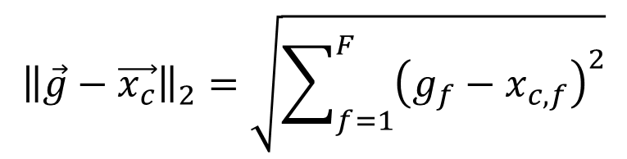
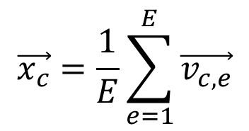
Calculating a centroid:
$$\vec{x_{c}}=\frac{1}{E}\sum_{e=1}^{E}{\vec{v_{c,e}}}$$
Remember!
Distance between the gesture to classify and a centroid:
$${\left\|\vec{g}−\vec{x_{c}}\right\|}_{2}=\sqrt{\sum_{f=1}^{F}{{\left(g_{f}−x_{c,f}\right)}^{2}}}$$

Slide 32
3rd solution (proposed by Rubine): pre-calculate hyperplanes to separate the examples (Support Vector Machine or SVM). See his paper for details. Below, an example of a case where SVM hyperplanes do a better job than centroids. K-means centroids would classify the point at “X” as red, but SVM would classify it as green. (In practice, such cases may be rare, and the extra complexity of programming SVM might not be worth the bother.)
Remember!
Dashed line: median between the centroids
Solid line: hyperplane that separates the red class from other examples

Slide 33
We have F features (i.e., an F-dimensional space),
C classes (or kinds of gestures), and E examples per class
Remember!
 | Time for pre-processing | Time to classify a gesture | Reliable?
1. Nearest neighbor | n/a | O( C E F ) | always
2. k-means centroids | O(C E F) to compute the centroids | O( C F ) | if the examples are linearly separable AND each class has approximately the same variance
3. Rubine’s SVM hyperplanes | Depends on the implementation. One iterative algorithm takes O( (number of iterations) C² E F ) to find good hyperplanes | O( C F ) | if the examples are linearly separable
Notes: approach 3 is the most complicated to program, while being slower than approach 2 and less reliable than approach 1. So, I recommend trying approaches 1 or 2 before trying approach 3.

Slide 34
Gesture recognition with the “$1” algorithm (Wobbrock et al., 2007) https://scholar.google.ca/scholar?q=wobbrock+wilson+%22gestures+without+libraries%2C+toolkits+or+training%22
$1 doesn’t use feature vectors; instead, it compares the geometry of a gesture with the geometry of each example, computing the point-by-point difference. This is easiest to do if all gestures have the same number of points.
In Wobbrock et al.’s 2007 article, the $1 approach is presented as one that only uses simple math operations, is easy to implement without libraries, and is fast, however this is in comparison to Rubine’s SVM hyperplane approach. If we simplify Rubine’s approach to classify feature vectors with nearest neighbor or k-means (as shown previously in the slides), then the feature vector approach becomes just as easy to implement and possibly faster than $1.
$1’s successful recognition rate is superior to Rubine’s, as measured by Wobbrock et al.
$1 involves a key step: resampling the gesture, so that the gesture and the examples all have the same number of points.
Time to classify a gesture: O( C E N ), where C is number of classes, E is number of examples per class, and N is number of points per example
(see written notes for more details)
Remember!

Slide 35
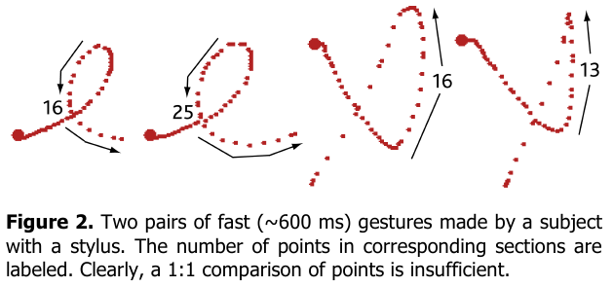
Wobbrock, Wilson, and Li. Gestures without libraries, toolkits or training: a $1 recognizer for user interface prototypes. UIST 2007
https://scholar.google.ca/scholar?q=wobbrock+wilson+gestures+without+libraries+toolkits+training+recognizer

Slide 36
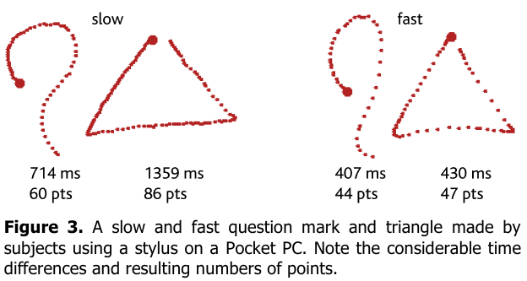
Wobbrock, Wilson, and Li. Gestures without libraries, toolkits or training: a $1 recognizer for user interface prototypes. UIST 2007
https://scholar.google.ca/scholar?q=wobbrock+wilson+gestures+without+libraries+toolkits+training+recognizer

Slide 37
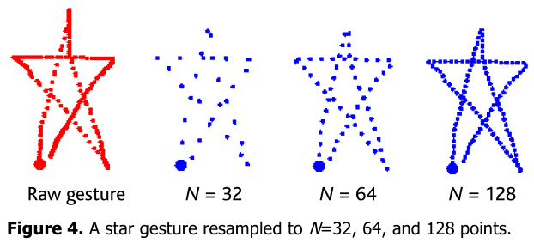
Wobbrock, Wilson, and Li. Gestures without libraries, toolkits or training: a $1 recognizer for user interface prototypes. UIST 2007
https://scholar.google.ca/scholar?q=wobbrock+wilson+gestures+without+libraries+toolkits+training+recognizer

Slide 38
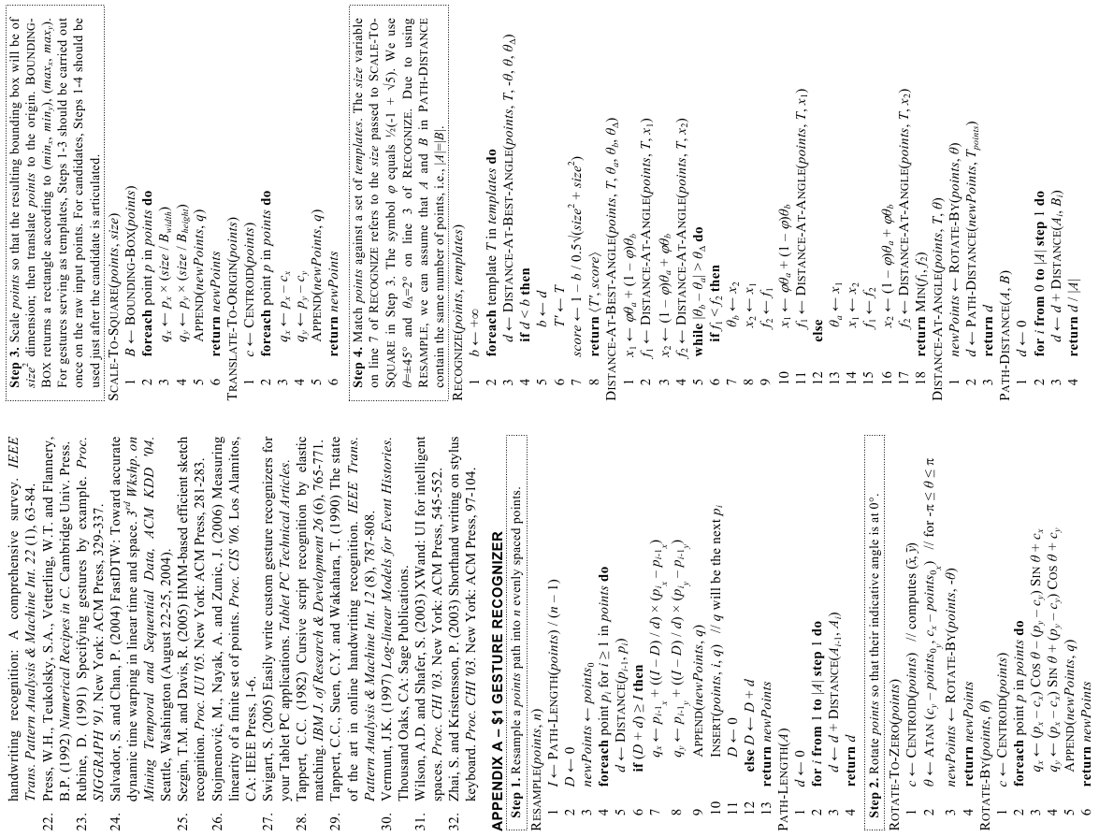
Wobbrock et al. (2007)
http://doi.acm.org/10.1145/1294211.1294238
Notes:
Wobbrock, J. O., Wilson, A. D., and Li, Y. 2007. Gestures without libraries, toolkits or training: a $1 recognizer for user interface prototypes. In Proceedings of the 20th Annual ACM Symposium on User interface Software and Technology (Newport, Rhode Island, USA, October 07 - 10, 2007). UIST '07. ACM, New York, NY, 159-168. DOI= http://doi.acm.org/10.1145/1294211.1294238

