Slide 1
JavaScript, HTML, DOM

Slide 2
Java vs JavaScript
"When Java applets failed, JavaScript became the 'Language of the Web' by default. [...] It is unfortunate that Java failed [as a language for web browsers]"
"JavaScript is the only language that is found in all browsers. [...] JavaScript is flourishing"
"In JavaScript, there is a beautiful, elegant, highly expressive language that is buried under a steaming pile of good intentions and blunders. [...It is] one of the most popular languages [...and] one of the most despised"
Source: Douglas Crockford, "JavaScript: The Good Parts", 2008, O'Reilly

Slide 3
JavaScript has both good parts and bad parts
Good parts: "JavaScript is built on some very good ideas and a few very bad ones. The very good ideas include functions, loose typing, dynamic objects, and an expressive object literal notation."
"JavaScript functions are first-class objects"; "functions are objects [...] functions can be stored in variables, objects, and arrays [...] can be passed as arguments to functions [...] can be returned from functions. Also, since functions are objects, functions can have methods."
Enables functional programming
Objects in JavaScript unify the notions of associative array / dictionary / hash table / mapping, are are easily serialized with JSON
Bad parts:
"JavaScript depends on global variables for linkage. All of the top-level variables of all compilation units are tossed together in a common namespace called the global object."
"The API of the browser, the Document Object Model (DOM) is quite awful"
Source: Douglas Crockford, "JavaScript: The Good Parts", 2008, O'Reilly

Slide 4
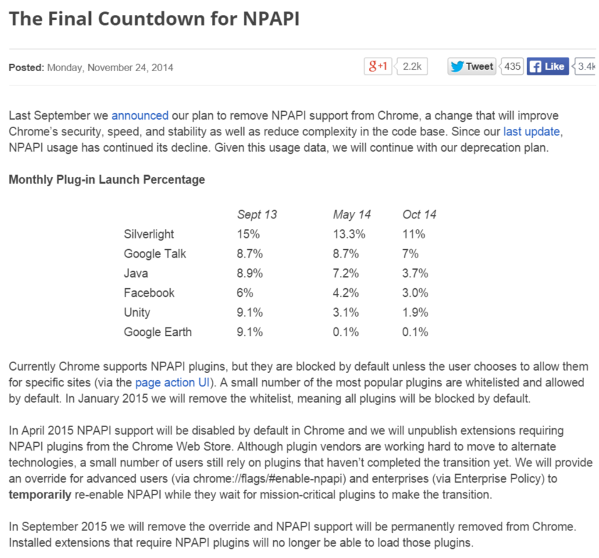

Slide 5
JavaScript: the language (ECMAScript 5, supported by Chrome 23+, IE 10+, FireFox 21+, Opera 15+, Safari 6+, iOS Safari 7+) http://kangax.github.io/compat-table/es5/ (For a bit of history about ECMAScript 4 and Adobe ActionScript 3: http://whydoeseverythingsuck.com/2008/08/ru-roh-adobe-screwed-by-ecmascript.html )

Slide 6
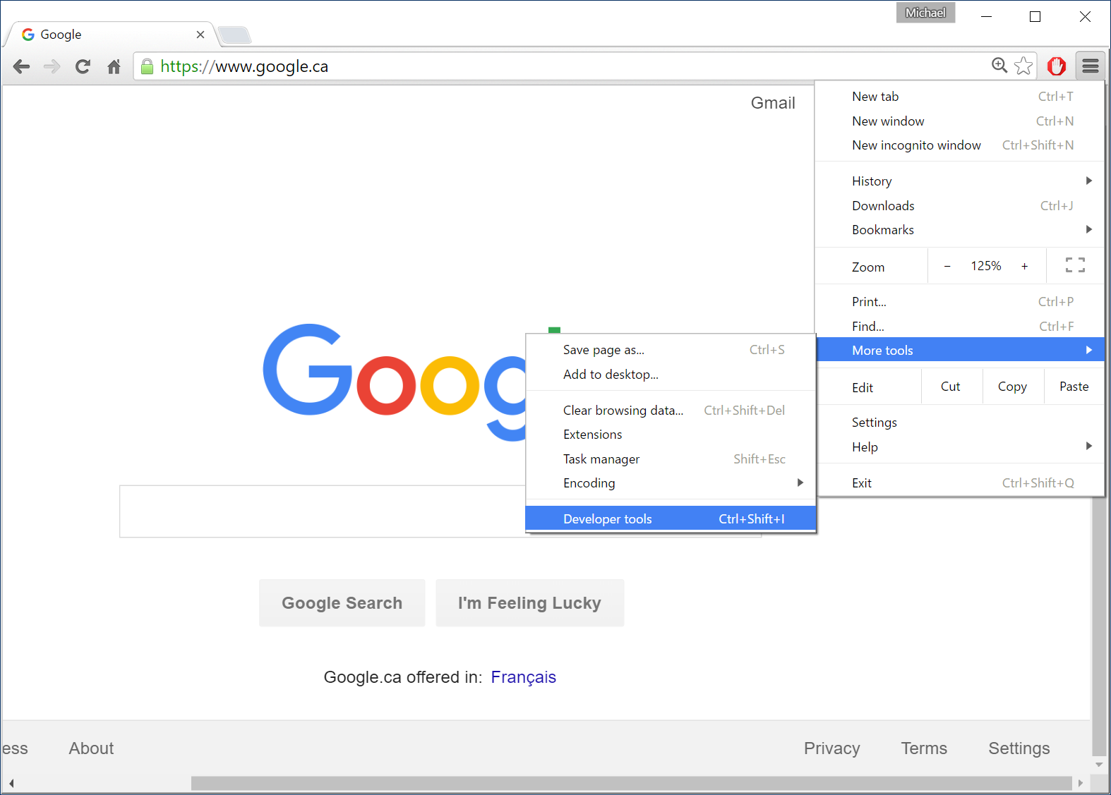

Slide 7
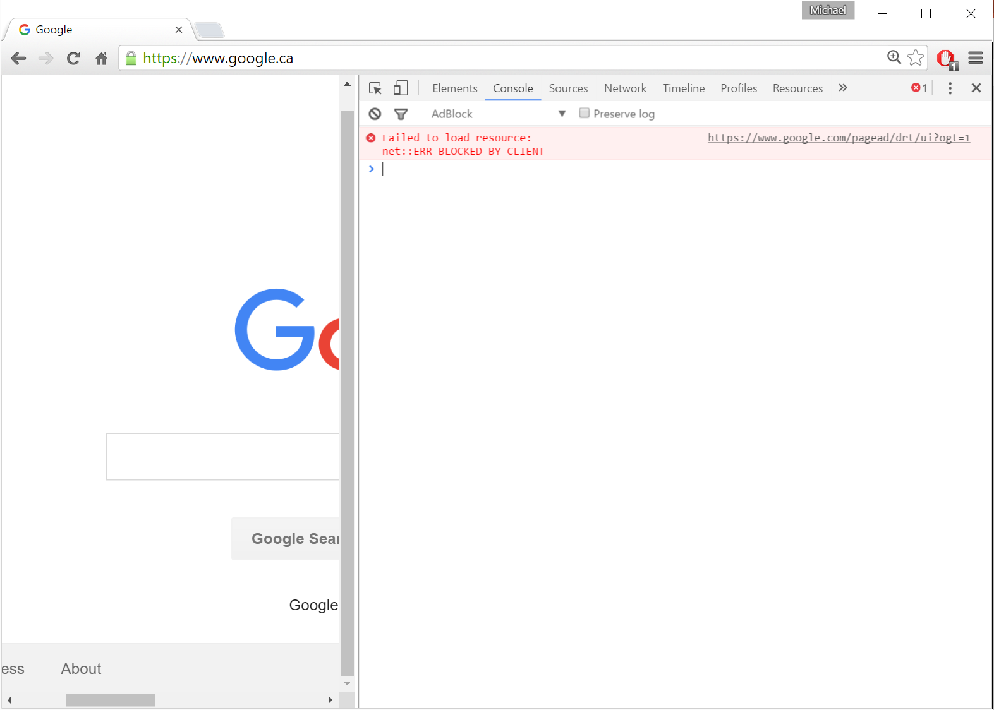
Console
prompt
Do Ctrl+mouse wheel
to change the font size

Slide 8
// boolean
var flag = true; // implicit type
flag = false;
// string
var fruitName = "apple"; // use " ...
fruitName = 'grape'; // ... or ' as quotes.
fruitName = 'or' + "ange"; // Use + to concatenate.
// The === sign compares the content of strings, not references:
fruitName === "orang" + "e" // true
fruitName.length === 6 // true
// Special characters: \", \', \\, \n (newline), \r (carriage return), \t (tab)
// Hexadecimal unicode: "\u0041" === "A",
// "\u2661" === "♡", '\uD83D\uDCA9' === "💩"
Remember!

Slide 9
// number: always stored in double precision floating point: 64 bits
1.0 === 1 // true
var x = 3; // x === 3;
x = 3.14; // x === 3.14
x = 355/113; // x === 3.1415929203539825
Math.floor(x) === 3 // integer part
x = 1/137; // approximates the fine structure constant
// x === 0.0072992700729927005
x = 1/0; // x === Infinity
x=0/0; // x === NaN
Remember!

Slide 10
Conversion between strings and numbers:
var x = 32;
x.toString() === "32"
x.toString(16) === "20" // base 16
parseInt("20") === 20
parseInt("20",16) === 32
The second parameter for parseInt() is the base, which is 10 by default. It is recommended that this base always be explicitly specified, otherwise, a string starting with zero might be interpreted in base 8 (octal), which is risky when working with dates.
parseInt("09") === 0 // before ECMAScript 5
parseInt("09") === 9 // ECMAScript 5
parseInt("0x100") === 256 // base 16, because the string starts with 0x

Slide 11
// comment
/* comment (avoid using this form…) */
… because */ might appear in a regular expression within a commented block of code, and get misinterpreted as the end of a comment

Slide 12
// Operators
// ! boolean negation
! true === false
// + - * / % arithmetic operators
12 % 5 === 2 // "modulo"; remainder of a division
12.3 % 5.1 === 2.1
// === !== < <= > >= equality and inequality
// There are also == and !=, but it is recommended that you avoid using these because they can cause implicit type conversions yielding unexpected results
// && || logical AND, logical OR
// ? : ternary operator
(a?b:c) // equal to b if a is true, otherwise equal to c

Slide 13
// Why are == and != to be avoided? They perform implicit type conversions.
'' == 0
0 == '0'
'' != '0' // so == is not transitive!
true != 'true'
false != 'false'
false == '0'
null == undefined
' \t\r\n ' == 0

Slide 14
// Be careful with implicit type conversions
'2'+'1' === "21" // string + string === string
'2'-'1' === 1 // string - string === number
'2'+1 === "21" // string + number === string
'2'-1 === 1 // string - number === number
'2' + + '1' === "21"
'foo' + + 'bar' === "fooNaN"
'2' + - '1' === "2-1"
'2' + - + - - + - - + + - + - + - + - - - '-1' === "21"
var x = 3;
'2' + x - x === 20
'2' - x + x === 2

Slide 15
if ( expression1 ) {
...
}
else if ( expression2 ) {
...
}
else {
...
}
Remember!

Slide 16
These two code blocks are equivalent:
switch ( expression ) { case a: ... break; case b: ... break; default: ... }
if ( expression === a ) { ... } else if ( expression === b ) { ... } else { ... }

Slide 17
for ( statement1; statement2; statement3 ) {
body;
}
// ... is equivalent to ...
statement1;
while ( statement2 ) {
body;
statement3;
}
Remember!

Slide 18
// Be careful ...
var x = 17.6; // implicit type
...
x = "seventeen"; // implicit type change: no warning!
Is the var keyword necessary when defining a variable? No, but ... "If you use var the variable is declared within the scope you are in (e.g. of the function). If you don't use var, the variable bubbles up through the layers of scope until it encounters a variable by the given name or the global object (window, if you are doing it in the browser), where it then attaches. It is then very similar to a global variable. [...] This is [...] one of the most dangerous issues with javascript [...] it's easy to forget var and have by accident a common variable name bound to the global object. This produces weird and difficult to debug behavior." -- http://stackoverflow.com/questions/2485423/is-using-var-to-declare-variables-optional

Slide 19
// Object
continent1 = {
name : "North America",
population : 530000000, // 530 million
area : 24709000 // in km2
};
continent1.name === "North America" // like a Java object
continent1["name"] === "North America" // like a dictionary
// We can dynamically add properties
continent1.populationDensity = continent1.population / continent1.area;
continent1.populationDensity === 21.449674207778543
// We can remove properties
delete continent1.area;
continent1.area === undefined
property
name
Remember!
value

Slide 20
// Array
var poutine = [ "fries", "cheese", "sauce" ];
poutine[1] === "cheese"
poutine.length === 3
poutine[4] = "bacon" // no warning or error!
poutine[4] === "bacon"
poutine[3] === undefined
poutine.length === 5
poutine[3] = "maple syrup"
poutine.length === 5
poutine.push("salt"); // to add to the end of the array
poutine === ["fries", "cheese", "sauce", "maple syrup", "bacon", "salt"]
Remember!

Slide 21
// The sieve of Eratosthenes
MAX = 100; // compute list of primes up to, and possibly including, this value
integerIsPrime = [ false, false ]; // integers 0, 1 are both non-prime (composite)
maxCandidate = Math.floor(Math.sqrt(MAX));
// Any integers <= MAX that are composite
// have at least one factor <= maxCandidate.
// Thus, we only need to check for factors >=2 and <= maxCandidate.
for ( candidate = 2; candidate <= maxCandidate; candidate ++ ) {
if ( integerIsPrime[ candidate ] === undefined )
// candidate is a prime number
integerIsPrime[ candidate ] = true;
if ( integerIsPrime[ candidate ] ) {
// candidate is a prime number.
// Mark all integers divisible by candidate as non-prime.
// Don't bother marking integers < candidate*candidate,
// because if they are composite, they must have a factor < candidate,
// and they would have been marked on an earlier pass.
for ( j = candidate*candidate; j <= MAX; j += candidate )
integerIsPrime[j] = false;
}
}
// Any remaining undefined entries in integerIsPrime are also prime
arrayOfPrimes = [];
for ( j = 0; j < integerIsPrime.length; j++ ) {
if ( integerIsPrime[ j ]===true || integerIsPrime[ j ]===undefined )
arrayOfPrimes.push( j );
}

Slide 22
// Array (continued)
poutine === ["fries", "cheese", "sauce", "maple syrup", "bacon", "salt"]
subArray = poutine.splice(2,1); // starting index, and how many to extract
subArray === ["sauce"]
poutine === ["fries", "cheese", "maple syrup", "bacon", "salt"]
subArray = poutine.splice(1,3);
subArray === ["cheese", "maple syrup", "bacon"]
poutine === ["fries", "salt"]
// Use .shift() instead of .splice(0,1) to remove the first element.
// An array may contain a mix of types!
var jumble = [ 2, true, "salad", { x:100,y:200 } , [3, 4] ];
jumble[3].x === 100
jumble[4][0] === 3
Remember!

Slide 23
// We can nest objects (or arrays)
// inside other objects (or arrays)
var prof = {
name : "McGuffin",
extension : "x8418",
courses : [ "GTI350", "GTI745", "MGL835" ]
};
var students = [
{ name : "Tremblay", courses : [ "GTI745", ... ] },
{ name : "Bouchard", courses : [ "GTI745", ... ] }, ...
];
prof.courses[2] === "MGL835"
students[1].courses[0] === "GTI745"
Remember!

Slide 24
// A for in loop on an object
var prof = {
name : "McGuffin",
extension : "x8418",
courses : [ "GTI350", "GTI745", "MGL835" ]
};
for ( var j in prof ) {
// j is a string containing the name of a property in prof.
// There is no guarantee that we will visit the properties
// in the same order that they were defined!
console.log( "prof." + j + " === " + prof[ j ] + " and j is a " + typeof(j) );
}
// output:
prof.name === McGuffin and j is a string
prof.extension === x8418 and j is a string
prof.courses === GTI350,GTI745,MGL835 and j is a string

Slide 25
// A for in loop on an array
var courses = [ "GTI350", "GTI745", "MGL835" ];
for ( var j in courses ) {
// j is a string containing the index of an element in courses.
// There is no guarantee that we will visit the elements
// in ascending order!
console.log( "courses[" + j + "] === " + courses[ j ] + " and j is a " + typeof(j) );
}
// output:
courses[0] === GTI350 and j is a string
courses[1] === GTI745 and j is a string
courses[2] === MGL835 and j is a string

Slide 26
// typeof
typeof( myObject )
// ... can yield:
// "boolean", "number", "string", "function", "object", "undefined"
typeof(null) === "object"
typeof(undefined) === "undefined"
var myObject = { x:1, y:2 };
typeof(myObject) === "object"
var myArray = [ 1, 2, 3 ];
typeof(myArray) === "object"
// How can we distinguish between normal objects and arrays?
if ( a && typeof(a)==="object" && a.constructor===Array ) {
// a is an array
}
When a is null, the if is cancelled

Slide 27
// Function
var myTwoNorm = function twoNorm( x, y, z ) {
return Math.sqrt( x*x + y*y + z*z );
}
// twoNorm is the name of the function. If this name is not given,
// the function is anonymous. This name is useful for doing recursion.
// myTwoNorm is a variable storing the function.
var result = myTwoNorm(1,2,3); // 3.7416573867739413
// Even if the caller doesn’t provide enough arguments, or too many arguments,
// the call still executes
var result = myTwoNorm(1,2); // z is undefined
// result === NaN

Slide 28
// Function (continued)
// For each call, the function receives two implicit parameters:
// this (an object), and arguments (an array with a .length).
// There are a few ways to call a function:
// 1. "function invocation pattern"
myTwoNorm(1,2,3); // this is the global object (In other words, when the code inside the function uses this, it will be referring to the global object, which is window in the case of code inside a web browser)
// 2. "apply invocation pattern" (apply() is a method that is automatically defined on all functions)
myTwoNorm.apply( myObj, [1,2,3] ); // this is myObj
// It’s as if myTwoNorm were a method on myObj. Using this invocation pattern, we can effectively call a function as if it were a method on any object!

Slide 29
// Function (continued 2)
// 3. "method invocation pattern"
var myVector3D = {
x:0, y:0, z:0,
twoNorm : function ( ) {
return Math.sqrt( this.x*this.x + this.y*this.y + this.z*this.z );
}
}
myVector3D.twoNorm();
// 4. "constructor invocation pattern" with the new keyword: we’ll return to this later

Slide 30
// Function (continued 3)
// Functions are objects, and therefore can have properties,
// be passed as arguments, be returned from functions,
// or be stored in an array or in an object.
myTwoNorm.maxArguments = 3;
myTwoNorm.author = "McGuffin";
myTwoNorm.someMethod = function() { ... };
var meanFunctions = [ function(a,b){return 0.5*(a+b)},
function(a,b){return Math.sqrt(a*b)}, function(a,b){return 1/(1/a+1/b)}
];
var pickABinaryFunction = function(){ return meanFunctions[1]; }
var c = pickABinaryFunction()(4,25); // c === 10, the geometric mean of 4 and 25
returns a function

Slide 31
JavaScript has no built-in support for a class of objects, but supports multiple ways of doing object-oriented programming. How can we create multiple instances of an object with shared methods, where each instance has its own copy of data? We can first define an object that serves as a prototype, and then create subsequent objects that inherit from the prototype. (Doing the same thing in Java or C++ would instead involve a class and no inheritance.) The prototype object provides the function definitions and initial values of data members.
var Point2D = { // Capitalized name makes it look like a class, but this is really a (prototype) object.
x:0, y:0,
norm : function ( ) {
return Math.sqrt( this.x*this.x + this.y*this.y );
}
}
var myPoint1 = Object.create( Point2D ); // Object.create() creates a 2nd object that inherits …
var myPoint2 = Object.create( Point2D ); // … its properties from the given object.
// Object.create() is explained more in the annex.
// Initially, myPoint1 and myPoint2 inherit all their properties (data and methods)
// from Point2D.
// But as soon as we assign a new value to a property (e.g., data member) of an object,
// this will mask the value of the prototype without changing the other object.
myPoint1.x = 10; // myPoint2.x still inherits a value of 0

Slide 32
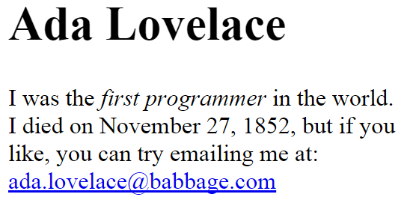
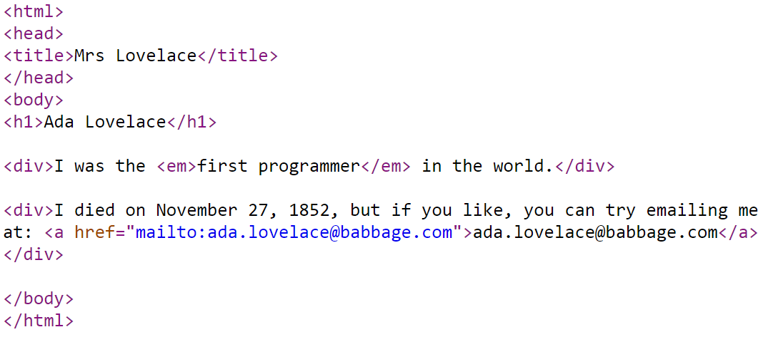
HTML

Slide 33
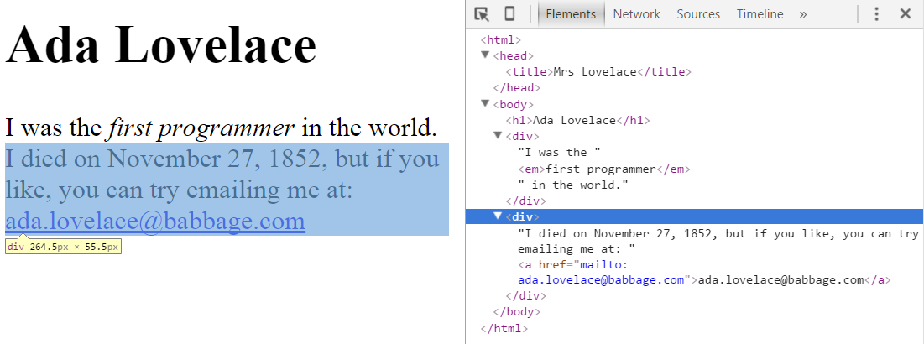
The DOM (Document Object Model) is a tree of elements in a web page

Slide 34
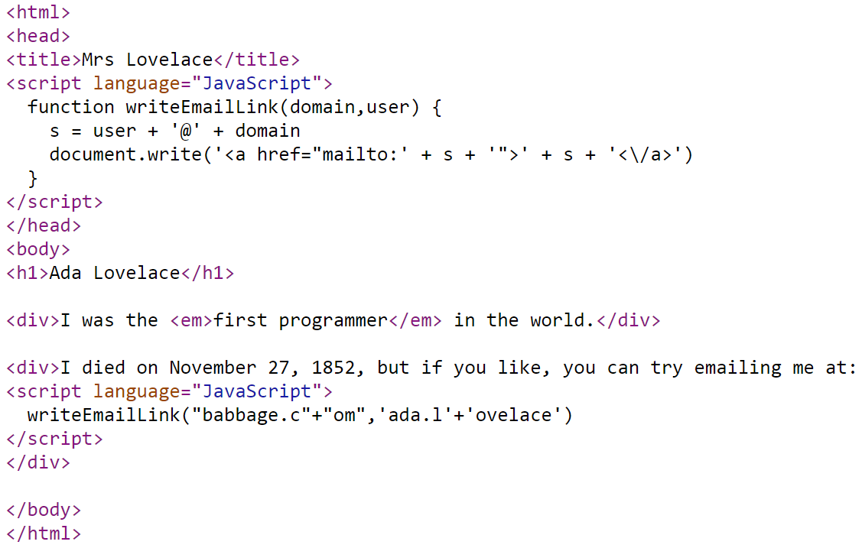
HTML + JavaScript
This example uses JavaScript to protect the email address from spammers that use web crawlers to harvest email addresses.

Slide 35
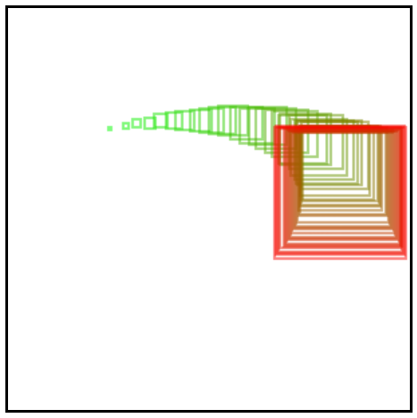
<html><body> <canvas id="canv" width="300" height="300" style="border:2px solid black;"> </canvas> <script>
var canvas = document.getElementById("canv");
var c = canvas.getContext("2d");
var t = []; // array of mouse coordinates
var redraw = function() {
c.clearRect( 0, 0, canvas.width, canvas.height );
for ( i = 0; i < t.length; i=i+1 ) {
var x = t[i][0];
var y = t[i][1];
var size = 2*i;
var f = Math.round( 255 * i / t.length );
c.strokeStyle = "rgb(" + f + "," + (255-f) + ",0)";
c.strokeRect( x-size/2, y-size/2, size, size );
}
}
var mouseMotion = function(e) {
var rectangle = canvas.getBoundingClientRect();
var x = e.clientX - rectangle.left;
var y = e.clientY - rectangle.top;
t.push( [ x, y ] ); // add an element to the end of the array
if ( t.length > 50 )
t.shift(); // remove first element from the array
redraw();
}
canvas.addEventListener('mousemove',mouseMotion);
</script></body></html>
Save this out to a .html file and open it in a browser. You should see this following your mouse cursor:

Slide 36
Annex: inheritance and derived objects

Slide 37
// How do we create derived objects?
// Approach in Java:
class baseClass { ... };
class derivedClass extends baseClass {
public derivedClass () { ... } // Note: the constructor is inside the devired class.
}
// JavaScript has no classes, but does have a notion of a constructor,
// which is a kind of function used to create a derived object
// that inherits from a base object.
// Keep in mind that, in JavaScript, functions are objects.
// Functions can therefore contain other objects.
// And actually, in JavaScript, the constructor contains the base object.

Slide 38
// How do we create derived objects? (continued 1)
// The constructor contains the base object, or more precisely,
// the constructor has a property that stores the base object.
// The base object is called the prototype.
// The constructor is used to create a derived object that inherits the properties of the prototype.
var vehicle = { speed : 0 } // base object
// By convention, the name of a constructor starts with an uppercase letter
var VehicleConstructor = function VC() {
// the code here is for initializing the new object, but could also remain empty
};
VehicleConstructor.prototype = vehicle; // base object
var airplane = new VehicleConstructor(); // derived object that is created
// airplane inherits the speed property of vehicle
airplane.speed === vehicule.speed // We say that airplane delegates to vehicle
airplane.__proto__ === vehicle
vehicle.hasOwnProperty('speed') === true
airplane.hasOwnProperty('speed') === false

Slide 39
// How do we create derived objects? (continued 2)
// Douglas Crockford, in his 2008 book "JavaScript: The Good Parts",
// finds the above way of creating derived objects ugly,
// and so he proposes hiding the details in a generic method:
if ( typeof(Object.create) !== 'function' ) {
Object.create = function(o) {
var F = function() {}; // constructor
F.prototype = o;
return new F();
}
}
var airplane = Object.create(vehicle);
// Crockford also recommends not using new elsewhere, because if we use it
// with a function that is not supposed to be used like a constructor,
// it could yield strange results.
This Object.create() method now seems to be defined by default in modern JavaScript platforms. Try using it interactively in Chrome, for example.

Slide 40
The preceding discussion might seem complicated. What if we just want to do object-oriented programming without anything like a class hierarchy (or object hierarchy). How is this done in JavaScript?
At least 3 approaches are possible :
1. If you only want one instance of your object (like a singleton), use object literal notation:
var videoGameBoss = {
strength:1000, life:100, isAlive:true,
sufferDamage : function ( ) {
this.life -= 5;
if ( this.life <= 0 ) this.isAlive = false;
}
}
videoGameBoss.sufferDamage();
if ( videoGameBoss.isAlive ) …

Slide 41
2. How can we create multiple instances of an object with shared methods, where each instance has its own copy of data? We can first define an object that serves as a prototype, and then create subsequent objects that inherit from the prototype. (Doing the same thing in Java or C++ would instead involve a class and no inheritance.) The prototype object provides the function definitions and initial values of data members.
var Point2D = { // Capitalized name makes it look like a class, but this is really a (prototype)
x:0, y:0,
norm : function ( ) {
return Math.sqrt( this.x*this.x + this.y*this.y );
}
}
var myPoint1 = Object.create( Point2D ); // Object.create() creates a 2nd object that inherits …
var myPoint2 = Object.create( Point2D ); // … its properties from the given object.
// Initially, myPoint1 and myPoint2 inherit all their properties (data and methods) // from Point2D. // But as soon as we assign a new value to a property of one of the objects, // it will mask the value of the prototype without changing the other object.
myPoint1.x = 10; // myPoint2.x still inherits a value of 0

Slide 42
3. An alternative to the preceding approach:
function Point2D() {
this.x = 0;
this.y = 0;
this.norm = function() { return Math.sqrt( this.x*this.x + this.y*this.y ); }
this.methode2 = function() { ... }
}
var myPoint1 = new Point2D();
var myPoint2 = new Point2D();
// Disadvantage of this 3rd approach: each new instance implies // a new redundant copy of each method, wasting time and memory. // Advantage: Point2D is a function, and therefore could take arguments // to specify how to initialize each new instance, for example: var myPoint3 = new Point2D( x3, y3 );

Slide 43
More information on object-oriented programming in JavaScript:
http://www.htmlgoodies.com/beyond/javascript/object.create-the-new-way-to-create-objects-in-javascript.html
http://javascriptissexy.com/oop-in-javascript-what-you-need-to-know/
http://code.tutsplus.com/tutorials/the-basics-of-object-oriented-javascript--net-7670
More information on derived objects:
http://javascript.crockford.com/prototypal.html
http://kevinoncode.blogspot.ca/2011/04/understanding-javascript-inheritance.html
http://pivotallabs.com/javascript-constructors-prototypes-and-the-new-keyword/

Slide 44
Annex: examples of functional programming in JavaScript
More examples of functional programming in JavaScript : https://www.youtube.com/watch?v=e-5obm1G_FY&t=5m2s (Anjana Vakil)
More about functional programming, in Python
https://maryrosecook.com/blog/post/a-practical-introduction-to-functional-programming
(Mary Rose Cook)

Slide 45
Examples of functional programming
array1 = ["dog","cat","horse","octopus"];
array1 = array1.filter(function(e) { return e != "octopus"; });
// result: ["dog","cat","horse"]
array2 = [3, 4, 5 ];
array2 = array2.map( function(e) { return e+10; });
// result: [13, 14, 15]

Slide 46
Examples of functional programming with d3 (a JavaScript library for doing visualization)
students = [
{math:75, physics:81, chemistry:68, soft_eng:84, music:92 },
{math:62, physics:64, chemistry:50, soft_eng:70, music:75 },
{math:90, physics:88, chemistry:79, soft_eng:92, music:65 },
];
// d3.keys(students[0]) returns ["math", "physics", "chemistry", "soft_eng", "music"]
// d3.extent([20,15,92,60]) returns [15, 92], i.e. the min and max of the array
courses = d3.keys(students[0]).filter(function(c) { return c !== "music"; });
// result: ["math", "physics", "chemistry", "soft_eng"]
intervalOfMarksByCourse = {};
courses.forEach(function(c) {
intervalOfMarksByCourse[c] = d3.extent(students, function(e) { return e[c]; });
});
// result: intervalOfMarksByCourse equals
// { chemistry:[50,79], soft_eng:[70,92], math:[62,90], physics:[64,88] }

Slide 47
Examples of functional programming with d3 (a JavaScript library for doing visualization)
var marks = [
[ "mary", "math", 82 ], [ "mary", "chemistry", 94 ], [ "john", "math", 80 ], [ "john", "chemistry", 88 ],
[ "peter", "math", 60 ], [ "peter", "chemistry", 75 ]
];
d3.nest()
.key(function(e){return e[0]})
.entries(marks);
// Result:
[
{
key: "mary",
values: [ ["mary","math",82], ["mary","chemistry",94] ]
},
{
key: "john",
values: [ ["john","math",80], ["john","chemistry",88] ]
},
{
key: "peter",
values: [ ["peter","math",60], ["peter","chemistry",75] ]
}
]

Slide 48
Examples of functional programming with d3 (a JavaScript library for doing visualization)
var marks = [
[ "mary", "math", 82 ], [ "mary", "chemistry", 94 ], [ "john", "math", 80 ], [ "john", "chemistry", 88 ],
[ "peter", "math", 60 ], [ "peter", "chemistry", 75 ]
];
averageMarks = d3.nest()
.key(function(e){return e[0]})
.rollup(function(e){return d3.mean(e, function(e2) { return e2[2]; })})
.entries(marks);
// Result:
[
{
key: "mary",
values: 88
},
{
key: "john",
values: 84
},
{
key: "peter",
values: 67.5
}
]

Slide 49
Examples of functional programming with d3 (a JavaScript library for doing visualization)
// content of averageMarks:
[
{
key: "mary",
values: 88
},
{
key: "john",
values: 84
},
{
key: "peter",
values: 67.5
}
]
averageMarks2 = averageMarks.map( function(e){return [e.key, e.values];} );
// Result:
[ ["mary",88], ["john",84], ["peter",67.5] ]

Slide 50
Examples of functional programming with d3 (a JavaScript library for doing visualization)
// content of averageMarks:
[
{
key: "mary",
values: 88
},
{
key: "john",
values: 84
},
{
key: "peter",
values: 67.5
}
]
averageMarks3 = {};
averageMarks.forEach(function(e) {
averageMarks3[e.key] = e.values;
});
// Result: {mary: 88, john: 84, peter: 67.5}

Slide 51
Examples of functional programming with d3 (a JavaScript library for doing visualization)
var marks = [
[ "mary", "math", 82 ], [ "mary", "chemistry", 94 ], [ "john", "math", 80 ], [ "john", "chemistry", 88 ],
[ "peter", "math", 60 ], [ "peter", "chemistry", 75 ]
];
averageMarksByCourse = d3.nest()
.key(function(e){return e[1]})
.rollup(function(e){return d3.mean(e, function(e2) { return e2[2]; })})
.entries(marks)
.map( function(e){return [e.key, e.values];} );
// Resultat: [["math",74],["chemistry",85.67]]

