Slide 3
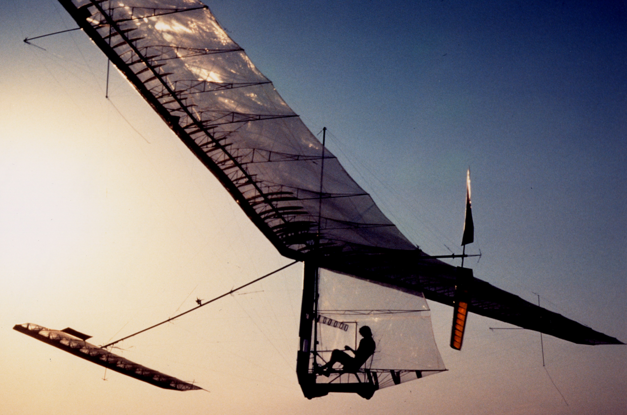
Paul MacCready and the Gossamer Condor
Human-powered aircraft that won the Kremer prize in 1977
Other teams spent months building a prototype, only for it to crash on the first try
MacCready had the insight that they needed a much faster way to iterate. His team’s prototype was made of mylar, wire, and aluminum tubes. His team could iterate in less than a day.
Lesson: seek a way to fail fast to learn and iterate faster
http://www.azarask.in/blog/post/the-wrong-problem/ ;
https://en.wikipedia.org/wiki/Gossamer_Condor

Slide 4
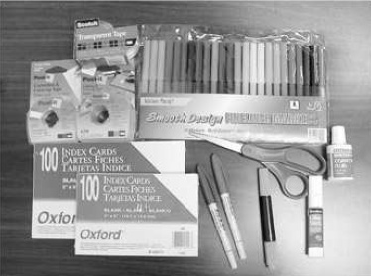
Paper prototypes
Static (though a human may simulate feedback); low fidelity
Easy to make and modify
Made with paper,
transparent sheets,
sticky notes (“post-its”),
cardboard, scissors, tape, pencils, pens, ...

Slide 5
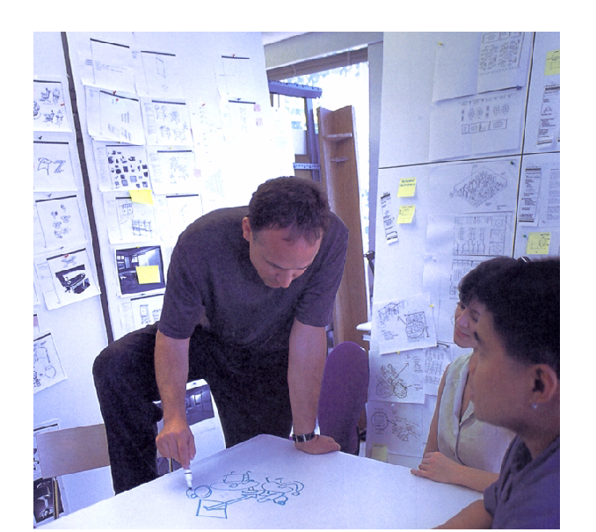
Design office at IDEO
From a paper by Guimbretière, Stone, Winograd, UIST 2001

Slide 6
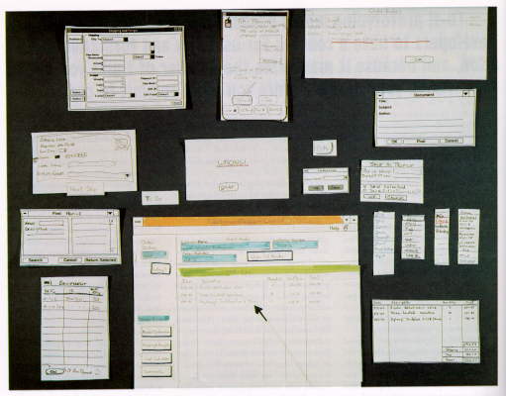
From Rettig (1994), “Prototyping for tiny fingers”, CACM

Slide 7
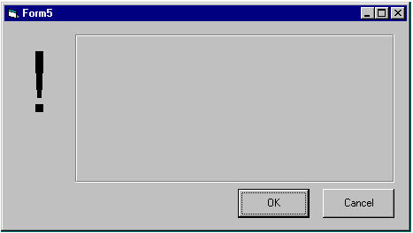

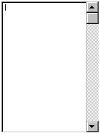
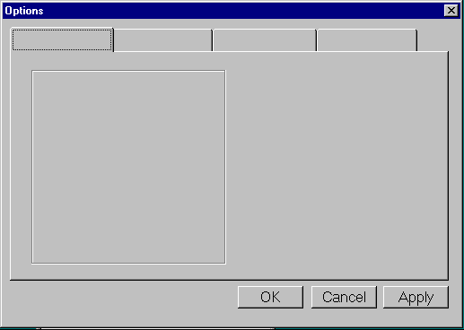
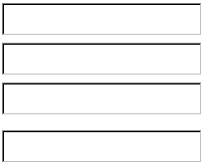
Examples …
We can print out empty interface components to serve as templates
For example, the below components were created with Visual Basic:
Button
Menu
Alert
Drop-down list
Scrollable list
Tabs
Text fields

Slide 8
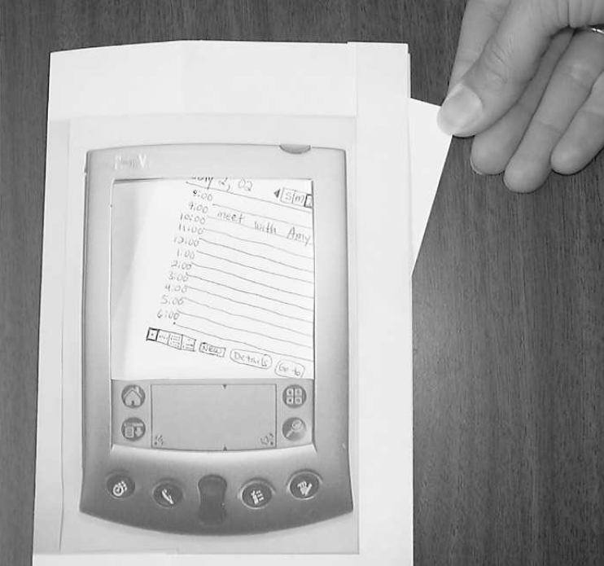
Palm Pilot physical frame
Image from Carolyn Snyder, "Paper Prototyping: The Fast and Easy Way to Design and Refine User Interfaces"

Slide 9
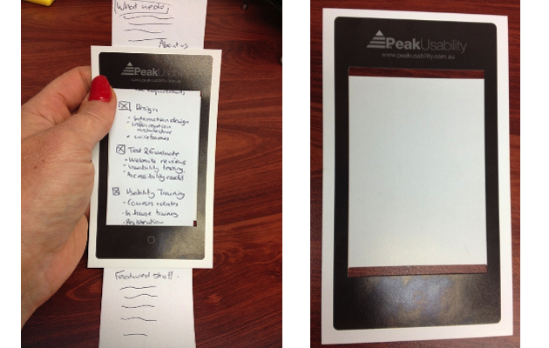
Simulated scrolling
http://uxmag.com/sites/default/files/uploads/lang-8-mobile-testing-lessons/mobile-paper-prototype.jpg

Slide 10
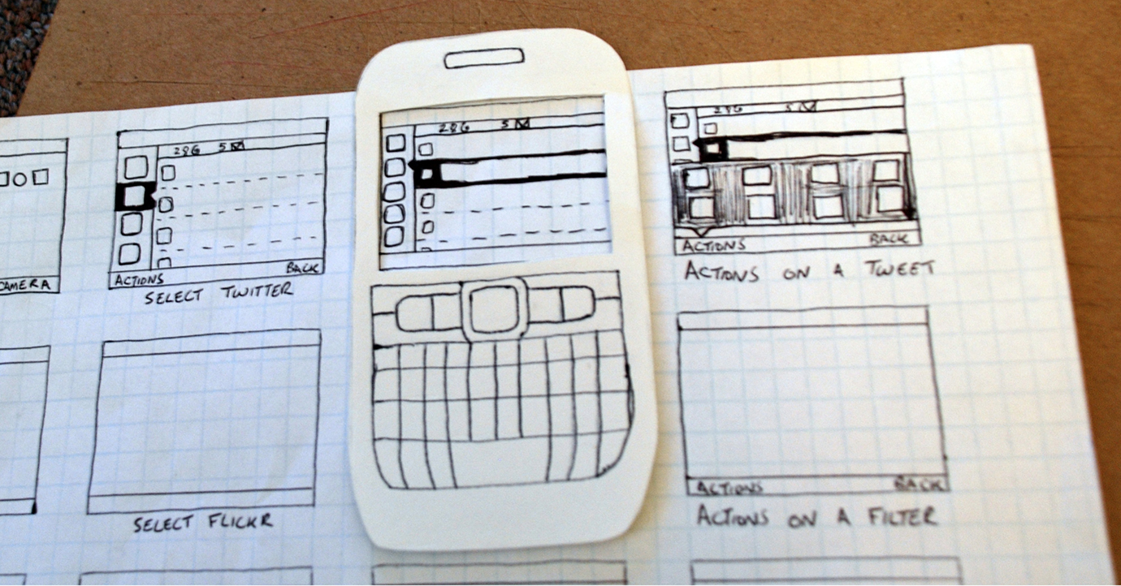
Ariel Waldman, on Interaction Design http://arielwaldman.com/ http://www.rachelilansimpson.com/what-is-it-that-you-do-exactly http://chiefdisruptionofficer.com/helpful-rapid-prototyping-methods-and-tools-to-bring-digital-ideas-to-life-fast/

Slide 11
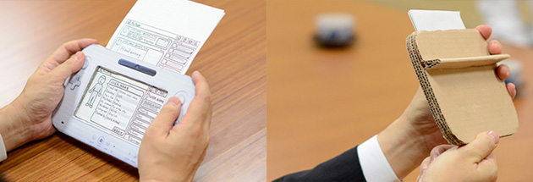
Prototype by Nintendo http://www.gamasutra.com/view/news/181321/Sometimes_paper_is_your_best_prototyping_tool__even_if_youre_Nintendo.php http://chiefdisruptionofficer.com/helpful-rapid-prototyping-methods-and-tools-to-bring-digital-ideas-to-life-fast/

Slide 12
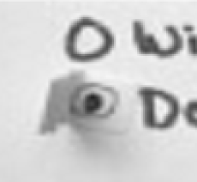
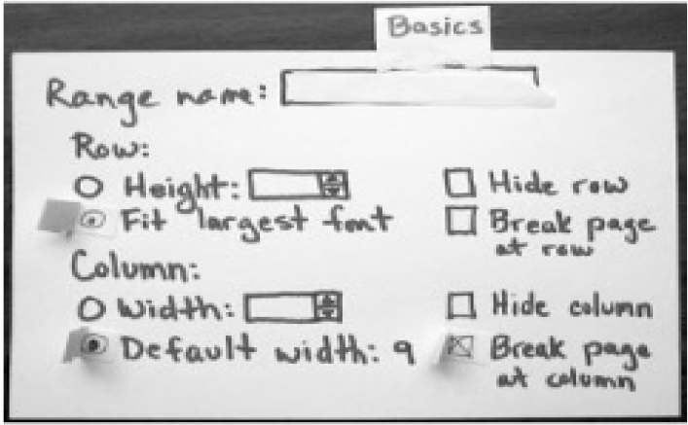
Check boxes and radio buttons

Slide 13
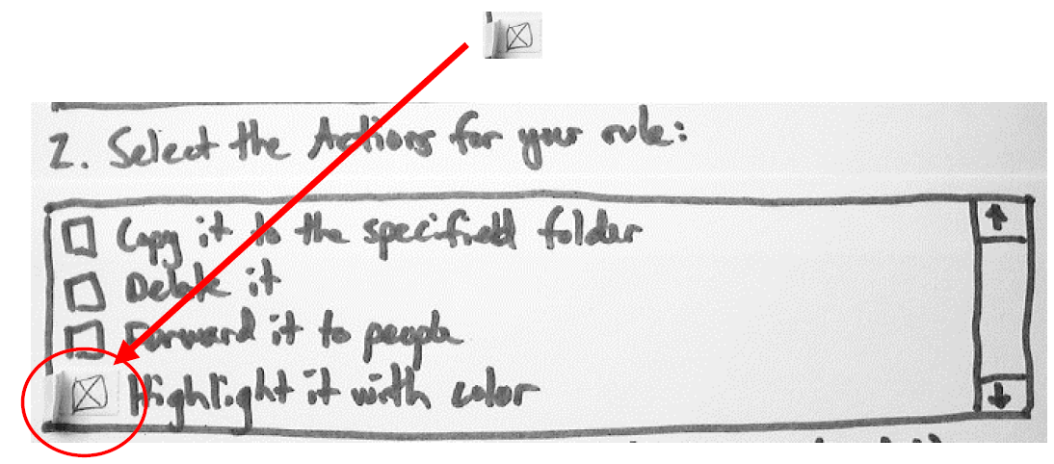
Check boxes and radio buttons

Slide 14
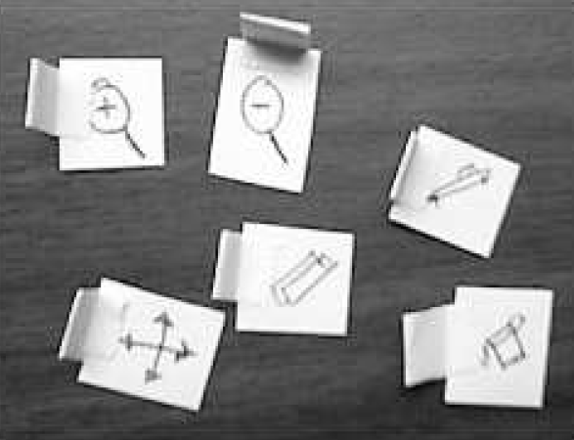
Cursors, floating tools

Slide 15
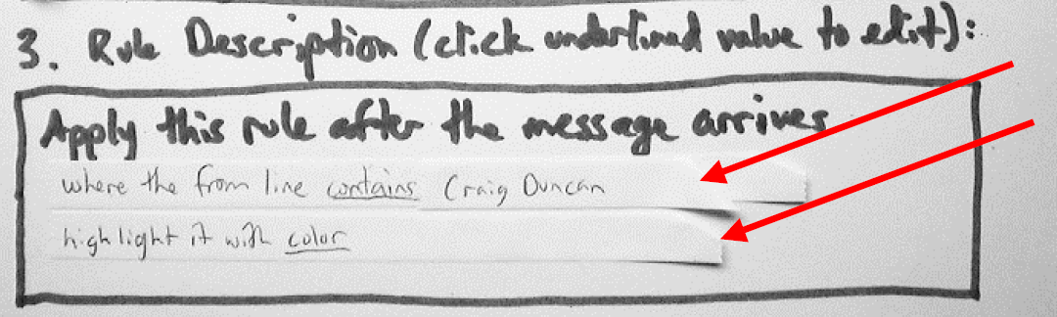
Text boxes

Slide 16
Prototype by Martin Gamsby at ETS, 2012

Slide 17
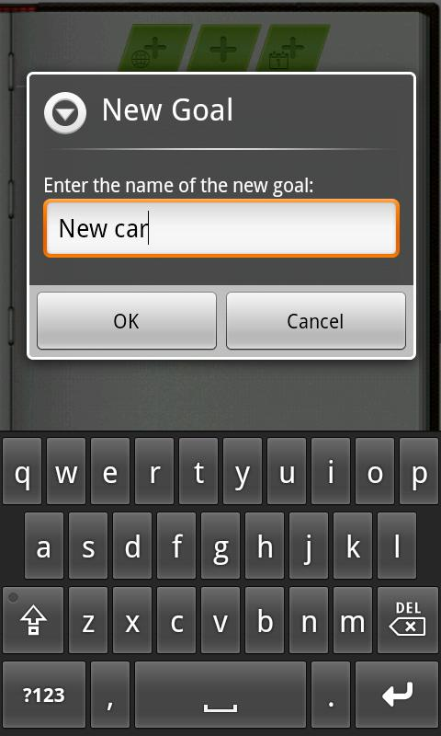
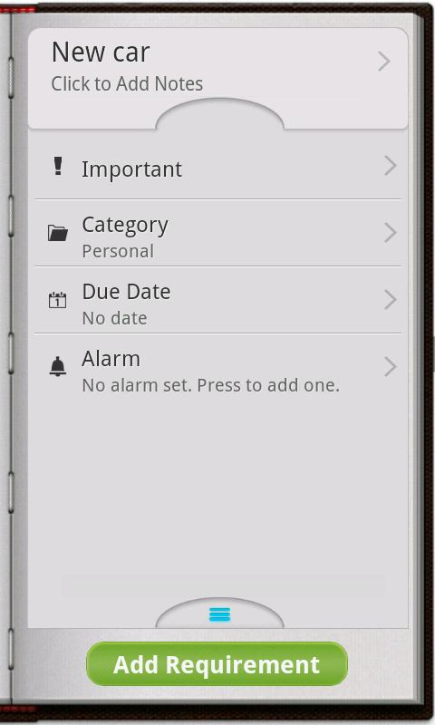
Project by Martin Gamsby at ETS, 2014
Available as an Android app:
http://goaldoplus.com/

Slide 18
Advantages of Paper Prototyping
“maximum feedback for minimum effort” (Snyder)
Easy to made and modify
No expertise required
Informality encourages creativity
Does not give the client the false impression that the implementation is almost finished
Designers are less emotionally attached to a prototype and will be more accepting of criticism
Users / clients will be less hesitant to suggest large changes
Allows users to participate in the prototyping process (participatory design)
  Example: PICTIVE (“Plastic Interface for Collaborative Technology Initiative through Video Exploration”, Muller 1992)

Slide 19
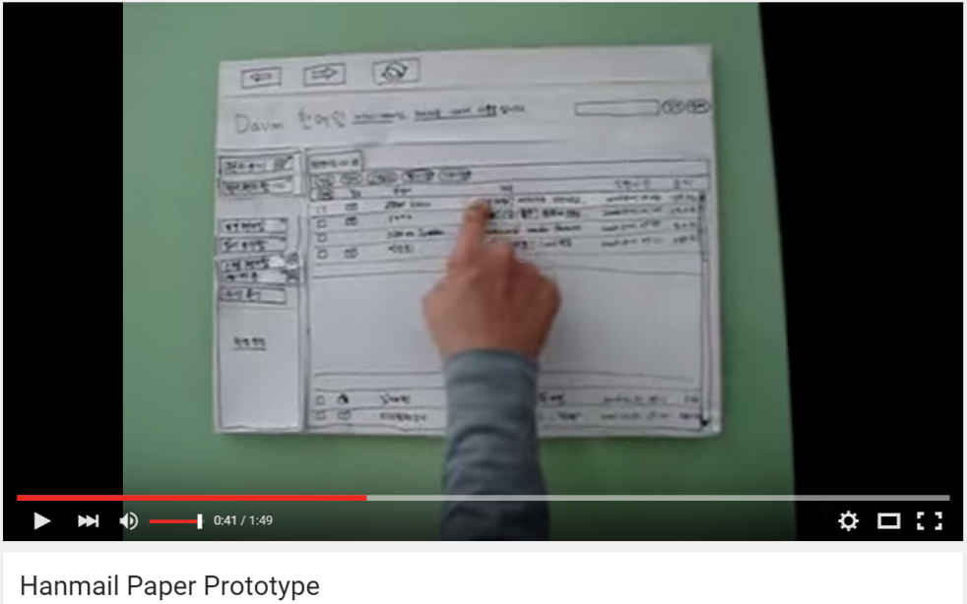
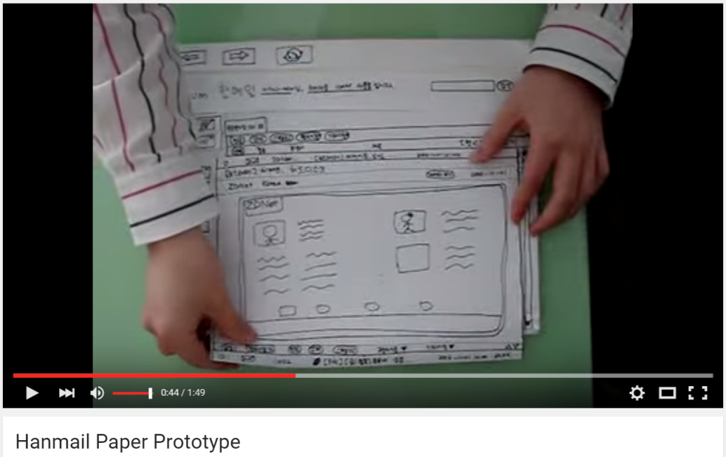
We can simulate the operation of an interface with paper
https://www.youtube.com/watch?v=GrV2SZuRPv0

Slide 20
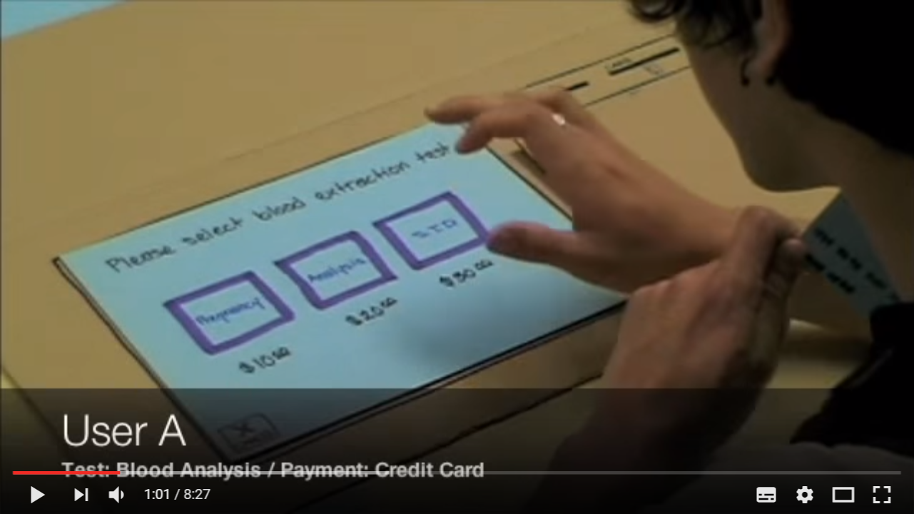
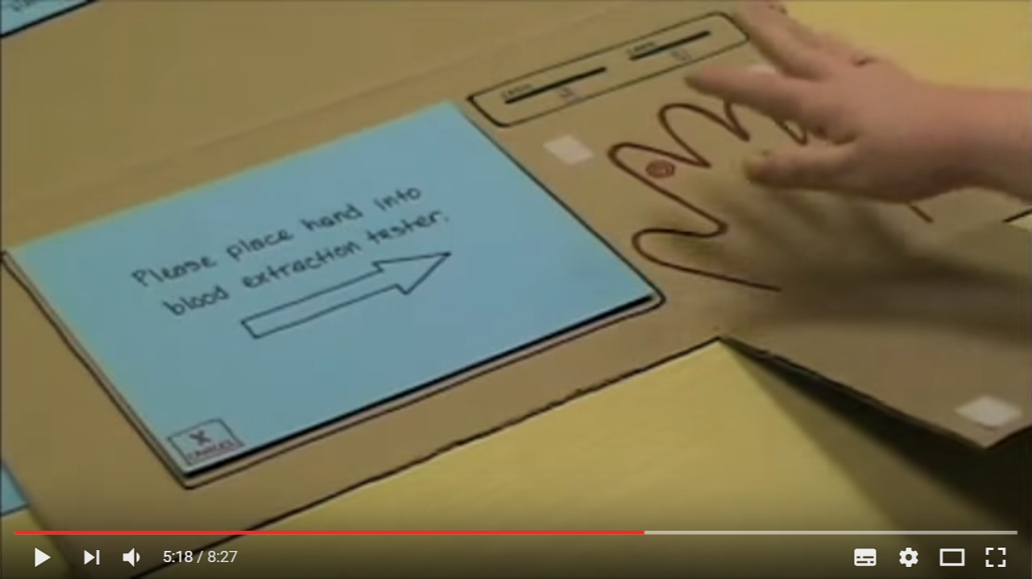
We can simulate the operation of an interface with paper
https://www.youtube.com/watch?v=_g4GGtJ8NCY

Slide 21
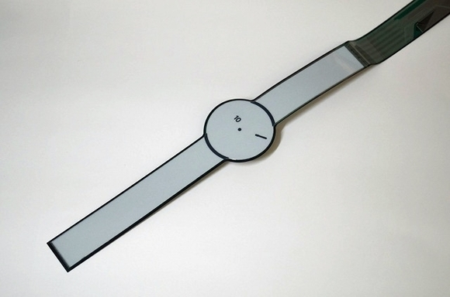
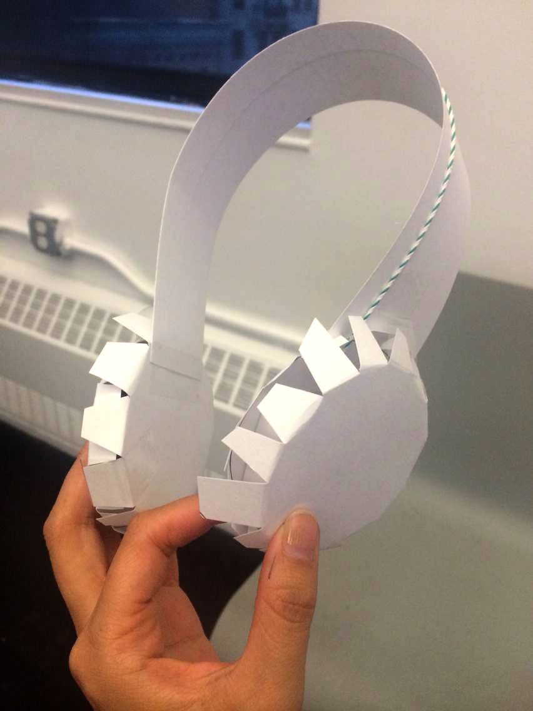
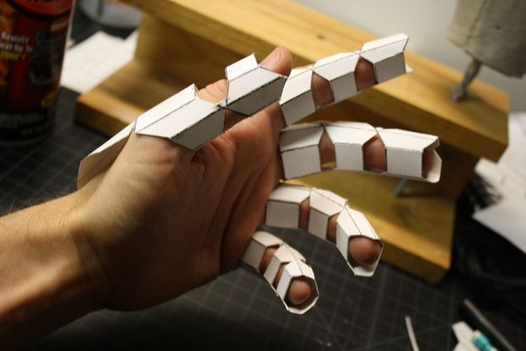
http://core0.staticworld.net/images/article/2014/11/detail_355_feswatch_flatmodule-100533165-large.jpg
http://devices4inquiry.aisencc.com/wp-content/uploads/sites/6/2014/09/1.jpg
http://3dprint.com/wp-content/uploads/2015/01/paper-prototype.jpg

Slide 22
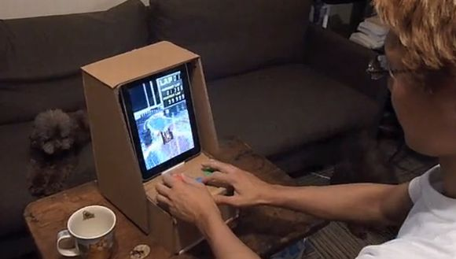
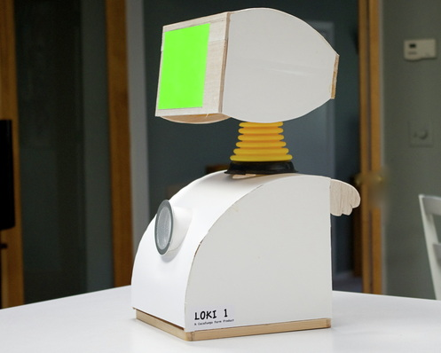
http://www.blogcdn.com/www.tuaw.com/media/2010/06/ipadarcadecabinet.jpg
http://howardloki.weebly.com/building-loki.html

Slide 23
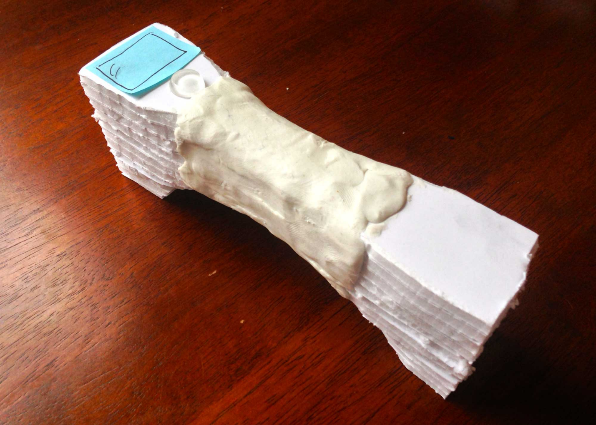
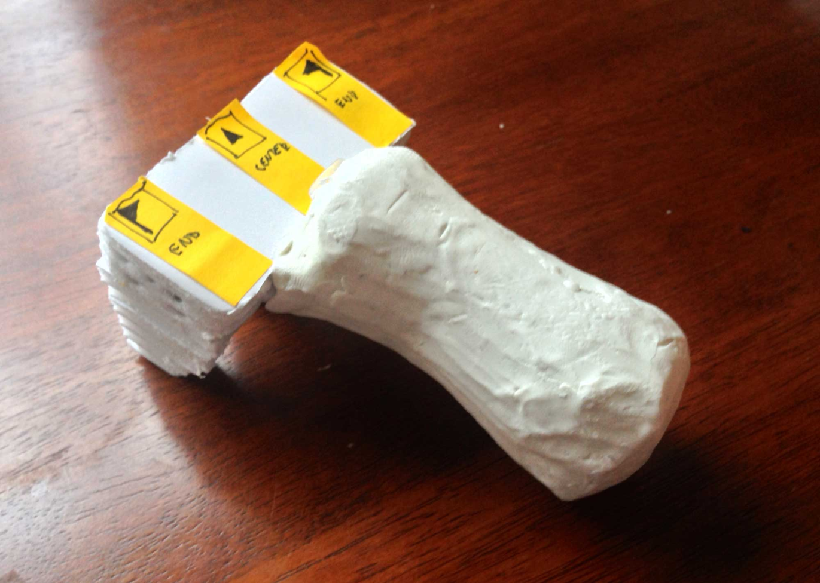
http://www.jeremyfriedland.com/portfolio/prototype.php

Slide 24
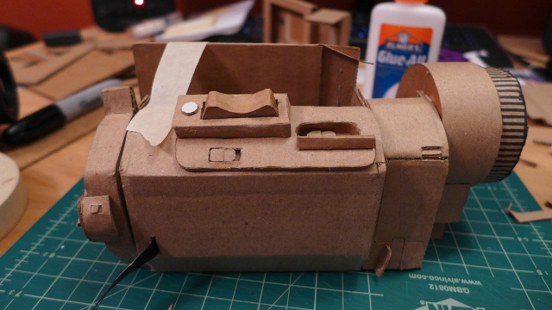
http://makingsociety.com/2014/11/how-to-cut-cardboard-prototyping/

Slide 25
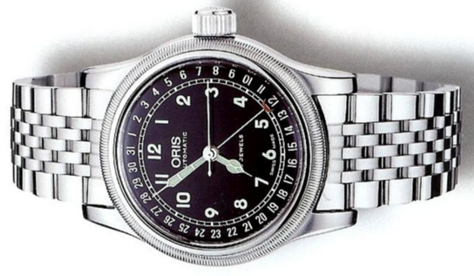
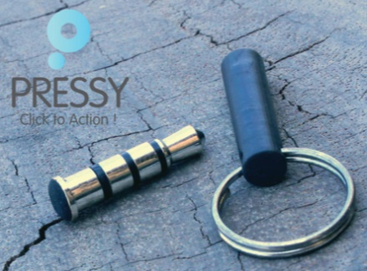
First Apple Watch Prototype
"the first working Watch prototype was an iPhone rigged with a Velcro strap. [...] a simulator that displayed a life-size image of an Apple Watch on the screen. [...] they made a custom dongle, an actual watch crown that plugged into the bottom of the phone through the cord jack."
http://www.wired.com/2015/04/the-apple-watch
... a bit like Pressy:
http://www.ablogtowatch.com/wp-content/uploads/2010/01/MAM-OR754754340641.jpg

Slide 26
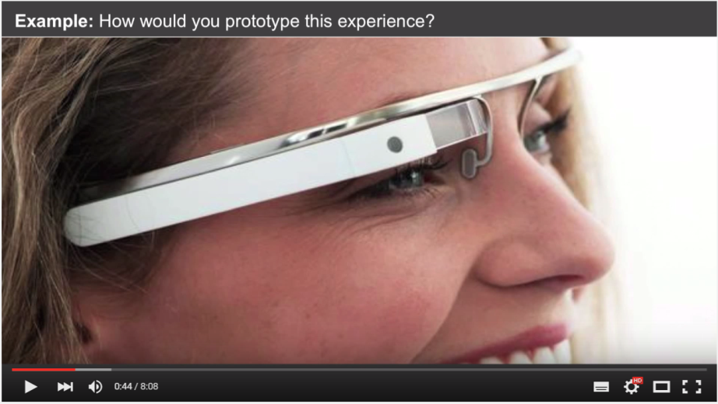
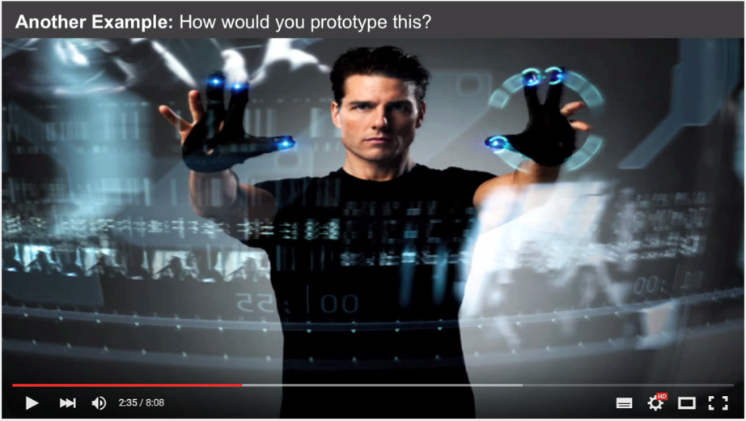
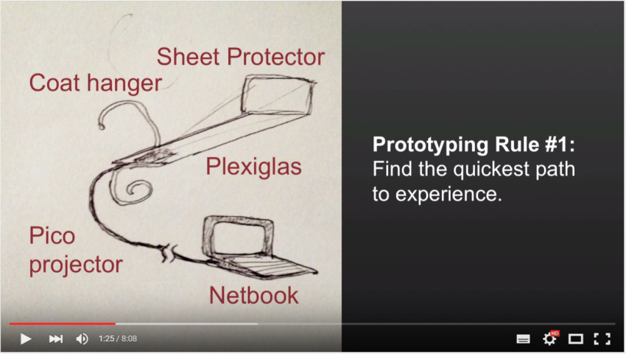
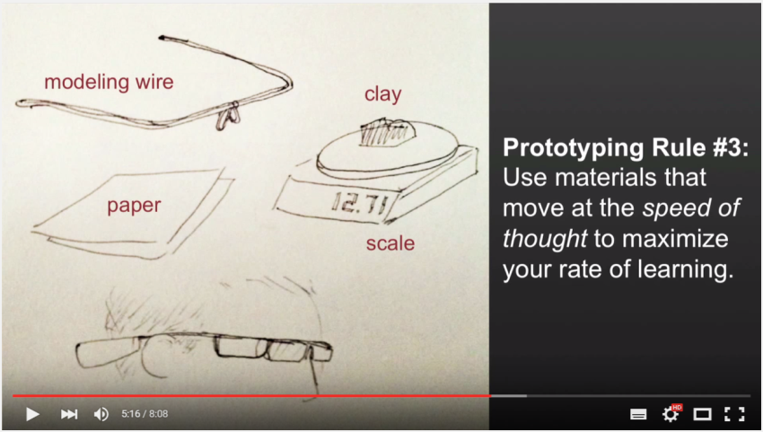
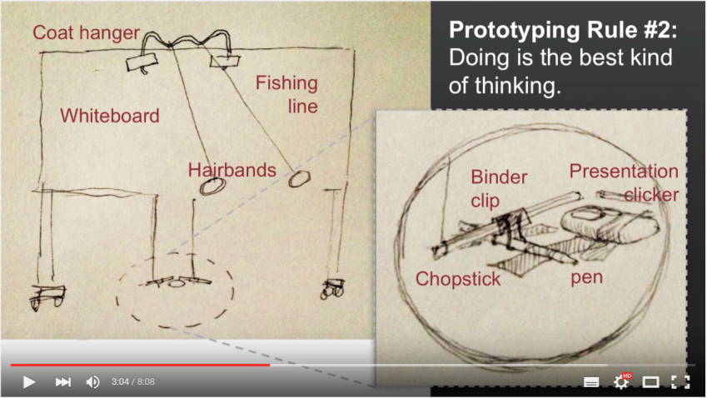
Rapid prototyping Google Glass - Tom Chi https://www.youtube.com/watch?v=d5_h1VuwD6g http://ed.ted.com/lessons/rapid-prototyping-google-glass-tom-chi

Slide 27
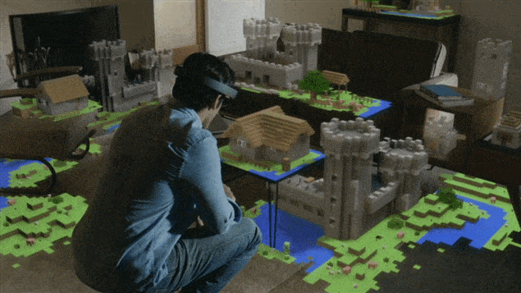
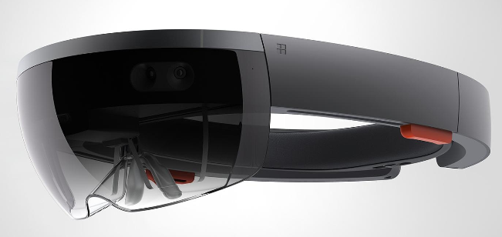
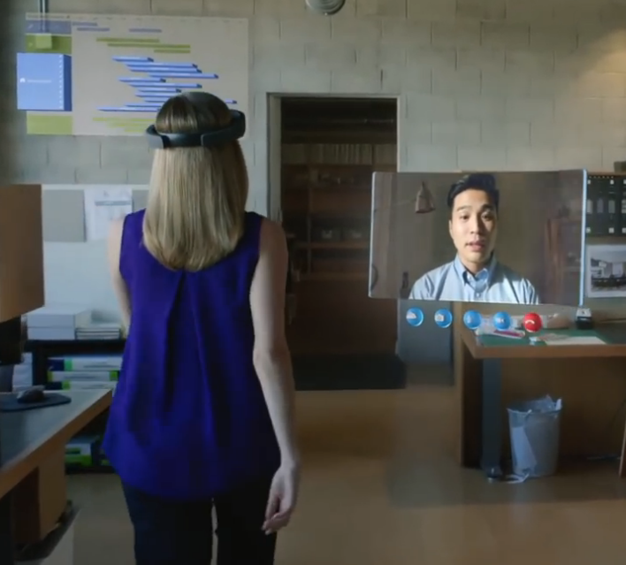
Microsoft HoloLens
https://www.youtube.com/watch?v=aThCr0PsyuA
https://www.youtube.com/watch?v=aAKfdeOX3-o
Minecraft

Slide 28
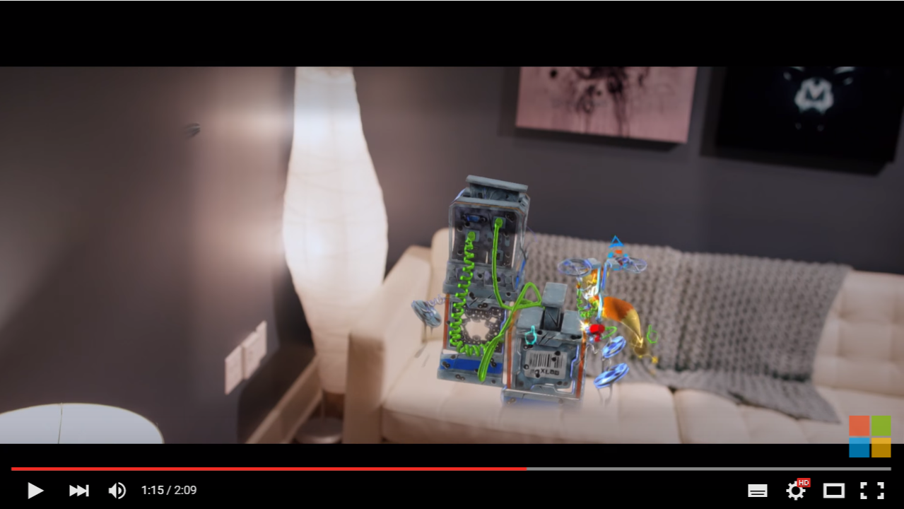
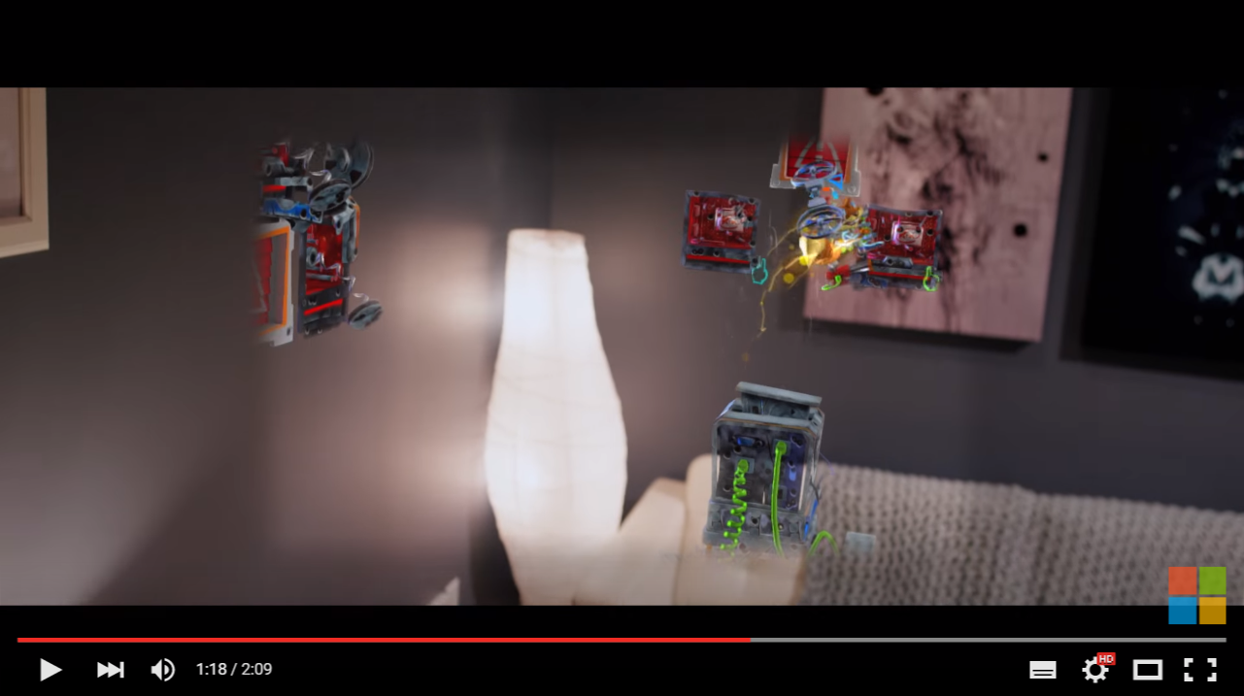
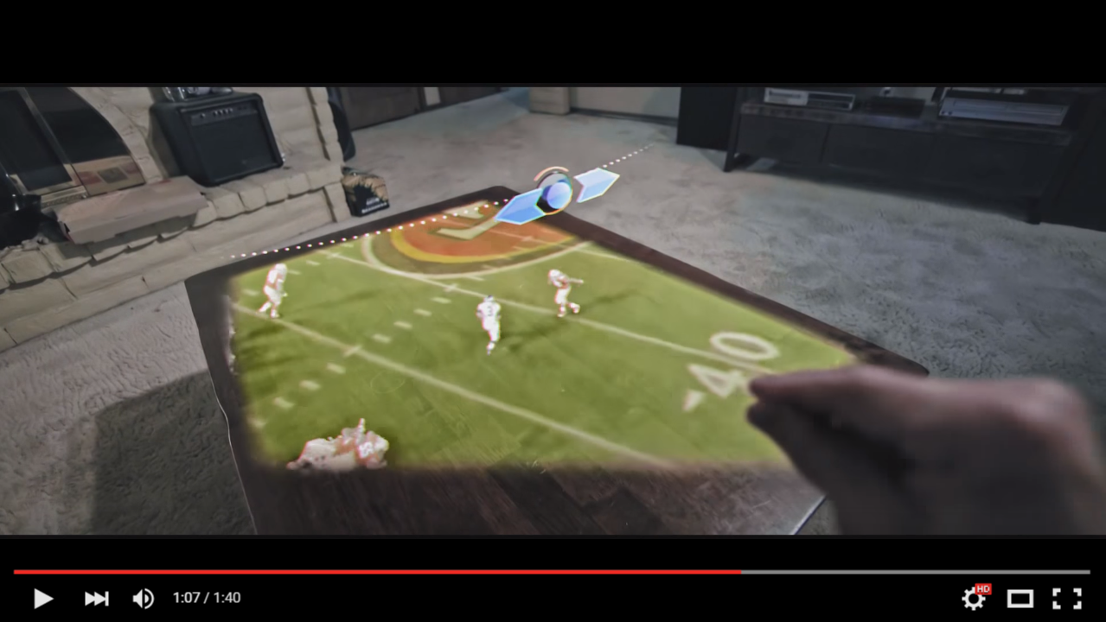
HoloLens field-of-view
https://www.youtube.com/watch?v=uQeOYi3Be5Y
“It’s like looking through a small portal, or a submarine periscope.”
-- https://www.thurrott.com/mobile/63086/hands-on-with-microsoft-hololens-third-times-the-charm
“I … cannot say the field of view is bothering me at all. You get used to it … overall the experience is quite good.” -- http://www.windowscentral.com/my-first-24-hours-microsoft-hololens
https://www.youtube.com/watch?v=HvYj3_VmW6I

Slide 29
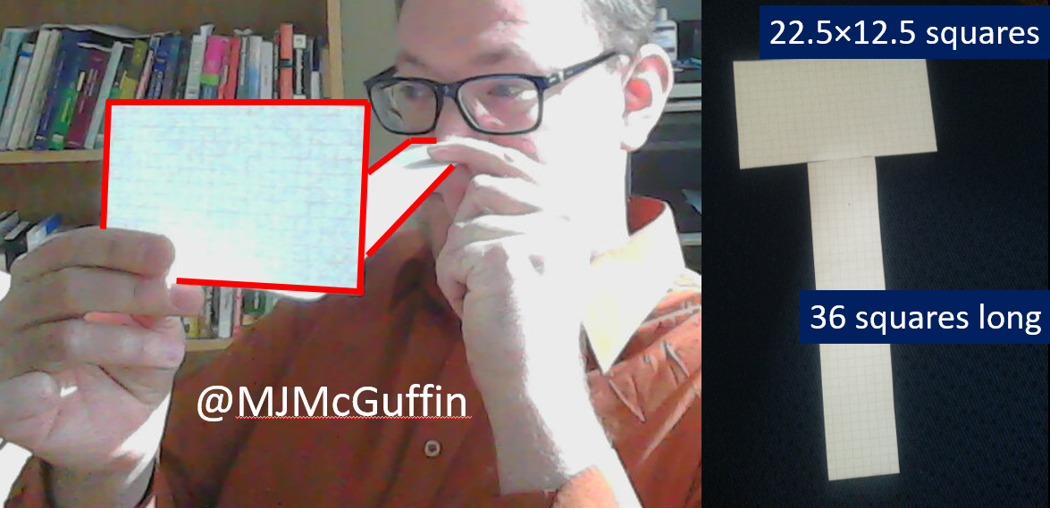
HoloLens: simulating a field of view ≈32°, 16:9 aspect ratio (2016)

Slide 30
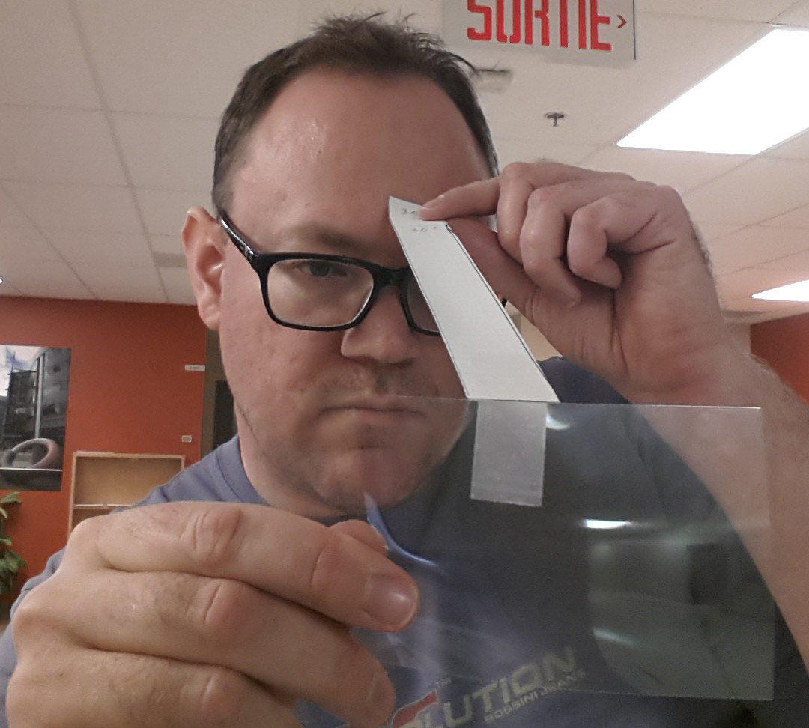
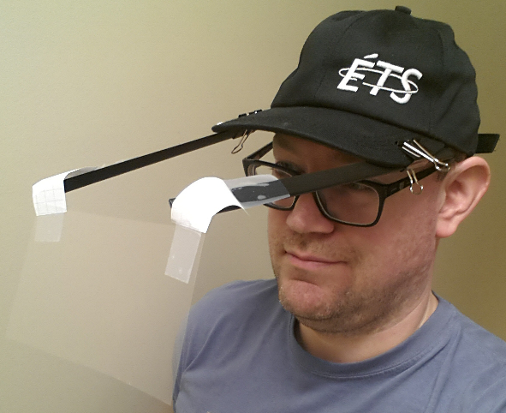
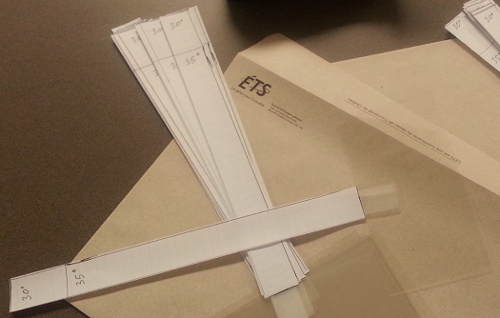

Slide 31
“Trial and error beats academic knowledge”
– Nassim Taleb
“A prototype is worth a thousand meetings.”
– ?
“There's no learning without trying lots of ideas and failing lots of times. ”
– Jonathan Ive, chief designer at Apple

Slide 32
creationism /n./
The (false) belief that large, innovative software designs can be completely specified in advance and then painlessly magicked out of the void by the normal efforts of a team of normally talented programmers. In fact, experience has shown repeatedly that good designs arise only from evolutionary, exploratory interaction between one (or at most a small handful of) exceptionally able designer(s) and an active user population --- and that the first try at a big new idea is always wrong. Unfortunately, because these truths don't fit the planning models beloved of management, they are generally ignored.
-- The Jargon File / New Hacker's Dictionary, Eric S. Raymond

Slide 33
Other prototyping techniques/tools
Web pages with fixed content (HTML)
Image or diagram editors
  Visio
  Adobe PhotoShop, GIMP, Paint.NET, Krita, Adobe Illustrator, Inkscape:
  all allow the user to work with layers
Interactive presentation tools
  Director
Executable code without full functionality
  VisualBasic, Java, C++ (Qt), etc.
  There are drag-and-drop tools for creating GUIs with standard widgets (Example: NetBeans for Java)

Slide 34
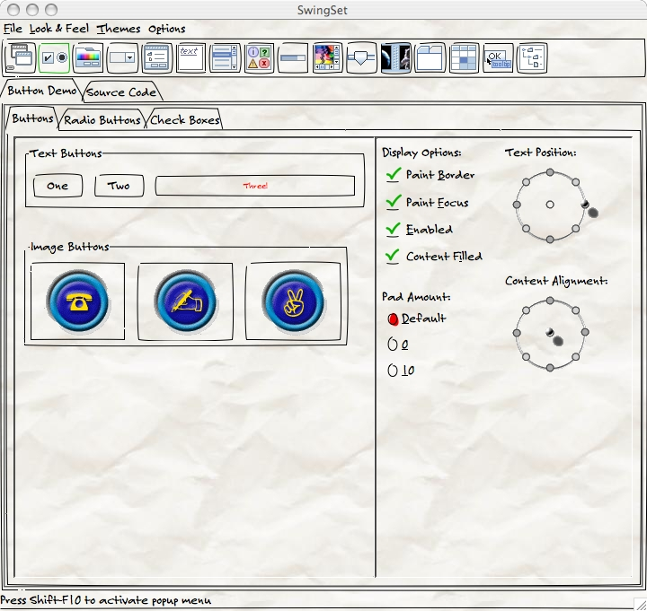
The Napkin look-and-feel for Java Swing http://napkinlaf.sourceforge.net/

Slide 35
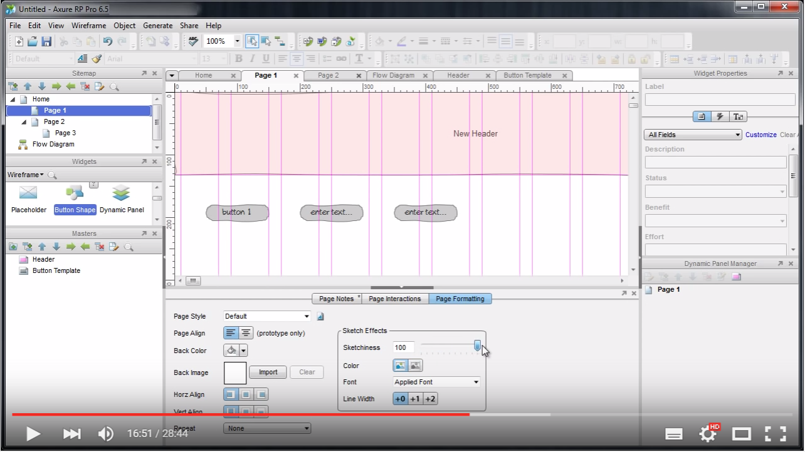
Axure: “sketchiness” slider set to 100%
https://www.youtube.com/watch?v=J2BDVM6Qw5s&t=16m47s

Slide 36
Other prototyping techniques
Wizard-of-Oz prototyping
  Example: simulation of speech recognition:
  Klemmer et al., “Suede: a Wizard of Oz prototyping tool for speech user interfaces”, UIST 2000, http://www.acm.org/uist/archive/videos/2000/p1-klemmer.mov
  Example: simulation of gesture recognition:
  Davis et al., “SketchWizard: Wizard of Oz prototyping of pen-based user interfaces”, UIST 2007, http://www.acm.org/uist/archive/videos/2007/p119-davis.mov
  The “WILD Room”: Google talk by Michel Beaudouin-Lafon
  http://www.youtube.com/watch?v=-R_cQSJ0wiI

Slide 37

Photo mockup
From slides by prof. Ron Baecker at U Toronto. Samsung SPH-WP10.

Slide 38

Photo mockup
http://www.maclife.com/article/feature/future_apple_design?page=0,1

Slide 39





"Surface Phone" concept by Nadir Aslam https://www.behance.net/gallery/24129169/Surface-Phone-Windows-10-Concept

Slide 40

Physical mockup
http://thefutureofthings.com/3081-the-future-of-electronic-paper/

Slide 41

Other prototyping techniques
Video prototypes
To show a vision, inspire employees / clients / investors,
promote a brand
Examples :
  Apple’s Knowledge Navigator (1987) http://www.youtube.com/results?search_query=apple+knowledge+navigator
  Sun Microsystems’ Starfire (1992) http://www.asktog.com/starfire/
  Intel UMPC Vision (≈2007) Ultra-Mobile PC http://www.youtube.com/results?search_query=Intel+UMPC+Vision
  Microsoft Future Vision 2019 / 2020
    Do a web search to find the videos
    http://worrydream.com/ABriefRantOnTheFutureOfInteractionDesign/
  “A Day Made of Glass” by Corning (2011) http://www.youtube.com/watch?v=6Cf7IL_eZ38
  Nokia
    http://www.youtube.com/results?search_query=nokia+morph+concept+phone
    http://www.youtube.com/results?search_query=nokia+humanform
    http://www.youtube.com/results?search_query=nokia+888+concept+phone
    Nokia's mobile phone of the future http://www.youtube.com/watch?v=LN0vVf-a9V0
  Thales Lambersart 2025 https://www.youtube.com/results?search_query=thales+lambersart (in French)
  “3M Flexible Transparent Touchscreen Concepts” http://www.youtube.com/watch?v=kCZz4jFok_o
  “Rolltop 2.0” laptop by Evgeny Orkin (2011) http://www.youtube.com/watch?v=b3txQs7jEJ4

Slide 42
Fictional user interfaces in movies
Fake interfaces made for films:
  Mark Coleran Reel 2008.06 http://vimeo.com/1563485
  "World Builder" (gestural 3D modeling): https://www.youtube.com/watch?v=QP3YywgRx5A&t=43s
  John Underkoffler: Pointing to the future of UI http://www.ted.com/talks/john_underkoffler_drive_3d_data_with_a_gesture
Surveys of examples of interfaces taken from science fiction films:
  "Chris Noessel: lessons of science fiction computer interfaces" https://www.youtube.com/watch?v=-SRmmwK-CLs
  Chris Noessel & Nathan Shedroff : Make It So: Learning From SciFi Interfaces https://www.youtube.com/watch?v=JMIyO8F0jxg
  Schmitz et al. 2008: A Survey of Human-Computer Interaction Design in Science Fiction Movies
  http://www.youtube.com/watch?v=SZBaOgmoe5U
  http://portal.acm.org/citation.cfm?id=1363210

Slide 43


Experimental prototyping tool
SILK (Sketching Interfaces Like Krazy)
Landay et Myers 2001
http://scholar.google.ca/scholar?q=landay+myers+%22sketching+interfaces%3A+toward+more+human%22
https://www.youtube.com/watch?v=VLQcW6SpJ88

Slide 44
Prototyping tool for web sites
DENIM (Design Environment for Navigation and Information Models)
(http://dub.washington.edu/denim/)
https://www.youtube.com/watch?v=tCVYKgewDXc

Slide 45

Balsamiq
http://www.youtube.com/watch?v=70hfU7_95Gw

Slide 46

AppSeed http://www.kickstarter.com/projects/appseed/appseed-turn-sketches-into-functioning-prototypes http://www.wired.com/design/2013/09/appseed-transforms-your-sketches-into-app-prototypes/

Slide 47
“Top 10 Awesome Wireframing Tools for Web Developers” http://theultralinx.com/2014/04/top-10-awesome-wireframing-tools-web-developers.html
Cacoo, Lumzy, Axure *, Lonely Charts, MockFlow, Uxpin, Mockingbird,
Simple Diagrams, Penultimate, Frame Box
Other promising tools:
http://proto.io/ *
http://www.justinmind.com/ *
http://pencil.evolus.vn/ (free)

Slide 48


Physical prototyping
For hardware interfaces
Example: phidgets – “physical widgets”
www.phidgets.com / Greenberg et Fitchett 2001

Slide 49
Physical prototyping
http://www.arduino.cc/
http://www.raspberrypi.org/

Slide 50


More physical prototyping
Example:
BUG (http://buglabs.net)

Slide 51
More physical prototyping
Other modular cellphone projects:
  Phonebloks https://phonebloks.com/
  http://www.youtube.com/watch?v=oDAw7vW7H0c
  Ara http://www.projectara.com/
  https://www.kickstarter.com/projects/seeed/rephone-kit-worlds-first-open-source-and-modular-p ;
  http://www.seeedstudio.com/depot/ ;
  http://www.seeed.cc/rephone/

Slide 52

Nexpaq https://www.kickstarter.com/projects/nexpaq/nexpaq-the-first-truly-modular-smartphone-case http://nexpaq.com/

Slide 53


Slide 54


Slide 55


Slide 56


Slide 57


Slide 58


Slide 59


Slide 60


Slide 61


Slide 62
Advantages of prototyping multiple alternatives in parallel?
We can explore more possibilities, and possibly combine solutions
We can eliminate bad starting ideas
Separation of designer’s ego from the design ideas – we are more receptive of criticism
Encourages comparison of different possibilities

